Slide 1
Week 30
Session 5: Weeks
26–30

Slide 2
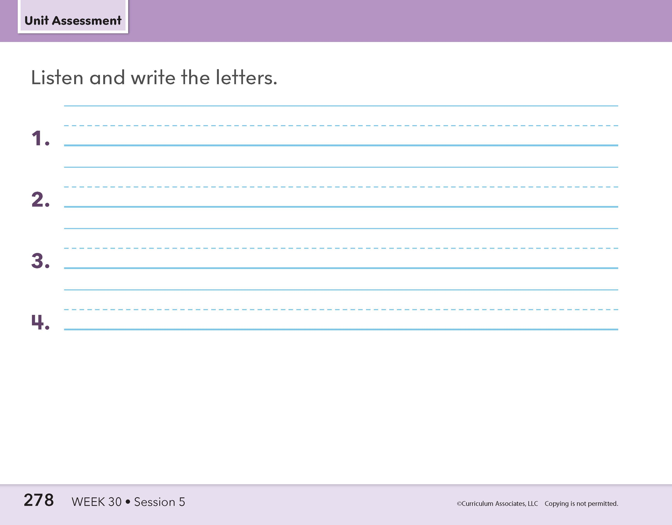
Whole-Class Assessment
5: Assessment
Notes:
Whole-Class Assessment
Tell children they are going to practice some of the sounds and words they learned this week.
PART 1: Encode Target Sound-Spellings
Say each sound. Have children write the letter(s) that stand for the sound. *Words for teacher reference only.
1. /ŭ/ (fun)* 3. /ĕ/ (bed)*
2. /ē/ (eve)* 4. /yo͞o/ (cube)*

Slide 3
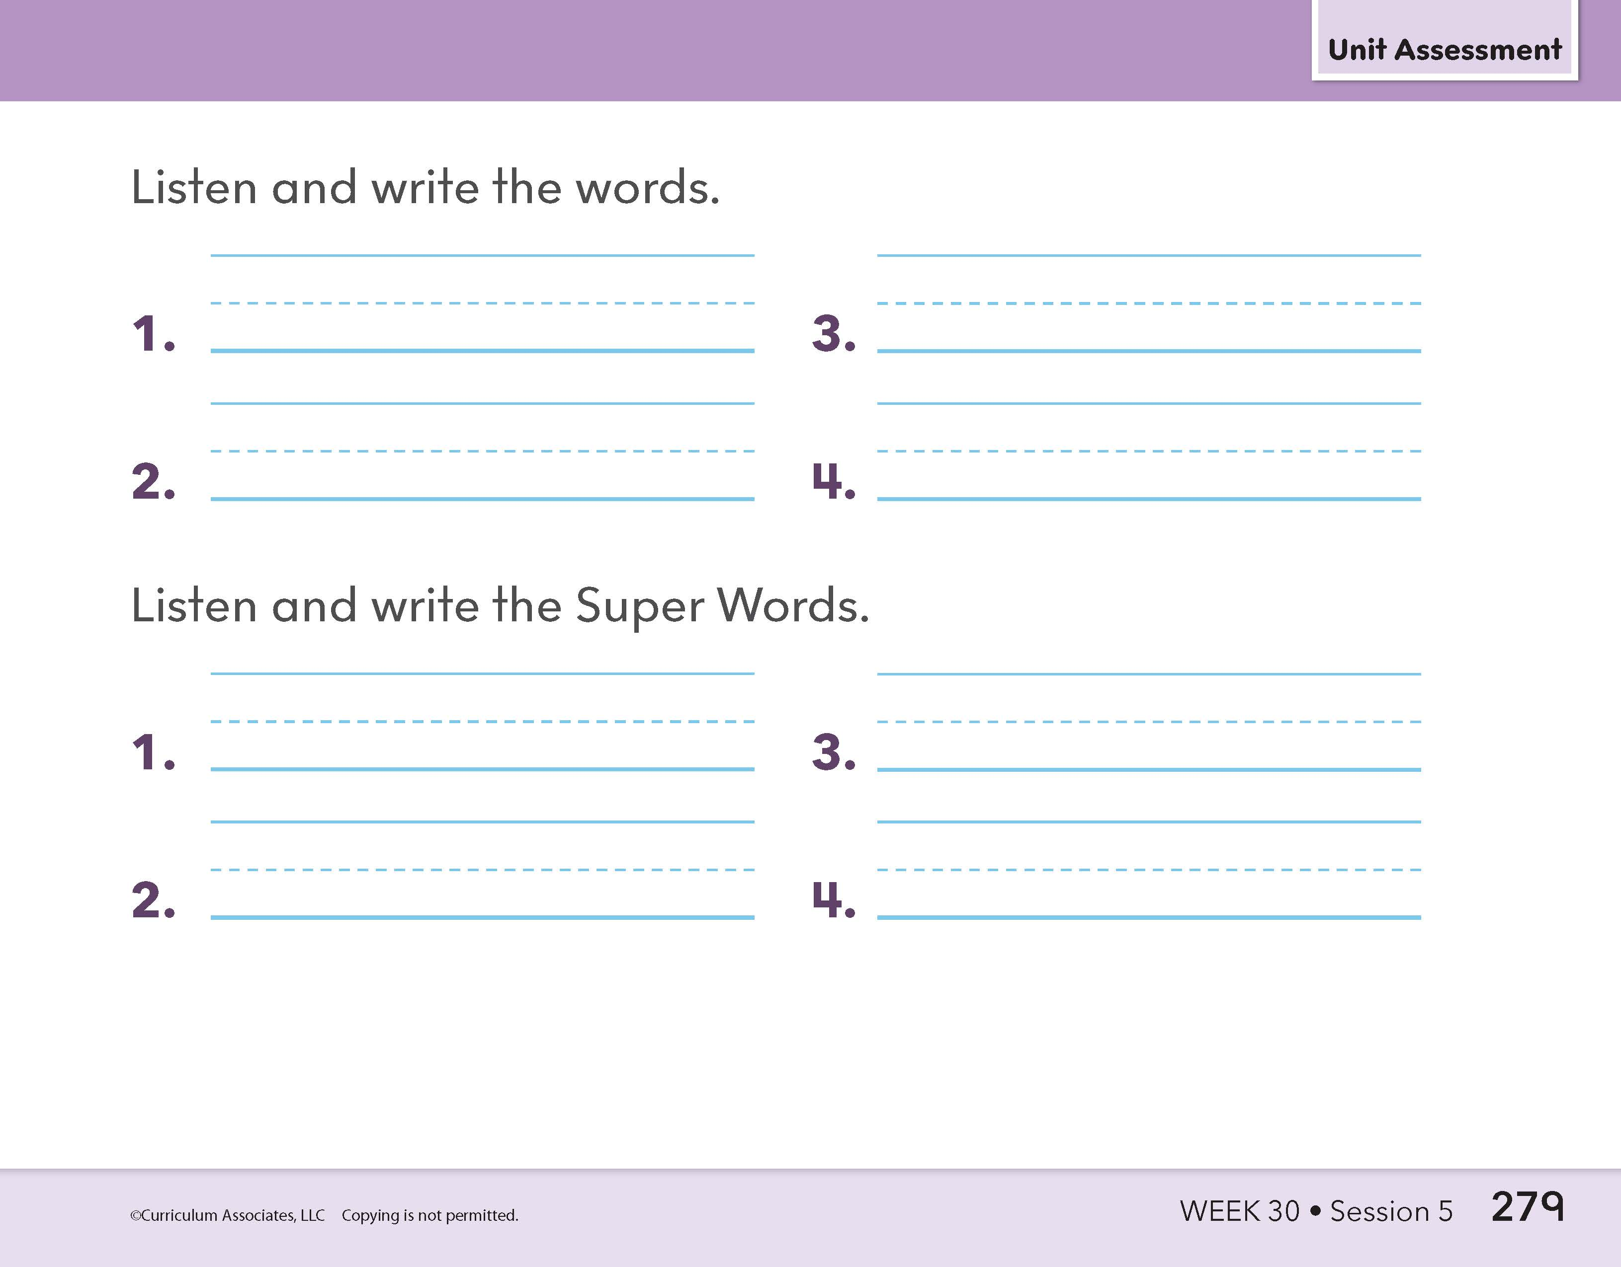
Whole-Class Assessment
5: Assessment
Notes:
PART 2: Encode Target Words
Read each word. Provide a context sentence when necessary.** Have children write the word.
1. meet 3. use
2. get 4. eve
PART 3: Spell High-Frequency Words
Read each word. Provide a context sentence when necessary.** Have children write the word.
1. how 3. now
2. down 4. which
**See the “Context Sentences for Dictation” document under Program Implementation: Assessment Resources in Teacher Toolbox.

Slide 4
Individual Assessment
Eve and June get a seed. Eve digs a deep hole. June sets the seed down into it. They get a hose.
5: Assessment
Notes:
PART 4: Read Connected Text
Have each child read one passage. Listen carefully for children to read with overall fluency. Choose a different passage for each child if working in pairs. Passage 1 continues on the next slide.
PASSAGE 1
Eve and June get a seed. Eve digs a deep hole. June sets the seed down into it. They get a hose.
They use it to keep the seed wet. Now what will poke up from the hole?

Slide 5
Individual Assessment
They use it to keep the seed wet. Now what will poke up from the hole?
5: Assessment
Notes:
PART 4: Read Connected Text
Have each child read one passage. Listen carefully for children to read with overall fluency. Choose a different passage for each child if working in pairs.
PASSAGE 1 (continued)
Eve and June get a seed. Eve digs a deep hole. June sets the seed down into it. They get a hose.
They use it to keep the seed wet. Now what will poke up from the hole?

Slide 6
Individual Assessment
Pete likes to ride on his bike. But a wheel has a hole in it! How will Pete use his bike now?
5: Assessment
Notes:
PART 4: Read Connected Text
Have each child read one passage. Listen carefully for children to read with overall fluency. Choose a different passage for each child if working in pairs. Passage 2 continues on the next slide.
PASSAGE 2
Pete likes to ride on his bike. But a wheel has a hole in it! How will Pete use his bike now?
Pete needs to call June. June will fix the wheel. Now Pete can ride on his bike!

Slide 7
Individual Assessment
Pete needs to call June. June will fix the wheel. Now Pete can ride on his bike!
5: Assessment
Notes:
PART 4: Read Connected Text
Have each child read one passage. Listen carefully for children to read with overall fluency. Choose a different passage for each child if working in pairs.
PASSAGE 2 (continued)
Pete likes to ride on his bike. But a wheel has a hole in it! How will Pete use his bike now?
Pete needs to call June. June will fix the wheel. Now Pete can ride on his bike!

