Slide 1
Week 27
Session 5: Final e Syllable Patterns

Slide 2
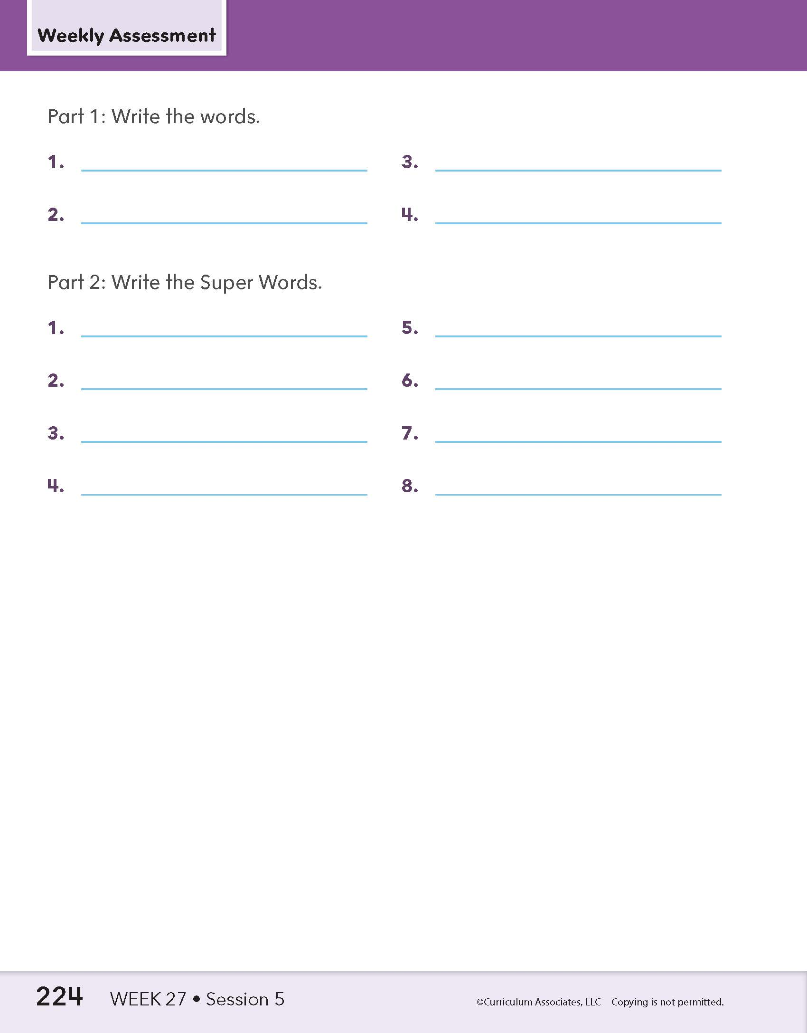
Whole-Class Assessment
5: Assessment
Notes:
Whole-Class Assessment
Tell children they are going to practice some of the syllable patterns and words they learned this week.
PART 1: Encode Longer Words
Read each word. Provide a context sentence when necessary.** Have children write the word.
rewrote
presale
completed
providing
**See the “Context Sentences for Dictation” document under Program Implementation: Assessment Resources in Teacher Toolbox.​
PART 2: Spell High-Frequency Words
Read each word. Provide a context sentence when necessary.** Have children write the word.
hours
ever
during
questions
today
color
early
Become
**See the “Context Sentences for Dictation” document under Program Implementation: Assessment Resources in Teacher Toolbox.​

Slide 3
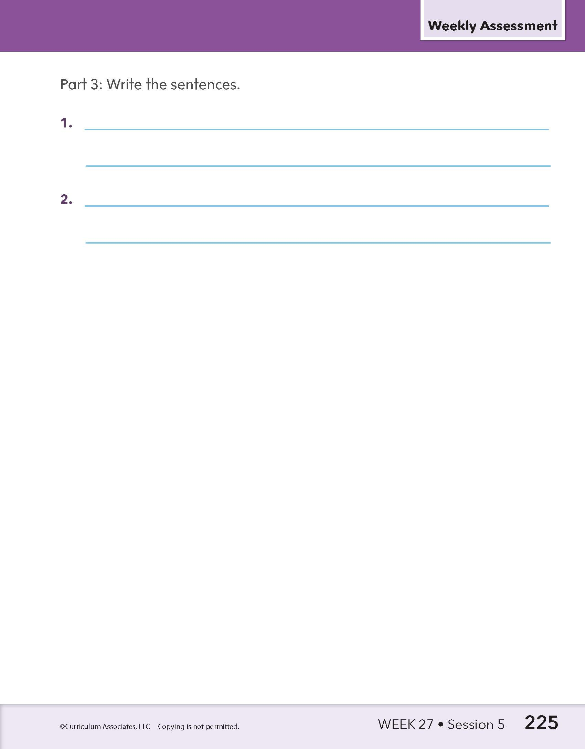
Whole-Class Assessment
5: Assessment
Notes:
PART 3: Write Connected Text
Read each sentence. Have children write the sentences. Remind them to use correct spelling and punctuation.
They are supposed to redirect traffic during the race.
He was unable to complete the race in three hours.

Slide 4
Individual Assessment
describing
escape
5: Assessment
Notes:
PART 4: Read Words
Have each child read one longer word in Part 4a. If the child makes an error, have the child read the corresponding alternate word. Choose a different set of words for each child if working in small groups. Repeat these steps for Part 4b.
PART 4a​
LONGER WORD ​
describing
located
rewriting
behaving
deflated
​
If the child makes an error, move to the the corresponding alternate word.
If not, continue to Part 4b on slide 9.
​
ALTERNATE WORD​
escape
donate
invite
became
mistake

Slide 5
Individual Assessment
located
donate
5: Assessment
Notes:
PART 4: Read Words
Have each child read one longer word in Part 4a. If the child makes an error, have the child read the corresponding alternate word. Choose a different set of words for each child if working in small groups. Repeat these steps for Part 4b.
PART 4a​
LONGER WORD ​
describing
located
rewriting
behaving
deflated
​
If the child makes an error, move to the the corresponding alternate word.
If not, continue to Part 4b on slide 9.
​
ALTERNATE WORD​
escape
donate
invite
became
mistake

Slide 6
Individual Assessment
rewriting
invite
5: Assessment
Notes:
PART 4: Read Words
Have each child read one longer word in Part 4a. If the child makes an error, have the child read the corresponding alternate word. Choose a different set of words for each child if working in small groups. Repeat these steps for Part 4b.
PART 4a​
LONGER WORD ​
describing
located
rewriting
behaving
deflated
​
If the child makes an error, move to the the corresponding alternate word.
If not, continue to Part 4b on slide 9.
​
ALTERNATE WORD​
escape
donate
invite
became
mistake

Slide 7
Individual Assessment
behaving
became
5: Assessment
Notes:
PART 4: Read Words
Have each child read one longer word in Part 4a. If the child makes an error, have the child read the corresponding alternate word. Choose a different set of words for each child if working in small groups. Repeat these steps for Part 4b.
PART 4a​
LONGER WORD ​
describing
located
rewriting
behaving
deflated
​
If the child makes an error, move to the the corresponding alternate word.
If not, continue to Part 4b on slide 9.
​
ALTERNATE WORD​
escape
donate
invite
became
mistake

Slide 8
Individual Assessment
deflated
mistake
5: Assessment
Notes:
PART 4: Read Words
Have each child read one longer word in Part 4a. If the child makes an error, have the child read the corresponding alternate word. Choose a different set of words for each child if working in small groups. Repeat these steps for Part 4b.
PART 4a​
LONGER WORD ​
describing
located
rewriting
behaving
deflated
​
If the child makes an error, move to the the corresponding alternate word.
If not, continue to Part 4b on slide 9.
​
ALTERNATE WORD​
escape
donate
invite
became
mistake

Slide 9
Individual Assessment
contribute
confuse
5: Assessment
Notes:
PART 4: Read Words
Have each child read one longer word in Part 4b. If the child makes an error, have the child read the corresponding alternate word. Choose a different set of words for each child if working in small groups.
PART 4b
LONGER WORD ​
contribute
recognize
envelope
demonstrate
telescope
​
If the child makes an error, move to the the corresponding alternate word.
If not, continue to Part 6 on slide 14.
​
ALTERNATE WORD​
confuse
excite
remote
amaze
tadpole

Slide 10
Individual Assessment
recognize
excite
5: Assessment
Notes:
PART 4: Read Words
Have each child read one longer word in Part 4b. If the child makes an error, have the child read the corresponding alternate word. Choose a different set of words for each child if working in small groups.
PART 4b
LONGER WORD ​
contribute
recognize
envelope
demonstrate
telescope
​
If the child makes an error, move to the the corresponding alternate word.
If not, continue to Part 6 on slide 14.
​
ALTERNATE WORD​
confuse
excite
remote
amaze
tadpole

Slide 11
Individual Assessment
envelope
remote
5: Assessment
Notes:
PART 4: Read Words
Have each child read one longer word in Part 4b. If the child makes an error, have the child read the corresponding alternate word. Choose a different set of words for each child if working in small groups.
PART 4b
LONGER WORD ​
contribute
recognize
envelope
demonstrate
telescope
​
If the child makes an error, move to the the corresponding alternate word.
If not, continue to Part 6 on slide 14.
​
ALTERNATE WORD​
confuse
excite
remote
amaze
tadpole

Slide 12
Individual Assessment
demonstrate
amaze
5: Assessment
Notes:
PART 4: Read Words
Have each child read one longer word in Part 4b. If the child makes an error, have the child read the corresponding alternate word. Choose a different set of words for each child if working in small groups.
PART 4b
LONGER WORD ​
contribute
recognize
envelope
demonstrate
telescope
​
If the child makes an error, move to the the corresponding alternate word.
If not, continue to Part 6 on slide 14.
​
ALTERNATE WORD​
confuse
excite
remote
amaze
tadpole

Slide 13
Individual Assessment
telescope
tadpole
5: Assessment
Notes:
PART 4: Read Words
Have each child read one longer word in Part 4b. If the child makes an error, have the child read the corresponding alternate word. Choose a different set of words for each child if working in small groups.
PART 4b
LONGER WORD ​
contribute
recognize
envelope
demonstrate
telescope
​
If the child makes an error, move to the the corresponding alternate word.
If not, continue to Part 6 on slide 14.
​
ALTERNATE WORD​
confuse
excite
remote
amaze
tadpole

Slide 14
Individual Assessment
Can you describe how you will produce the report in color?
5: Assessment
Notes:
PART 5: Read Connected Text
Have each child read two sentences. Choose different sentences for each child if working in small groups.
Can you describe how you will produce the report in color?
Jake spends hours reading alone despite having lots of toys.
If you dislike the bracelet, you can return it during store hours.
Use a dark color to retrace the letters on the piece of paper.
What color do you propose we repaint the inside of the house?
The excited fans cheered, sang, and chanted during the pregame.
Will the store provide a rebate if you buy a phone during the sale?
If you preheat the oven, we can complete dinner early.
If James refuses to get there early, will he still compete in the game?
How many hours do you suppose it will take to unpack the moving boxes?

Slide 15
Individual Assessment
Jake spends hours reading alone despite having lots of toys.
5: Assessment
Notes:
PART 5: Read Connected Text
Have each child read two sentences. Choose different sentences for each child if working in small groups.
Can you describe how you will produce the report in color?
Jake spends hours reading alone despite having lots of toys.
If you dislike the bracelet, you can return it during store hours.
Use a dark color to retrace the letters on the piece of paper.
What color do you propose we repaint the inside of the house?
The excited fans cheered, sang, and chanted during the pregame.
Will the store provide a rebate if you buy a phone during the sale?
If you preheat the oven, we can complete dinner early.
If James refuses to get there early, will he still compete in the game?
How many hours do you suppose it will take to unpack the moving boxes?

Slide 16
Individual Assessment
If you dislike the bracelet, you can return it during store hours.
5: Assessment
Notes:
PART 5: Read Connected Text
Have each child read two sentences. Choose different sentences for each child if working in small groups.
Can you describe how you will produce the report in color?
Jake spends hours reading alone despite having lots of toys.
If you dislike the bracelet, you can return it during store hours.
Use a dark color to retrace the letters on the piece of paper.
What color do you propose we repaint the inside of the house?
The excited fans cheered, sang, and chanted during the pregame.
Will the store provide a rebate if you buy a phone during the sale?
If you preheat the oven, we can complete dinner early.
If James refuses to get there early, will he still compete in the game?
How many hours do you suppose it will take to unpack the moving boxes?

Slide 17
Individual Assessment
Use a dark color to retrace the letters on the piece of paper.
5: Assessment
Notes:
PART 5: Read Connected Text
Have each child read two sentences. Choose different sentences for each child if working in small groups.
Can you describe how you will produce the report in color?
Jake spends hours reading alone despite having lots of toys.
If you dislike the bracelet, you can return it during store hours.
Use a dark color to retrace the letters on the piece of paper.
What color do you propose we repaint the inside of the house?
The excited fans cheered, sang, and chanted during the pregame.
Will the store provide a rebate if you buy a phone during the sale?
If you preheat the oven, we can complete dinner early.
If James refuses to get there early, will he still compete in the game?
How many hours do you suppose it will take to unpack the moving boxes?

Slide 18
Individual Assessment
What color do you propose we repaint the inside of the house?
5: Assessment
Notes:
PART 5: Read Connected Text
Have each child read two sentences. Choose different sentences for each child if working in small groups.
Can you describe how you will produce the report in color?
Jake spends hours reading alone despite having lots of toys.
If you dislike the bracelet, you can return it during store hours.
Use a dark color to retrace the letters on the piece of paper.
What color do you propose we repaint the inside of the house?
The excited fans cheered, sang, and chanted during the pregame.
Will the store provide a rebate if you buy a phone during the sale?
If you preheat the oven, we can complete dinner early.
If James refuses to get there early, will he still compete in the game?
How many hours do you suppose it will take to unpack the moving boxes?

Slide 19
Individual Assessment
The excited fans cheered, sang, and chanted during the pregame.
5: Assessment
Notes:
PART 5: Read Connected Text
Have each child read two sentences. Choose different sentences for each child if working in small groups.
Can you describe how you will produce the report in color?
Jake spends hours reading alone despite having lots of toys.
If you dislike the bracelet, you can return it during store hours.
Use a dark color to retrace the letters on the piece of paper.
What color do you propose we repaint the inside of the house?
The excited fans cheered, sang, and chanted during the pregame.
Will the store provide a rebate if you buy a phone during the sale?
If you preheat the oven, we can complete dinner early.
If James refuses to get there early, will he still compete in the game?
How many hours do you suppose it will take to unpack the moving boxes?

Slide 20
Individual Assessment
Will the store provide a rebate if you buy a phone during the sale?
5: Assessment
Notes:
PART 5: Read Connected Text
Have each child read two sentences. Choose different sentences for each child if working in small groups.
Can you describe how you will produce the report in color?
Jake spends hours reading alone despite having lots of toys.
If you dislike the bracelet, you can return it during store hours.
Use a dark color to retrace the letters on the piece of paper.
What color do you propose we repaint the inside of the house?
The excited fans cheered, sang, and chanted during the pregame.
Will the store provide a rebate if you buy a phone during the sale?
If you preheat the oven, we can complete dinner early.
If James refuses to get there early, will he still compete in the game?
How many hours do you suppose it will take to unpack the moving boxes?

Slide 21
Individual Assessment
If you preheat the oven, we can complete dinner early.
5: Assessment
Notes:
PART 5: Read Connected Text
Have each child read two sentences. Choose different sentences for each child if working in small groups.
Can you describe how you will produce the report in color?
Jake spends hours reading alone despite having lots of toys.
If you dislike the bracelet, you can return it during store hours.
Use a dark color to retrace the letters on the piece of paper.
What color do you propose we repaint the inside of the house?
The excited fans cheered, sang, and chanted during the pregame.
Will the store provide a rebate if you buy a phone during the sale?
If you preheat the oven, we can complete dinner early.
If James refuses to get there early, will he still compete in the game?
How many hours do you suppose it will take to unpack the moving boxes?

Slide 22
Individual Assessment
If James refuses to get there early, will he still compete in the game?
5: Assessment
Notes:
PART 5: Read Connected Text
Have each child read two sentences. Choose different sentences for each child if working in small groups.
Can you describe how you will produce the report in color?
Jake spends hours reading alone despite having lots of toys.
If you dislike the bracelet, you can return it during store hours.
Use a dark color to retrace the letters on the piece of paper.
What color do you propose we repaint the inside of the house?
The excited fans cheered, sang, and chanted during the pregame.
Will the store provide a rebate if you buy a phone during the sale?
If you preheat the oven, we can complete dinner early.
If James refuses to get there early, will he still compete in the game?
How many hours do you suppose it will take to unpack the moving boxes?

Slide 23
Individual Assessment
How many hours do you suppose it will take to unpack the moving boxes?
5: Assessment
Notes:
PART 5: Read Connected Text
Have each child read two sentences. Choose different sentences for each child if working in small groups.
Can you describe how you will produce the report in color?
Jake spends hours reading alone despite having lots of toys.
If you dislike the bracelet, you can return it during store hours.
Use a dark color to retrace the letters on the piece of paper.
What color do you propose we repaint the inside of the house?
The excited fans cheered, sang, and chanted during the pregame.
Will the store provide a rebate if you buy a phone during the sale?
If you preheat the oven, we can complete dinner early.
If James refuses to get there early, will he still compete in the game?
How many hours do you suppose it will take to unpack the moving boxes?

