Slide 1
Week 27
Session 2: Diphthong ou

Slide 2
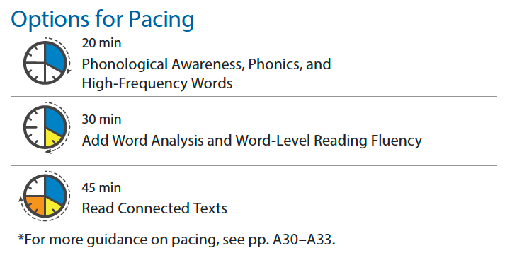
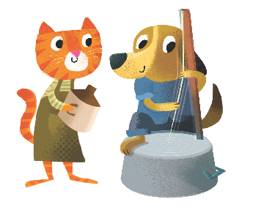
Notes:
Session 2 Skills
Phonological Awareness: Segment Phonemes
Phonics: Encode Words
High-Frequency Words: always, done, give, here
Word Analysis: Compound Words
Read Connected Text: Up in a Cloud
Fluency: Rate/Pace

Slide 3
Today’s Focus
Diphthong: ou
2

Slide 4
Listen Up!
Segment Phonemes
2: Phonological Awareness
Notes:
SEGMENT SOUNDS ROUTINE
MODEL: Segment the sounds in spout.
Listen to the Word: I am going to break the word spout into its sounds.
Say the Sounds in the Word: What sounds do I hear in spout? /s/ /p/ /ou/ /t/
APPLY: Have children segment the sounds in couch.
Listen to the Word: Your turn! Listen carefully as I say a word: couch.
Say the Sounds in the Word: Now you say the sounds you hear in couch. (/k/ /ou/ /ch/)
Now use the routine and have children segment the sounds in the words below. Correct all errors.
cloud, /k/ /l/ /ou/ /d/
ground, /g/ /r/ /ou/ /n/ /d/
storm, /s/ /t/ /ôr/ /m/
shout, /sh/ /ou/ /t/
round, /r/ /ou/ /n/ /d/
born, /b/ /ôr/ /n/

Slide 5
Build Words!
Building Words
2: Phonics
Notes:
BUILDING WORDS
Warm up for dictation. Use Word Building Cards to model building found. Point to each card, say the sound, and then blend the word. Guide children to change one letter to spell pound.

Slide 6
Build Words!
Building Words
2: Phonics
Notes:
Point to each card, say the sound, and then blend the word. Guide children to change one letter to spell round.

Slide 7
Build Words!
Building Words
2: Phonics
Notes:
Point to each card, say the sound, and then blend the word.

Slide 8
Build Words!
Encode Words
2: Phonics
Notes:
DICTATION: We built some ou words with our cards. Now let’s write some words!
SPELL IT ROUTINE
MODEL: Think aloud as you spell the word pounce.
Say the Word: The word is pounce. I am going to think about the sounds I hear in pounce.
Connect Sounds to Spellings: First, I will say the word slowly, pounce. Next, I will think about the first sound I hear. The first sound in pounce is /p/. I know that the letter p stands for /p/. I will write p.

Slide 9
Build Words!
Encode Words
2: Phonics
Notes:
Connect Sounds to Spellings: Now, I will think about the next sound I hear. The next sound in pounce is /ou/. I know that the letters o and u together stand for /ou/. I will write ou.

Slide 10
Build Words!
Encode Words
2: Phonics
Notes:
Connect Sounds to Spellings: Now, I will think about the next sound I hear. The next sound in pounce is /n/. I know that the letter n stands for /n/. I will write n.

Slide 11
Build Words!
Encode Words
2: Phonics
Notes:
Connect Sounds to Spellings: Now, I will think about the last sound I hear. The last sound in pounce is /s/. I know that the letter c followed by e can stand for the /s/ sound. I will write ce. The e at the end of pounce is silent.

Slide 12
Build Words!
2: Phonics
Notes:
APPLY: Have children write today’s dictation words and sentence on p. 211 of their Student Workbook.
Say the Word: Your turn! The first word is proud. Remember to say the word to yourself to help you think about the sounds.
Connect Sounds to Spellings: Think about the first sound in proud. Which letter stands for that sound? Write the letter. Keep going for each sound in proud!
Dictate the words and sentence below for children to spell.
1. proud
2. ounce
3. about
4. sport
5. Some birds always fly south in winter.

Slide 13
Build Words!
1. proud
3. about
2. ounce
4. sport
5. Some birds always fly south in winter.
2: Phonics
Notes:
When done, display the words and have partners check each other’s spelling for accuracy.

Slide 14
Build Words!
Compound Words
clubhouse
2: Word Analysis
Notes:
TEACH: Remind children that a compound word is two smaller words put together to make a longer word. They can look for the two smaller words that make up a compound word to help them read it.
MODEL: Write the word clubhouse. Say, To read this longer word, I will first look to see if I see any smaller words in it. First, I see the word club. When I cover that up, then I see the second part of the longer word is house. Then I blend those two smaller words to read the longer word: club-house; clubhouse.

Slide 15
Build Words!
Compound Words
outside
2: Word Analysis
Notes:
APPLY: Now write the word outside. Have children look at the word and identify the two smaller words. Ask, What two smaller words do you see? (out, side) Now blend the two words to read the longer word. (out-side, outside)
See the practice page for Word Analysis.

Slide 16
Build Words!
2: Word Analysis
Notes:
Have children complete the practice page for Word Analysis.
Before children begin working, say picture names aloud as necessary: 1. dog, house; 2. drum, sticks; 3. rain, bow; 4. gold, fish; 5. cup, cake.

Slide 17
Build Words!
Super Words
2: High-Frequency Words
Notes:
REVIEW: Review this week’s Super Words: always, done, give, here. Have partners use Word Building Cards to practice spelling the Super Words.

Slide 18
Build Words!
Super Words
2: High-Frequency Words
Notes:
REVIEW: Review this week’s Super Words: always, done, give, here. Have partners use Word Building Cards to practice spelling the Super Words.

Slide 19
Build Words!
Super Words
2: High-Frequency Words
Notes:
REVIEW: Review this week’s Super Words: always, done, give, here. Have partners use Word Building Cards to practice spelling the Super Words.

Slide 20
Build Words!
Super Words
2: High-Frequency Words
Notes:
REVIEW: Review this week’s Super Words: always, done, give, here. Have partners use Word Building Cards to practice spelling the Super Words.
APPLY: See the practice page for High-Frequency Words.

Slide 21
Build Words!
2: High-Frequency Words
Notes:
Have children complete the practice page for High-Frequency Words.

Slide 22
Let’s Read!
First Read
2: Read Connected Text
Notes:
Introduce: This week, children will read about clouds. This text, Up in a Cloud, explains how clouds are formed as part of the water cycle.
Share: Unit Words appear, Earth, moon, weather
TEACH/MODEL: Model decoding the title. Call attention to this week’s Super Words in bold and the Unit Words appear and Earth. Remind children that they are learning about words with /ou/ spelled ou. Then display words with /ou/ spelled ou from the text, such as cloud and out (shown on the next slide), to have children practice reading target-skill words for automaticity. Model decoding the first sentence before reading the text in unison with children. Point to each word as you read and have children do the same.
APPLY: Have children reread the text in unison. Circulate and provide feedback as needed. If time permits, have children read the text again using partner-reading or whisper-reading.

Slide 23
Let’s Read!
cloud
out
2: Read Connected Text
Notes:
Display words from the text, such as cloud and out, to have children practice reading target-skill words for automaticity.
Return to the previous slide to continue the First Read.

Slide 24
Let’s Read!
Second Read
2: Read Connected Text
Notes:
TEACH/MODEL: Remind children that reading at a natural pace will make it easier to understand a text. Read the first paragraph on p. 214 at a very slow pace. Ask children what they noticed about your reading. Say, When I read too slowly, it makes it harder to follow along and understand the text. Now listen to how the text sounds as I read at a natural pace. Reread the text and discuss the difference with children.
SELF-CORRECTION
PACING Fix-Up Strategy
Explain to children that readers use different strategies, or tools, to help them read. Say, If your reading is too fast or too slow, stop and read again. Remember that when you read aloud, you should read at a pace that sounds like you are talking. That will help you and your listeners understand the text. Ask yourself: Did my pace sound natural? Did it make it easy for listeners to understand the text?
APPLY: Read the second paragraph on p. 214 aloud as children echo-read. Listen for appropriate pace.

