Slide 1
Week 27
Session 1: Diphthong ou

Slide 2
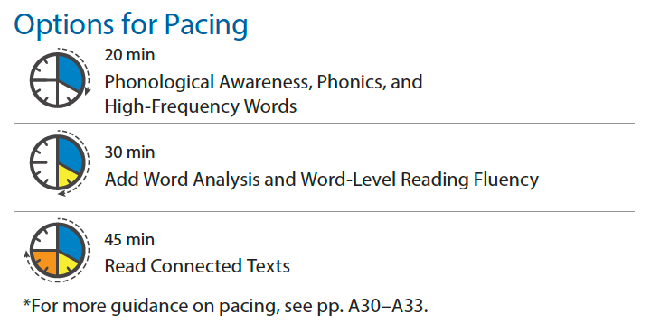
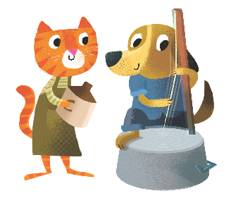
Notes:
Session 1 Skills
Phonological Awareness: Blend Phonemes, Isolate Phonemes
Phonics: Diphthong: ou
High-Frequency Words: always, done, give, here

Slide 3
Today’s Focus
Diphthong: ou
1

Slide 4
Listen Up!
Blend Phonemes
1: Phonological Awareness
Notes:
BLEND SOUNDS ROUTINE
MODEL: Blend the sounds in proud.
Listen to the Sounds: I am going to blend sounds together to say a word. Listen as I say the sounds: /p/ /r/ /ou/ /d/.
Blend the Sounds Together: Now I will blend those sounds together: /prrroud/. The word is proud.
APPLY: Have children blend the sounds in round.
Listen to the Sounds: Your turn! Listen as I say the sounds in a word: /r/ /ou/ /n/ /d/.
Blend the Sounds Together: Now you blend the sounds together to say the word. (/rrrounnnd/) What is the word? (round)
Now use the routine and have children blend the sounds in the words below. Correct all errors.
/b/ /ou/ /n/ /s/, bounce
/ou/ /ch/, ouch
/s/ /p/ /r/ /ou/ /t/, sprout
/p/ /ou/ /n/ /d/, pound
/w/ /ĭ/ /th/ /ou/ /t/, without
/ou/ /t/ /s/ /ī/ /d/, outside

Slide 5
Listen Up!
Isolate Phonemes
1: Phonological Awareness
Notes:
ISOLATE SOUNDS ROUTINE
MODEL: Isolate the medial sound in the word south.
Listen for the Sound: I am going to listen for the middle sound in the word south.
Say the Sound: Now I will say the middle sound I hear in south: /ou/. The middle sound in south is /ou/.
APPLY: Have children isolate the medial sound in the word shout.
Listen for the Sound: Your turn! What is the middle sound in the word shout?
Say the Sound: Now you say the middle sound you hear. (/ou/) Again. (/ou/)
Now use the routine and have children isolate the middle sound in each word below. Correct all errors.
loud, /ou/
pop, /ŏ/
mouse, /ou/
house, /ou/
mouth, /ou/
fox, /ŏ/

Slide 6
Build Words!
Diphthong: ou
1: Phonics
Notes:
TEACH: Use the SS&A Cards to introduce the diphthong ou. Say the image name, say the sound, and have children repeat after you.
Consider playing the articulation video accessible through Teacher Toolbox.

Slide 7
Build Words!
Diphthong: ou
couch
1: Phonics
Notes:
TEACH: Explain that the letters o and u together can stand for /ou/. Write couch and read it aloud. Underline ou. Point to the letters, say the sound, and have children repeat after you.

Slide 8
Build Words!
Blend Words Routine
found
1: Phonics
Notes:
BLEND WORDS ROUTINE
MODEL: Write the word found.
Say the Sounds: I am going to say each sound in the word found: the letter f stands for /f/, ou stand for /ou/, n stands for /n/, and d stands for /d/.
Blend the Sounds Together: Now listen as I blend these sounds together: /fffounnnd/, found. Say the word with me: found.

Slide 9
Build Words!
Blend Words Routine
house
1: Phonics
Notes:
BLEND WORDS ROUTINE
APPLY: Write the word house.
Say the Sounds: Your turn! Say each sound in the word. (/h/ /ou/ /s/)
Blend the Sounds Together: Now blend the sounds together. (/housss/, house)

Slide 10
Build Words!
Blend Words Routine
out
1: Phonics
Notes:
Now use the routine and have children blend sounds to say the words below. Correct all errors.
out
cloud
scout
pounce
sound
round

Slide 11
Build Words!
Blend Words Routine
cloud
1: Phonics
Notes:
Now use the routine and have children blend sounds to say the words below. Correct all errors.
out
cloud
scout
pounce
sound
round

Slide 12
Build Words!
Blend Words Routine
scout
1: Phonics
Notes:
Now use the routine and have children blend sounds to say the words below. Correct all errors.
out
cloud
scout
pounce
sound
round

Slide 13
Build Words!
Blend Words Routine
pounce
1: Phonics
Notes:
Now use the routine and have children blend sounds to say the words below. Correct all errors.
out
cloud
scout
pounce
sound
round

Slide 14
Build Words!
Blend Words Routine
sound
1: Phonics
Notes:
Now use the routine and have children blend sounds to say the words below. Correct all errors.
out
cloud
scout
pounce
sound
round

Slide 15
Build Words!
Blend Words Routine
round
1: Phonics
Notes:
Now use the routine and have children blend sounds to say the words below. Correct all errors.
out
cloud
scout
pounce
sound
round

Slide 16
Build Words!
Super Words
1: High-Frequency Words
Notes:
TEACH: Introduce this week’s high-frequency words always, done, give, and here.
SUPER WORDS ROUTINE
See and Say the Word: Display the Super Word Card. Read the word and have children repeat it. Read the context sentences on the back of the card.
My pets are always hungry!
We always tell them to wait.
When it’s time, I always feed them.
Spell the Word: Have children say the letters in the word. Review known sound-spellings and have children say them with you. Point out that the letters in Super Words may not always follow the rules. Pronounce any unfamiliar parts of the word and have children repeat after you.
Write the Word: Have children write the word on a piece of paper and check their spelling.

Slide 17
Build Words!
Super Words
1: High-Frequency Words
Notes:
SUPER WORDS ROUTINE
See and Say the Word: Display the Super Word Card. Read the word and have children repeat it. Read the context sentences on the back of the card.
Are you done with your chores?
I will be done when I make my bed.
Lunch should be done by then.
Spell the Word: Have children say the letters in the word. Review known sound-spellings and have children say them with you. Point out that the letters in Super Words may not always follow the rules. Pronounce any unfamiliar parts of the word and have children repeat after you.
Write the Word: Have children write the word on a piece of paper and check their spelling.

Slide 18
Build Words!
Super Words
1: High-Frequency Words
Notes:
SUPER WORDS ROUTINE
See and Say the Word: Display the Super Word Card. Read the word and have children repeat it. Read the context sentences on the back of the card.
We need to give the puppy a bath.
Can you give me some help?
Give me the soap and a rag, please.
Spell the Word: Have children say the letters in the word. Review known sound-spellings and have children say them with you. Point out that the letters in Super Words may not always follow the rules. Pronounce any unfamiliar parts of the word and have children repeat after you.
Write the Word: Have children write the word on a piece of paper and check their spelling.

Slide 19
Build Words!
Super Words
1: High-Frequency Words
Notes:
SUPER WORDS ROUTINE
See and Say the Word: Display the Super Word Card. Read the word and have children repeat it. Read the context sentences on the back of the card.
Here is a bag of cracked corn.
We can sit here on the dock.
Ducks swim by here for the corn.
Spell the Word: Have children say the letters in the word. Review known sound-spellings and have children say them with you. Point out that the letters in Super Words may not always follow the rules. Pronounce any unfamiliar parts of the word and have children repeat after you.
Write the Word: Have children write the word on a piece of paper and check their spelling.
APPLY: See the practice page for High-Frequency Words.

Slide 20
Build Words!
1: Phonics
Notes:
Have children complete the practice page for Phonics.
Before children begin working, say picture names aloud as necessary: 1. mouse; 2. couch; 3. house; 4. cloud.

Slide 21
Build Words!
1: High-Frequency Words
Notes:
Have children complete the practice page for High-Frequency Words.

Slide 22
Word-Level Reading
1: High-Frequency Words
Notes:
WORD-LEVEL READING FLUENCY
Guide children to read the words on Student Workbook p. 210. Remind them that some words will have the sound-spellings they are learning this week; others will have review sound-spellings. Line 4 is intended for children who are ready for a challenge.

