Slide 2
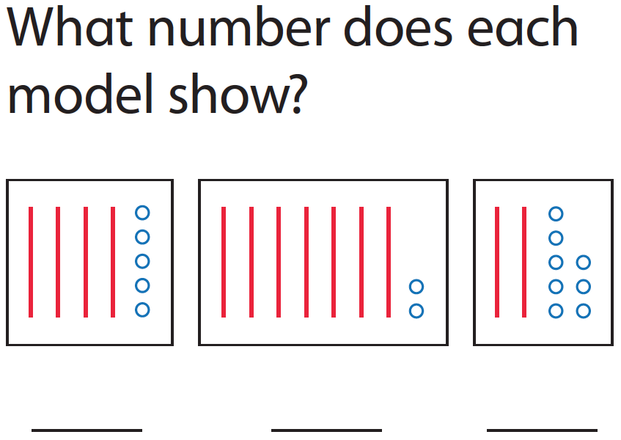

Slide 3
Notes:
No Pair share in G1

Slide 7
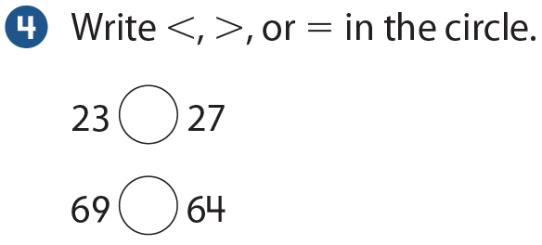

Slide 8
