Slide 1
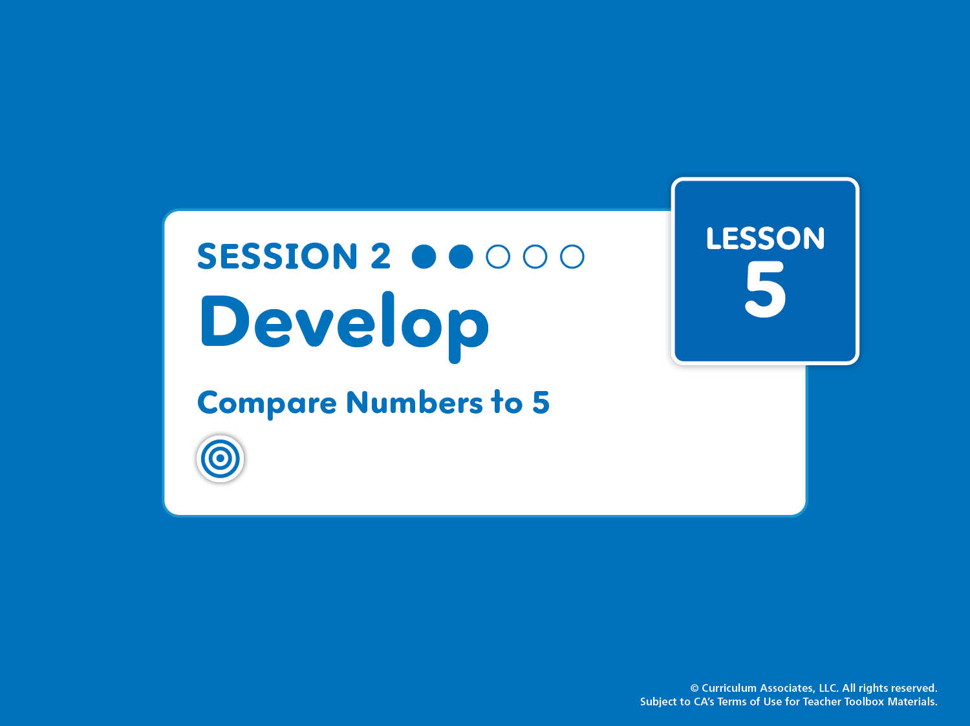
Lesson 5, Session 2: Develop
Compare Numbers to 5
Compare groups of objects and numbers up to 5. Recognize that each counting number is one more than the last.
Notes:
Purpose
Develop understanding of one-to-one matching to compare groups.
Recognize that a group has more when, after matching, that group has objects left over.
Math Toolkit
Make available for use at any time in the lesson:
Counters
Connecting cubes
5-Frames Workmat

Slide 2
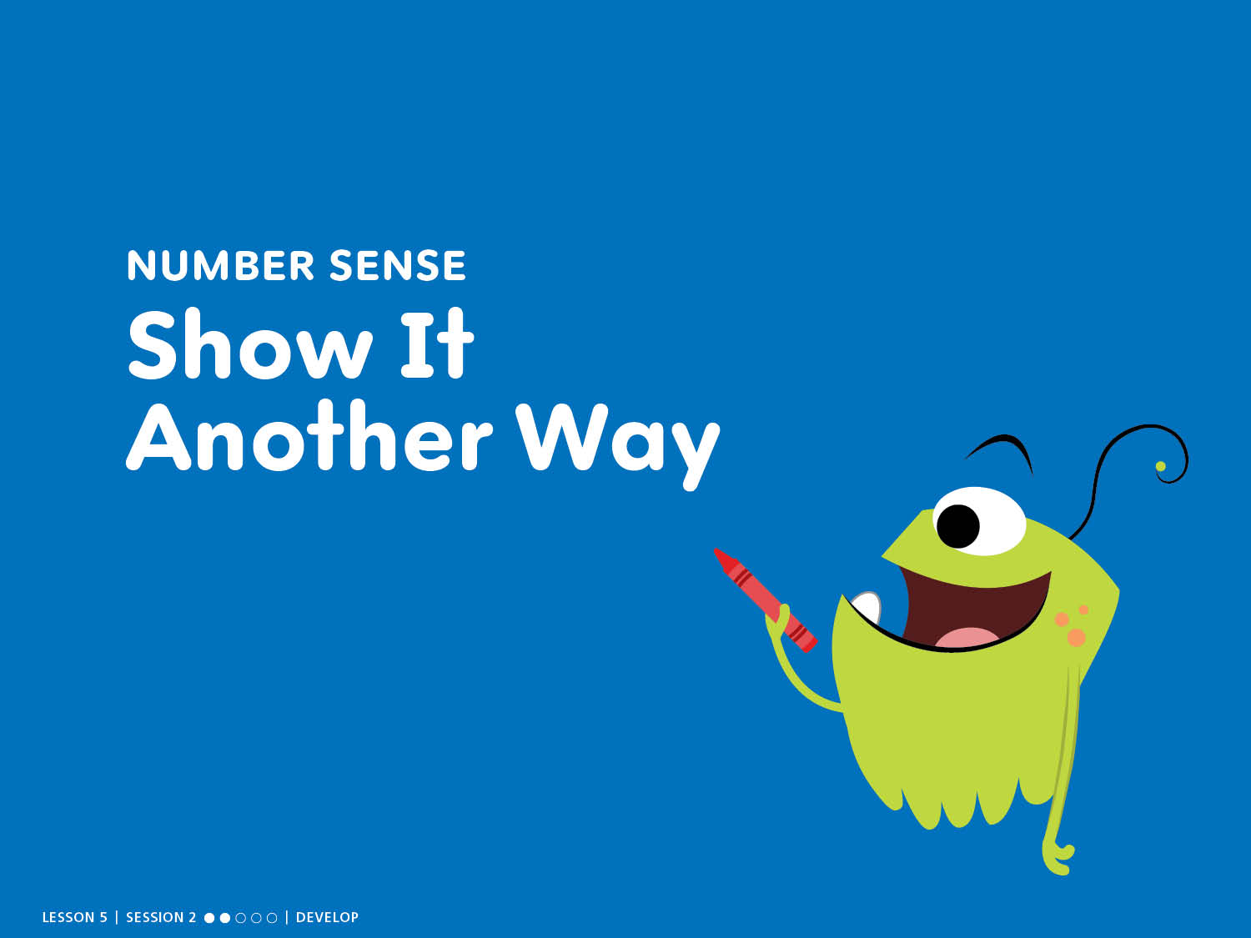
NUMBER SENSE
Show It Another Way
Notes:
START: Number Sense – Teacher’s Guide page 97a
Show It Another Way
ASK: How can you show the number another way?
Counting Tip
PASS AND COUNT Have children count forward by 1s from 1 to 40 as they pass a bean bag around the circle. Then reverse direction and count backward from 10 to 0.

Slide 3
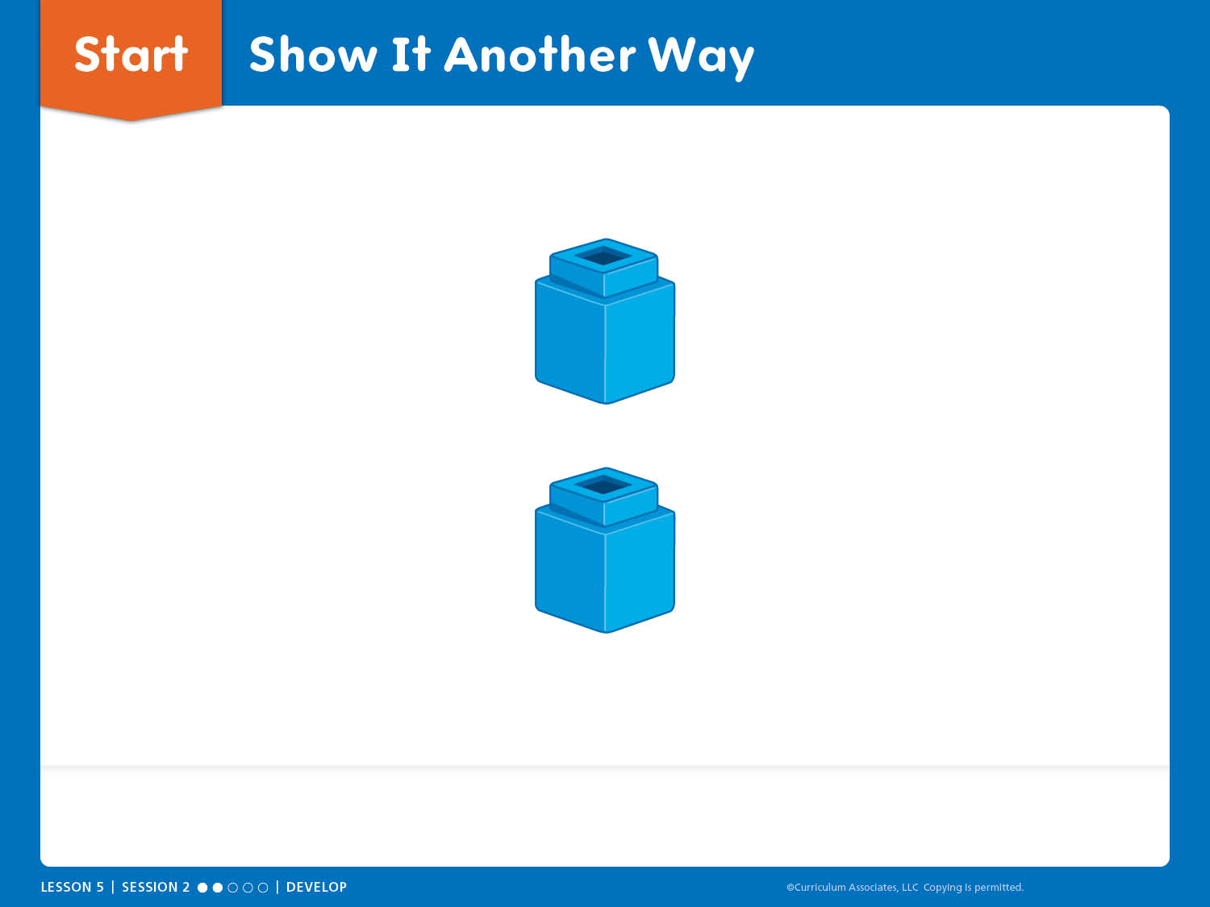
Start: Show It Another Way
How can you show the number another way?
Notes:
START: Number Sense – Teacher’s Guide page 97a
Show It Another Way
ASK: How can you show the number another way?
Encourage children to use materials, fingers, or drawings.
Have children turn and talk about how they showed the number.
Listen and look for a variety of solutions for whole class sharing.
Facilitate Whole Class Discussion
What number did you show? How did you show it?
How is your partner’s way the same or different from yours?

Slide 4
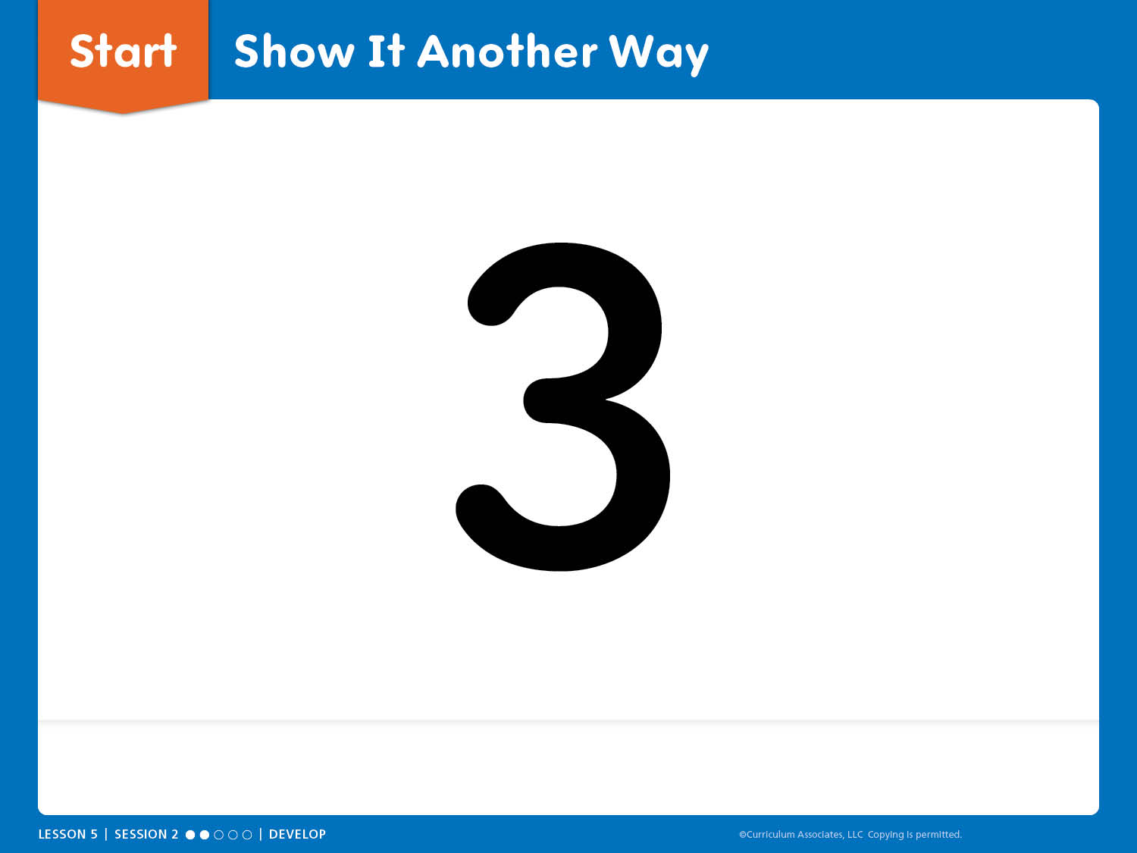
Start: Show It Another Way
How can you show the number another way?
Notes:
START: Number Sense – Teacher’s Guide page 97a
Show It Another Way
ASK: How can you show the number another way?
Encourage children to use materials, fingers, or drawings.
Have children turn and talk about how they showed the number.
Listen and look for a variety of solutions for whole class sharing.
Facilitate Whole Class Discussion
What number did you show? How did you show it?
How is your partner’s way the same or different from yours?

Slide 5
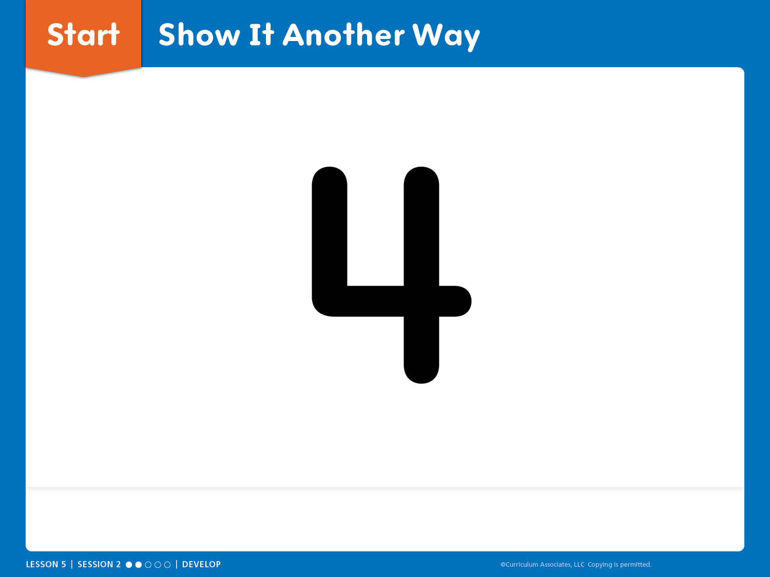
Start: Show It Another Way
How can you show the number another way?
Notes:
START: Number Sense – Teacher’s Guide page 97a
Show It Another Way
ASK: How can you show the number another way?
Encourage children to use materials, fingers, or drawings.
Have children turn and talk about how they showed the number.
Listen and look for a variety of solutions for whole class sharing.
Facilitate Whole Class Discussion
What number did you show? How did you show it?
How is your partner’s way the same or different from yours?

Slide 6
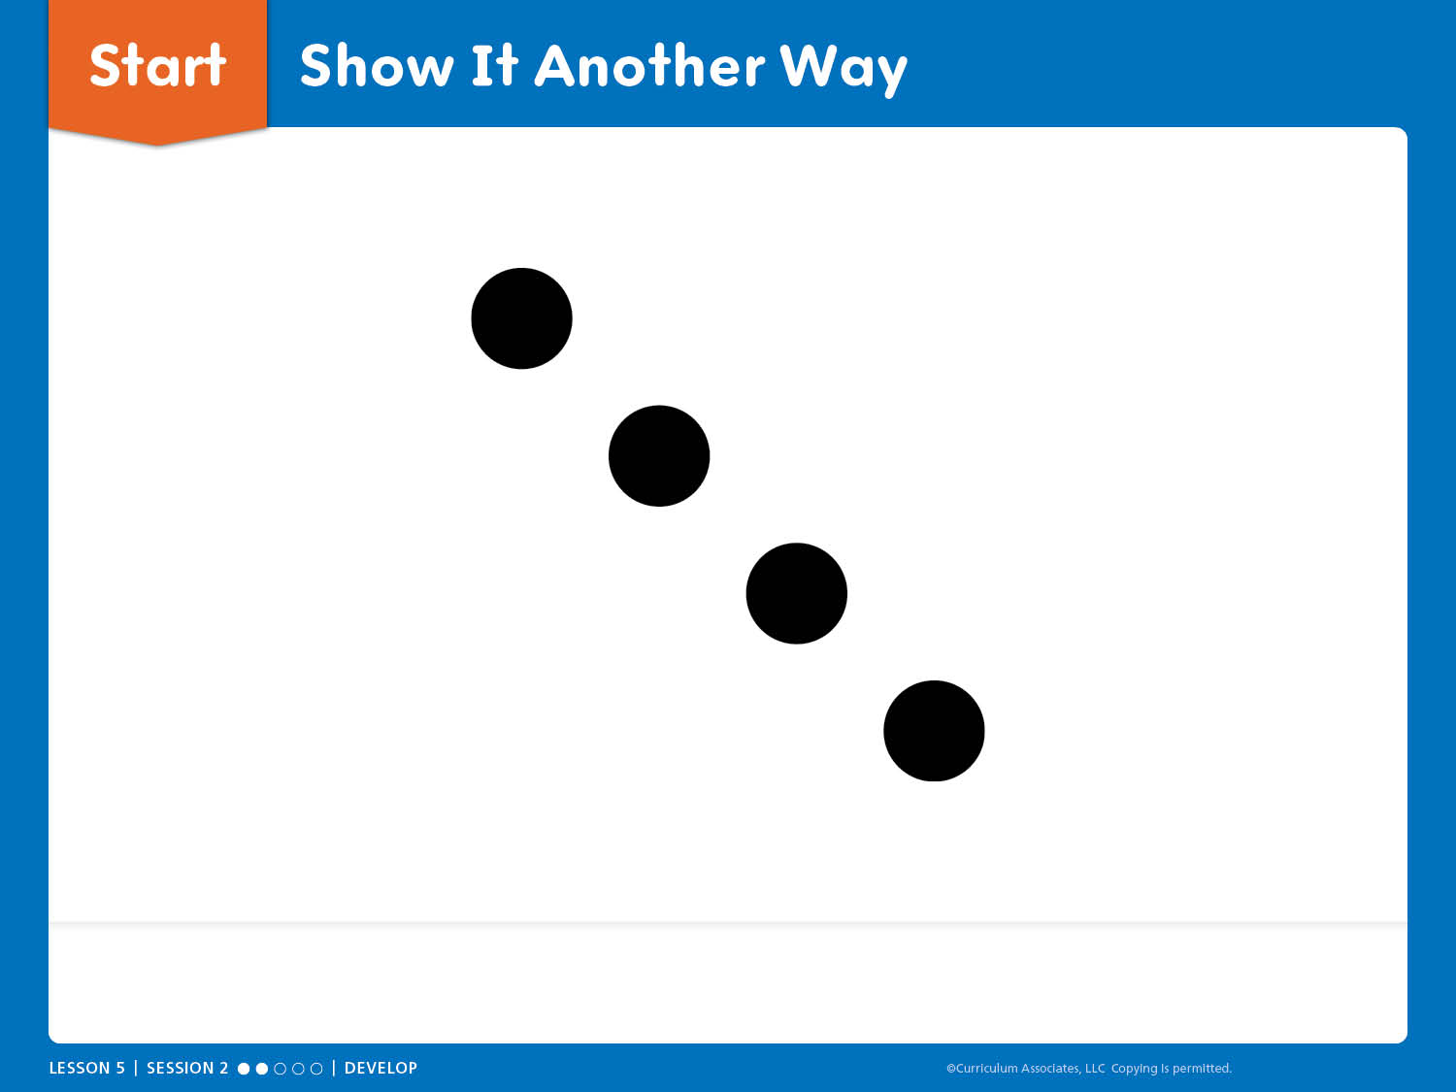
Start: Show It Another Way
How can you show the number another way?
Notes:
START: Number Sense – Teacher’s Guide page 97a
Show It Another Way
ASK: How can you show the number another way?
Encourage children to use materials, fingers, or drawings.
Have children turn and talk about how they showed the number.
Listen and look for a variety of solutions for whole class sharing.
Facilitate Whole Class Discussion
What number did you show? How did you show it?
How is your partner’s way the same or different from yours?

Slide 7

Try-Discuss-Connect
Notes:
Try-Discuss-Connect – Teacher’s Guide page 97
How can you compare two groups?
Math Toolkit
Counters
Connecting cubes
5-Frames Workmat

Slide 8
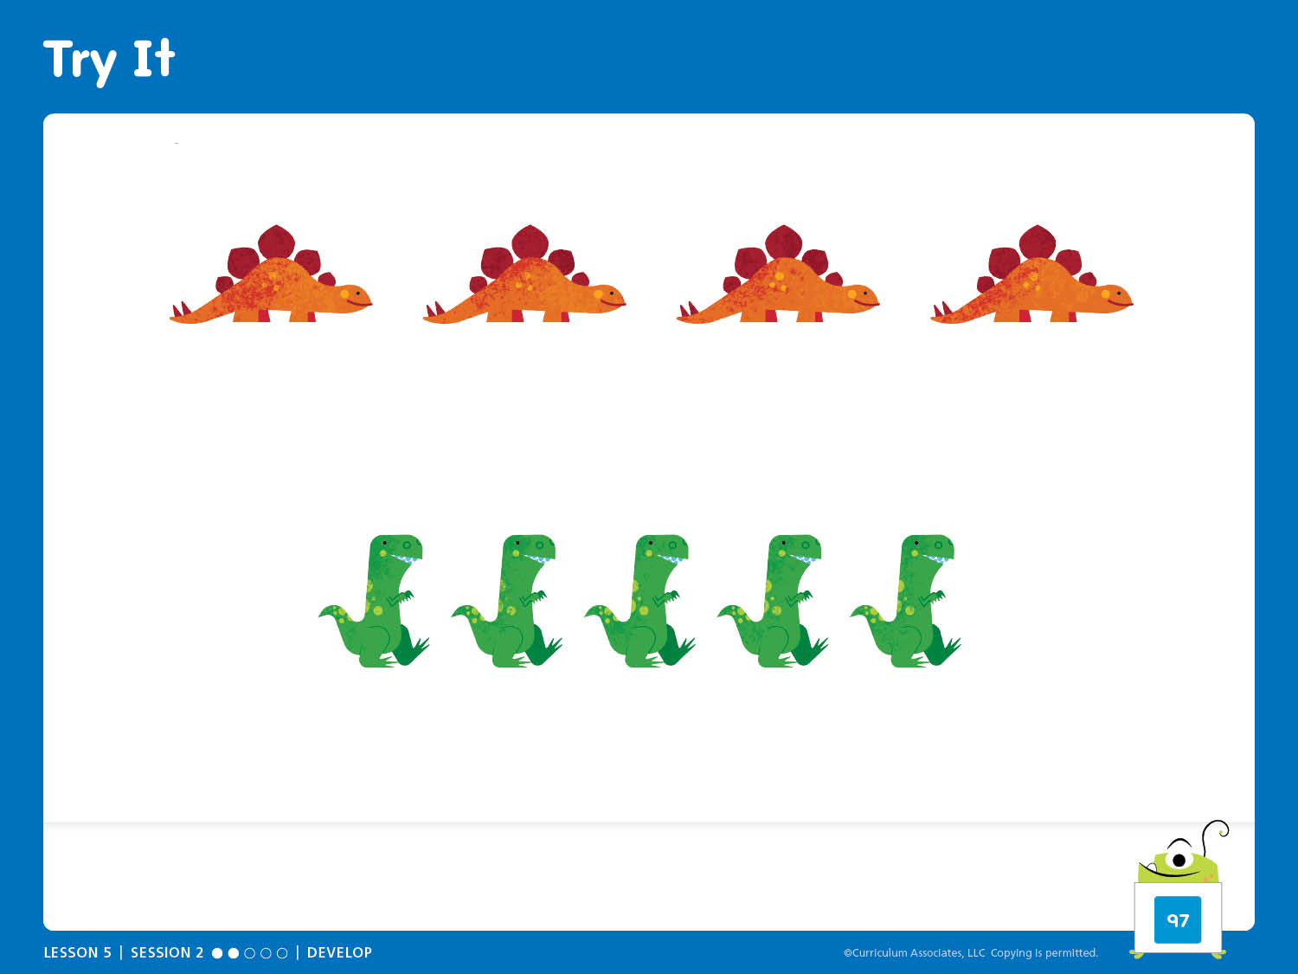
Try It
There are different kinds of toy dinosaurs at the market. Which group has more?
Notes:
Try-Discuss-Connect – Teacher’s Guide page 97
How can you compare two groups?
Try It
Read the problem aloud:
There are different kinds of toy dinosaurs at the market. Which group has more?
Use Notice and Wonder to help children make sense of the problem. Ensure children understand they should show a way to compare the dinosaurs in each group.

Slide 9
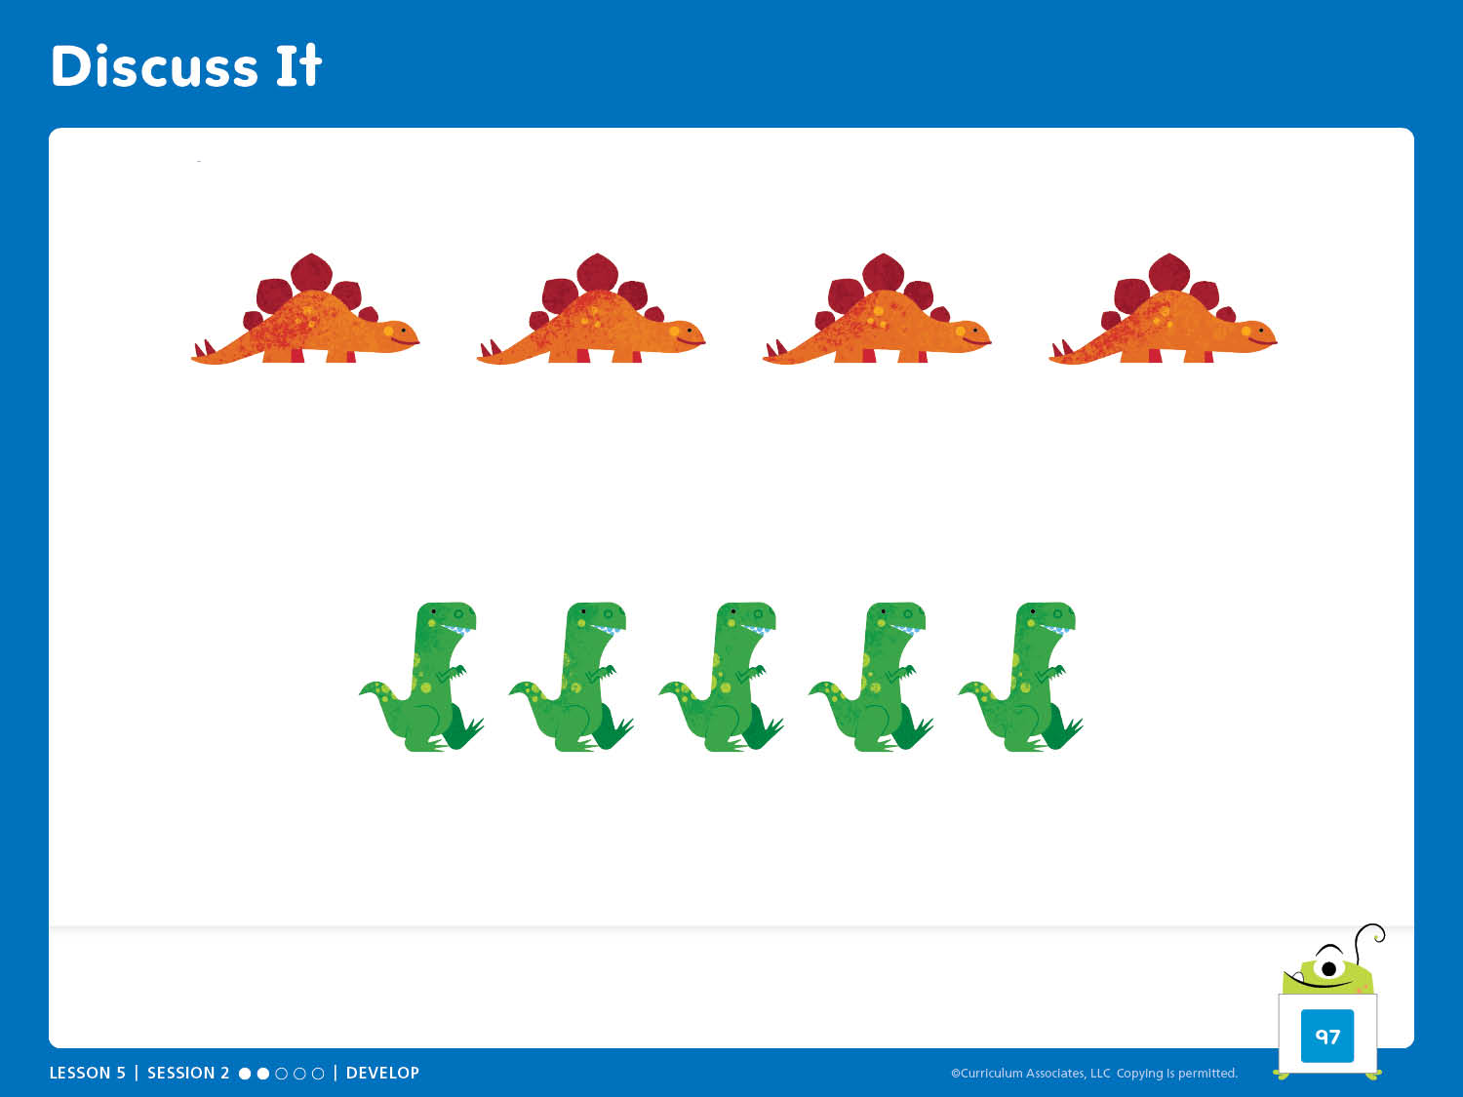
Discuss It
How do you know which group has more dinosaurs?
Notes:
Try-Discuss-Connect – Teacher’s Guide page 97
How can you compare two groups?
Discuss It
Have children respond to the Discuss It question with a partner:
How do you know which group has more dinosaurs?
Select and Sequence Strategies
One possible order for whole class discussion:
Counting
Matching the objects
Comparing numbers
ASK:
How does [child name]’s strategy show which group has more?
Guide children to Compare and Connect the strategies.

Slide 10
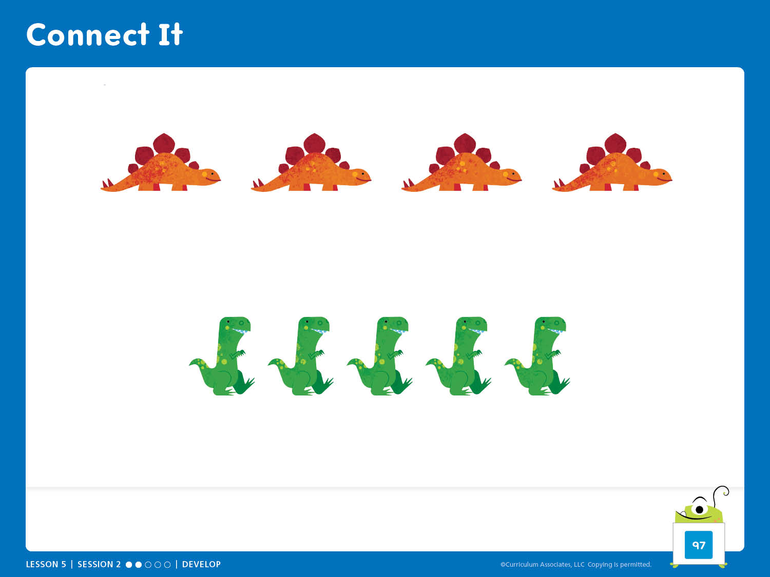
Connect It
How does matching the objects show which group has more?
Notes:
Try-Discuss-Connect – Teacher’s Guide page 97
How can you compare two groups?
Connect It
Help children recognize that you can match objects to compare groups.
ASK:
How does matching the objects show which group has more?

Slide 11
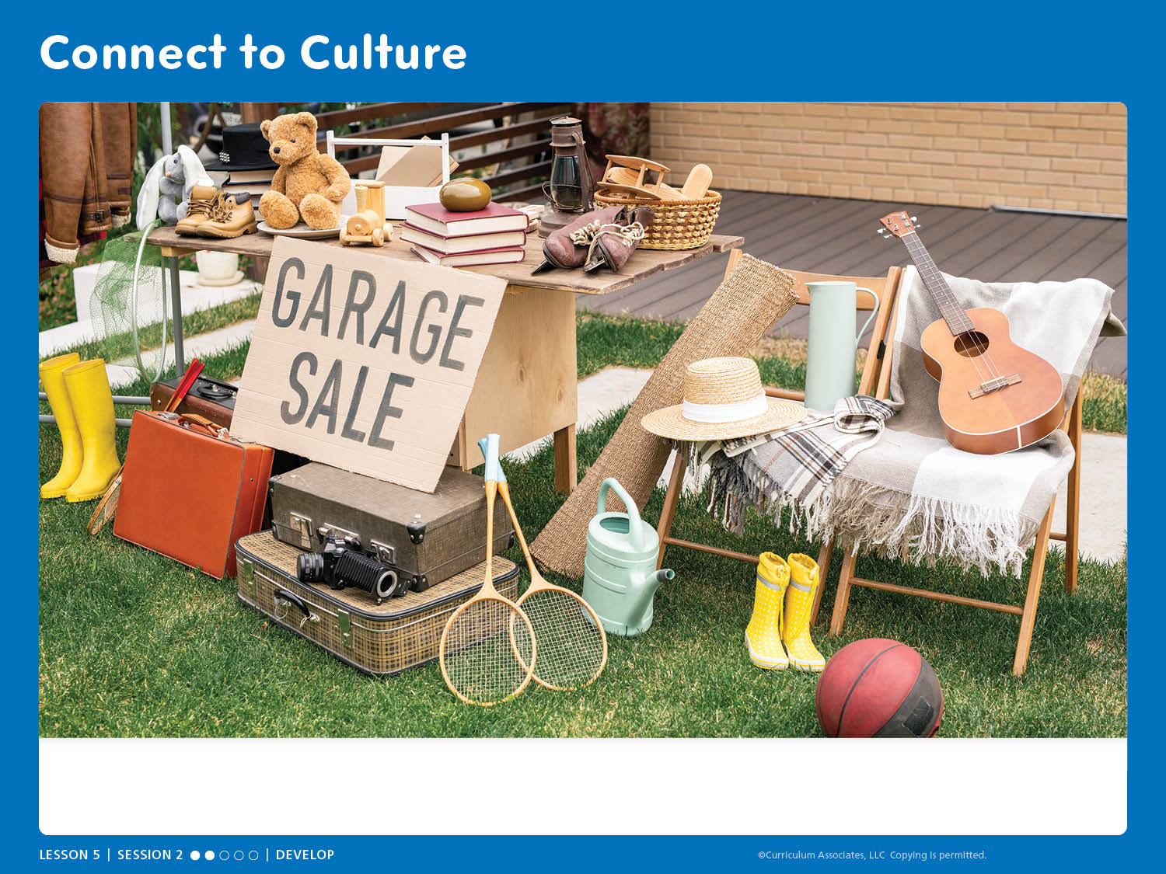
Connect to Culture
If you went to this garage sale, what would you like to take home? Why?
Notes:
Connect to Culture – Teacher’s Guide page 94b
Show children the slide to launch a discussion.
SAY: Outdoor markets can be big or small. Sometimes people put things they no longer want in their yard or garage and sell them to others who are happy to have them.
ASK: Have you ever been to a garage sale or a yard sale? What did you see there?
Invite children to share what they see for sale in the slide, noting any objects that there are more than one of.
ASK: If you went to this garage sale, what would you like to take home? Why?

Slide 12

Apply It
Notes:
Apply It – Teacher’s Guide page 98
How can you use objects to compare numbers?
Counter Compare Activity
Materials (per pair)
Two-color counters (20)
Number and Dot Row Cards (2 sets, Numbers 0 to 5)
Preparation: Give each pair 20 two-color counters and a stack of Number and Dot Row Cards (2 sets mixed together).

Slide 13
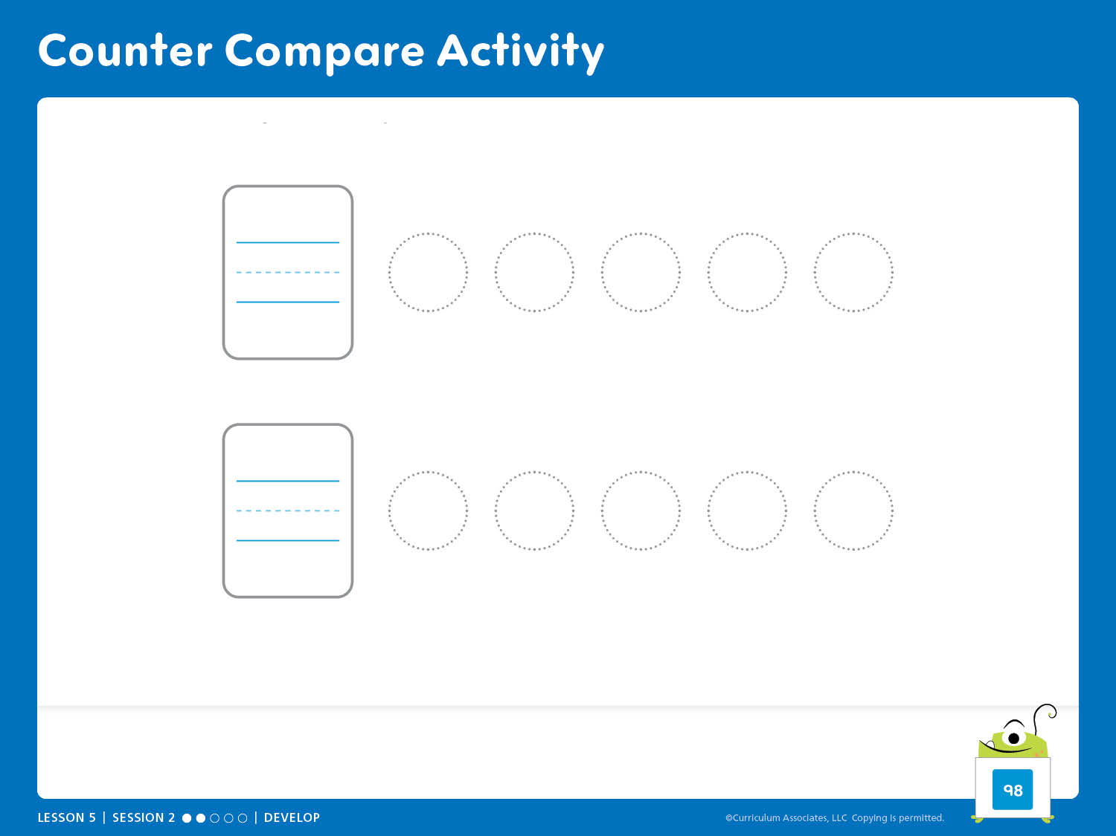
Counter Compare Activity
How do you know which group has more or less?
Notes:
Apply It – Teacher’s Guide page 98
How can you use objects to compare numbers?
Counter Compare Activity
This activity guides children to develop understanding of using one-to-one matching to compare groups.
ASK:
How did matching help you know which player had more counters?
Error Alert
If the number of counters shown does not match the number on the card, encourage children to check their work by matching each dot on the card with one of their counters.

Slide 14
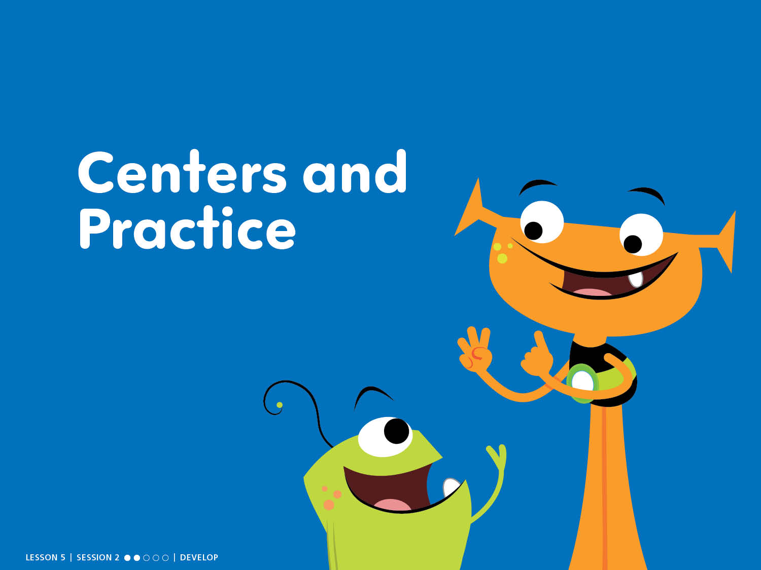
Centers and Practice
Session Centers: Counter Compare
Centers Library: Tile Puzzles, Show It
Practice: Circle/Draw

Slide 15
Counter Compare Activity
How do you know which group has more or less?

Slide 16
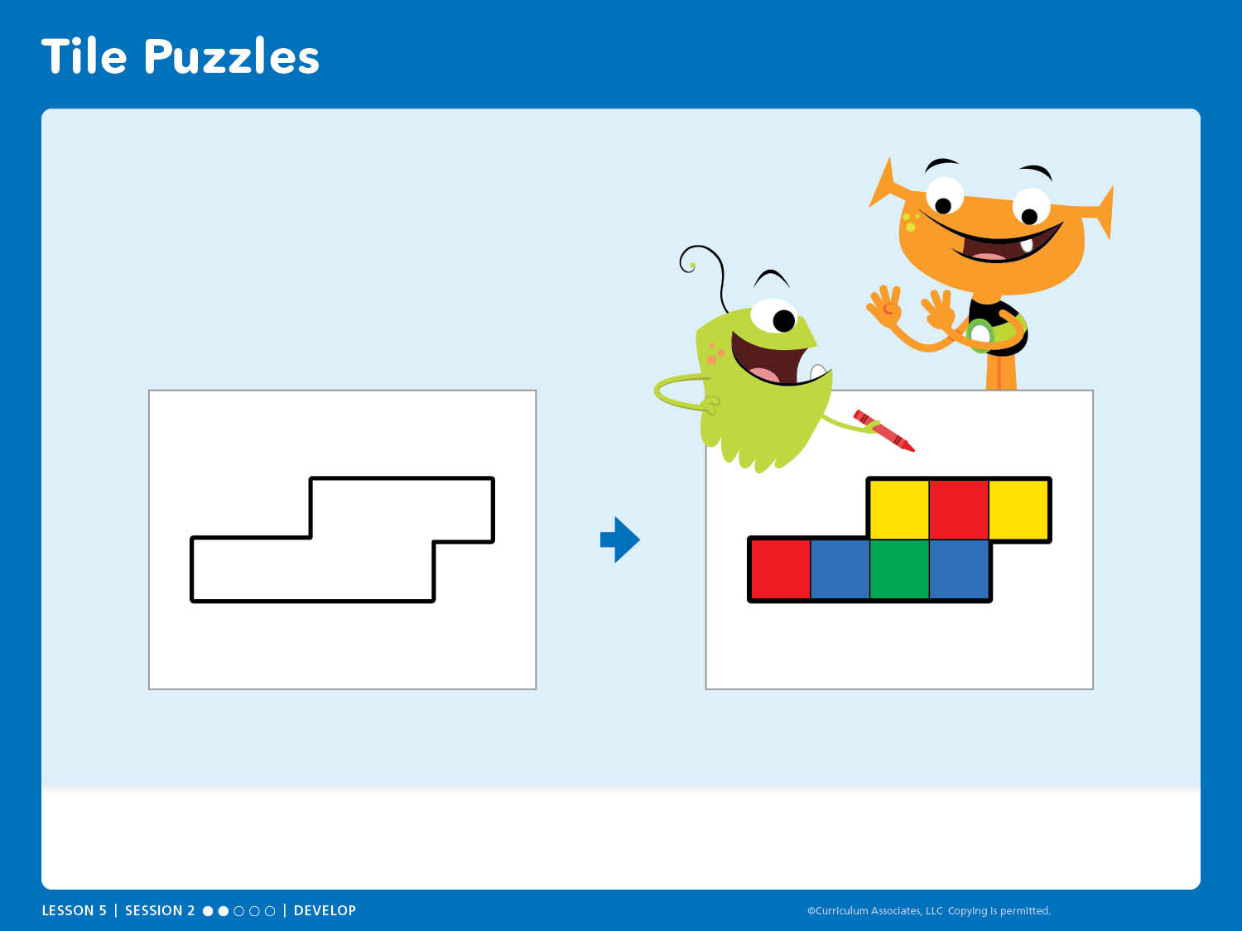
Tile Puzzles
Centers Library
SKILL REVIEW Tile Puzzles, Card 8

Slide 17
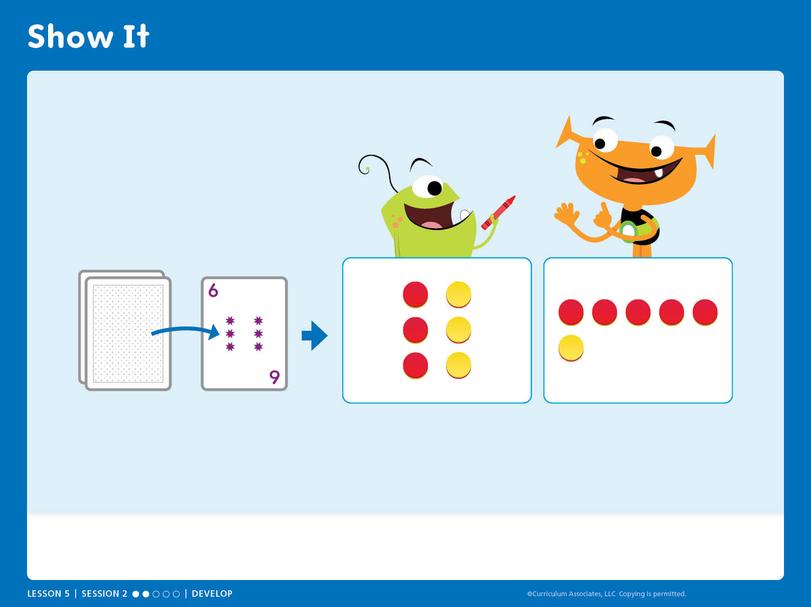
Show It
Centers Library
FLUENCY Show It, Card 13

Slide 18
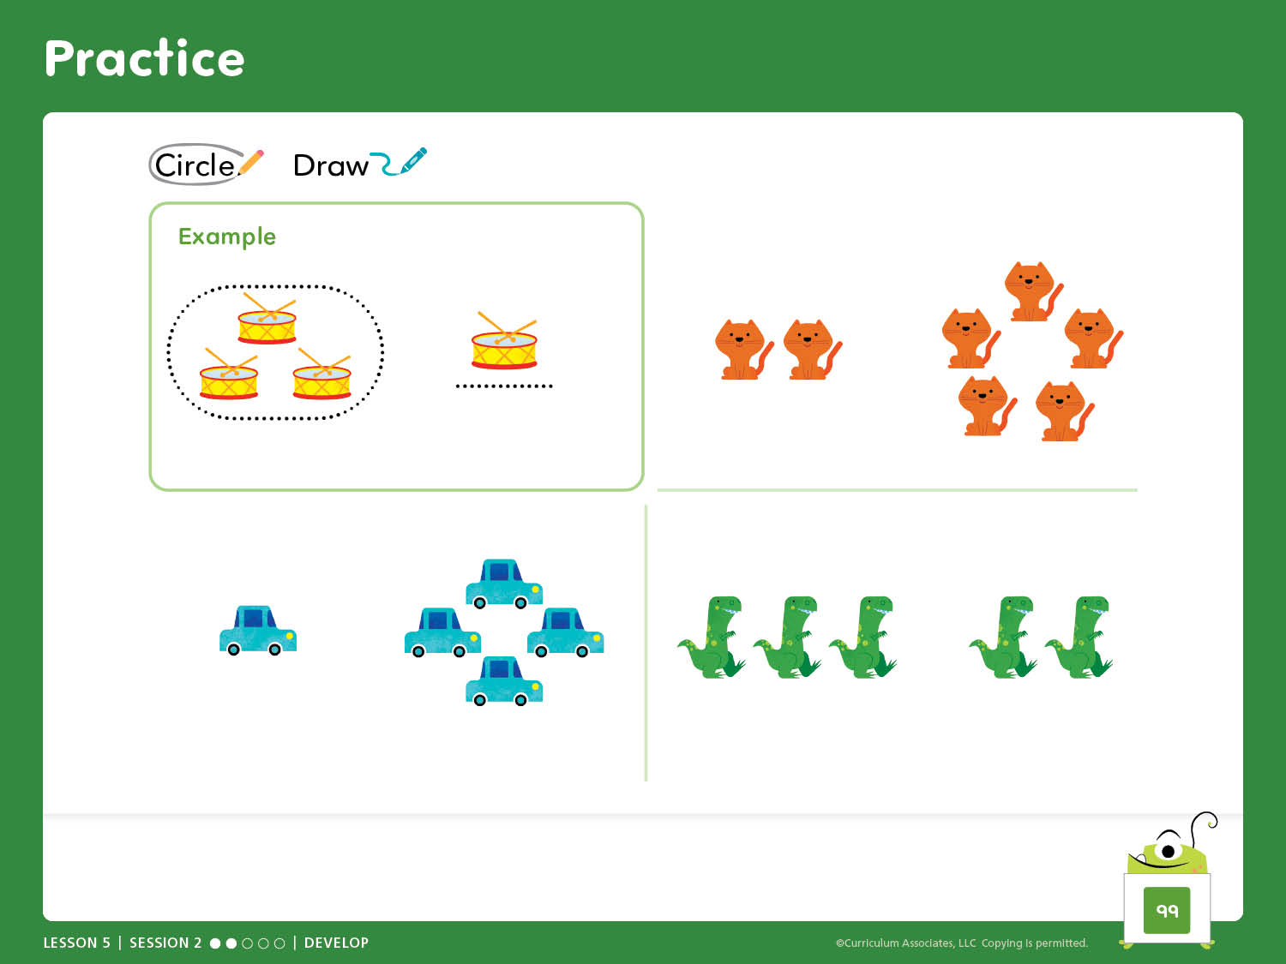
Practice
Circle the group that shows more. Draw a line under the group that shows less.

Slide 19
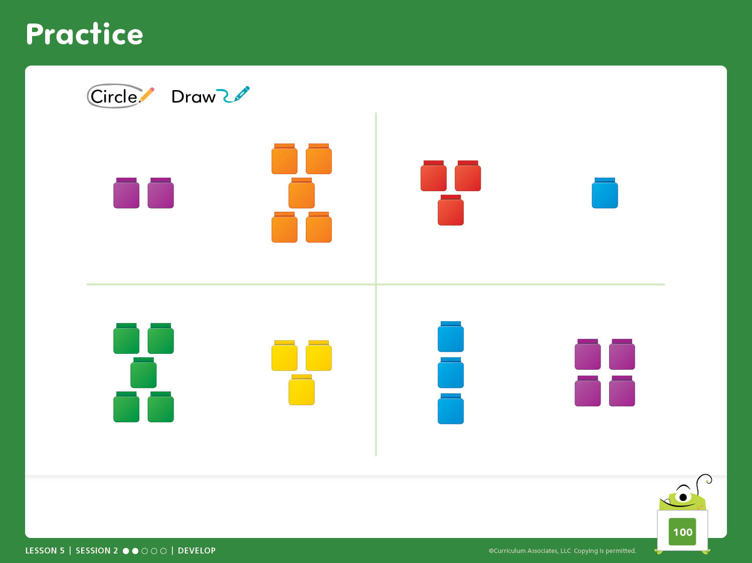
Practice
Circle the group that shows more. Draw a line under the group that shows less.

Slide 20
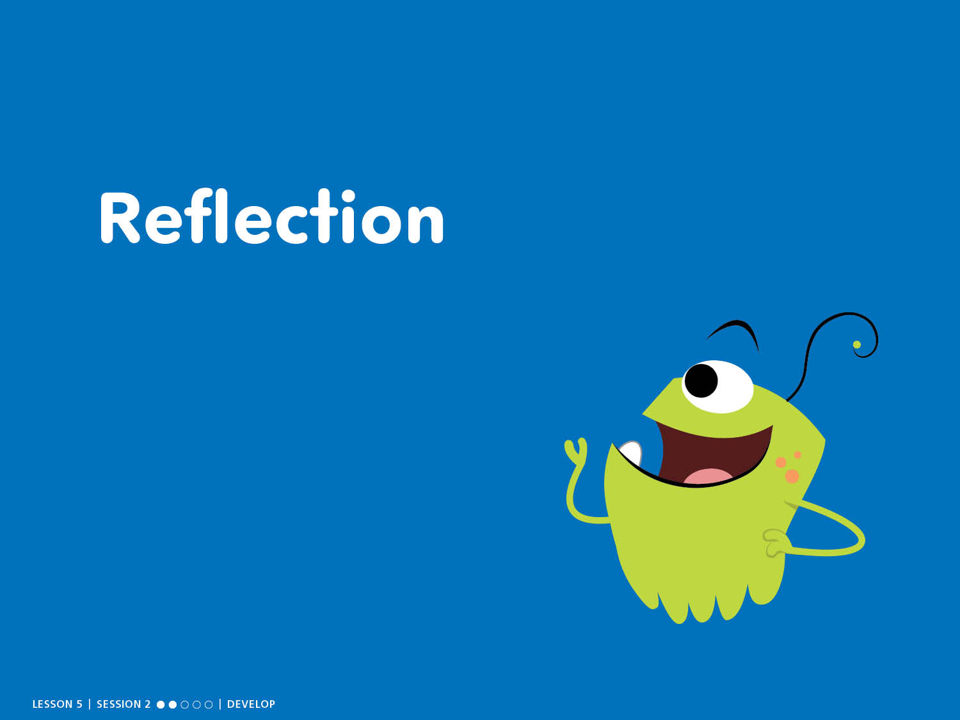
Reflection

Slide 21
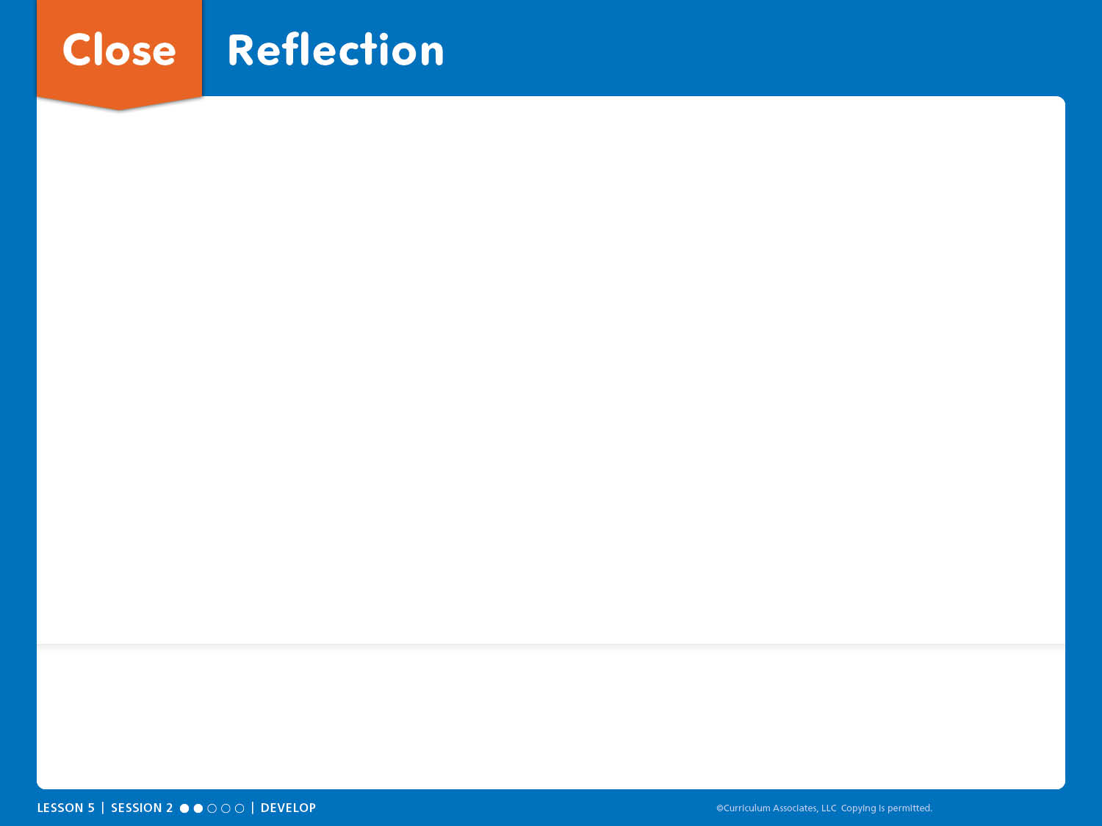
Close: Reflection
I learned . . .
I think . . .
I wonder . . .
MATH REFLECTION Think about some ways you compared numbers. What did you discover about more, less, and the same?
SELF REFLECTION Why is it important to keep your math activity space organized?

Slide 22
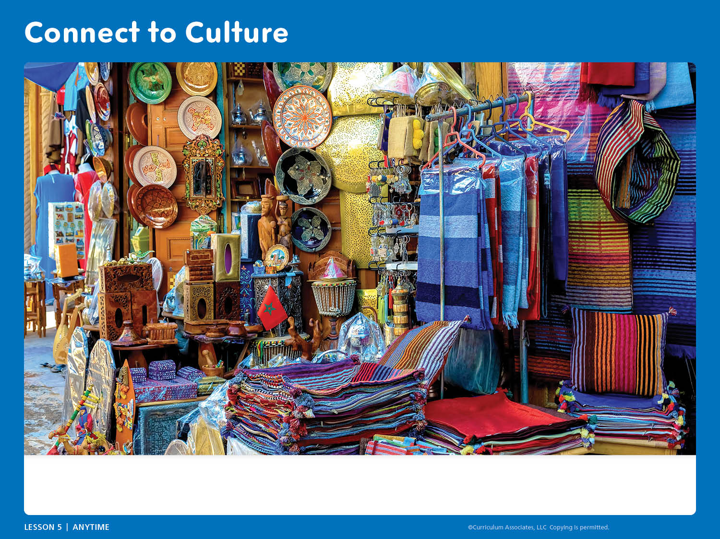
Connect to Culture
What do you notice? What questions do you have about markets where you live and in other places?
Notes:
Connect to Culture – Teacher’s Guide page 94b
ANYTIME DURING THE LESSON
During read-aloud or other whole class times, guide an exploration of different kinds of markets based on children’s questions and curiosity.
Show children the slide.
ASK: What do you notice? How is this market the same or different from markets you have seen?
Share that this is a market in Morocco, called a souk.
ASK: What do you wonder? What questions do you have about markets where you live and in other places?
Use videos, online searches, books, and information from children and families to explore kinds of markets.

