Slide 1
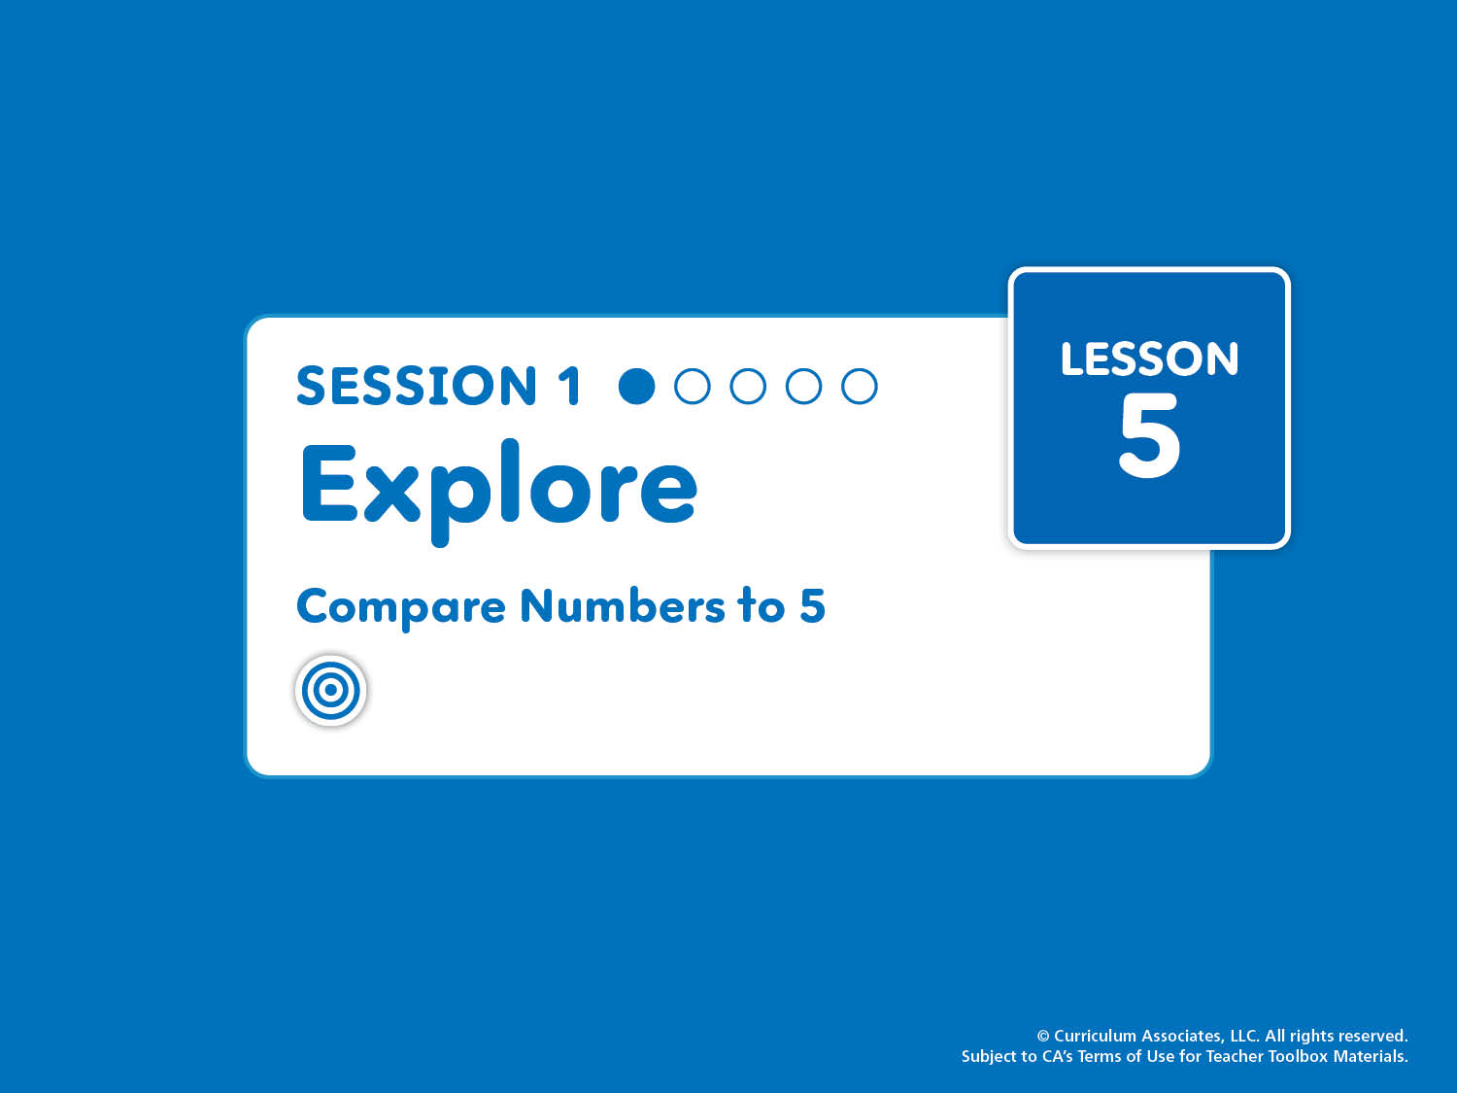
Lesson 5, Session 1: Explore
Compare Numbers to 5
Compare groups of objects and numbers up to 5. Recognize that each counting number is one more than the last.
Notes:
Purpose
Explore the concepts of more, less, and same.
Explore comparing quantities visually and physically.
Math Toolkit
Make available for use at any time in the lesson:
Counters
Connecting cubes
5-Frames Workmat

Slide 2
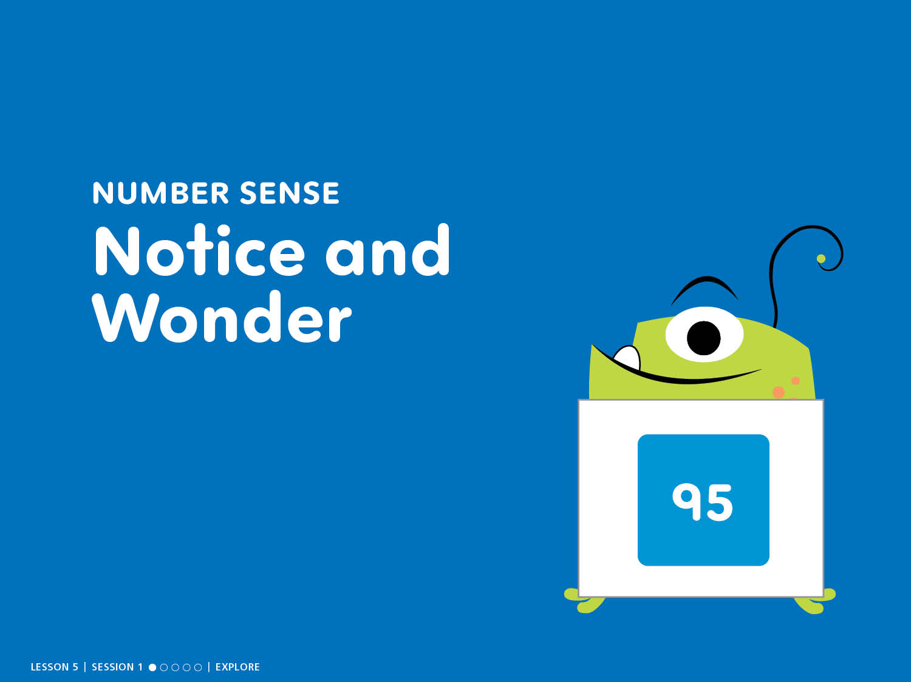
NUMBER SENSE
Notice and Wonder
Notes:
START: Number Sense – Teacher’s Guide page 95
Notice and Wonder
ASK: What do you notice? What do you wonder?
Counting Tip
RHYME AND COUNT (chant) Groups of 10 can help us see from zero to infinity! Have children count orally by 10s to 100 as they flash 10 fingers with each number. Repeat the count 2 or 3 times.

Slide 3
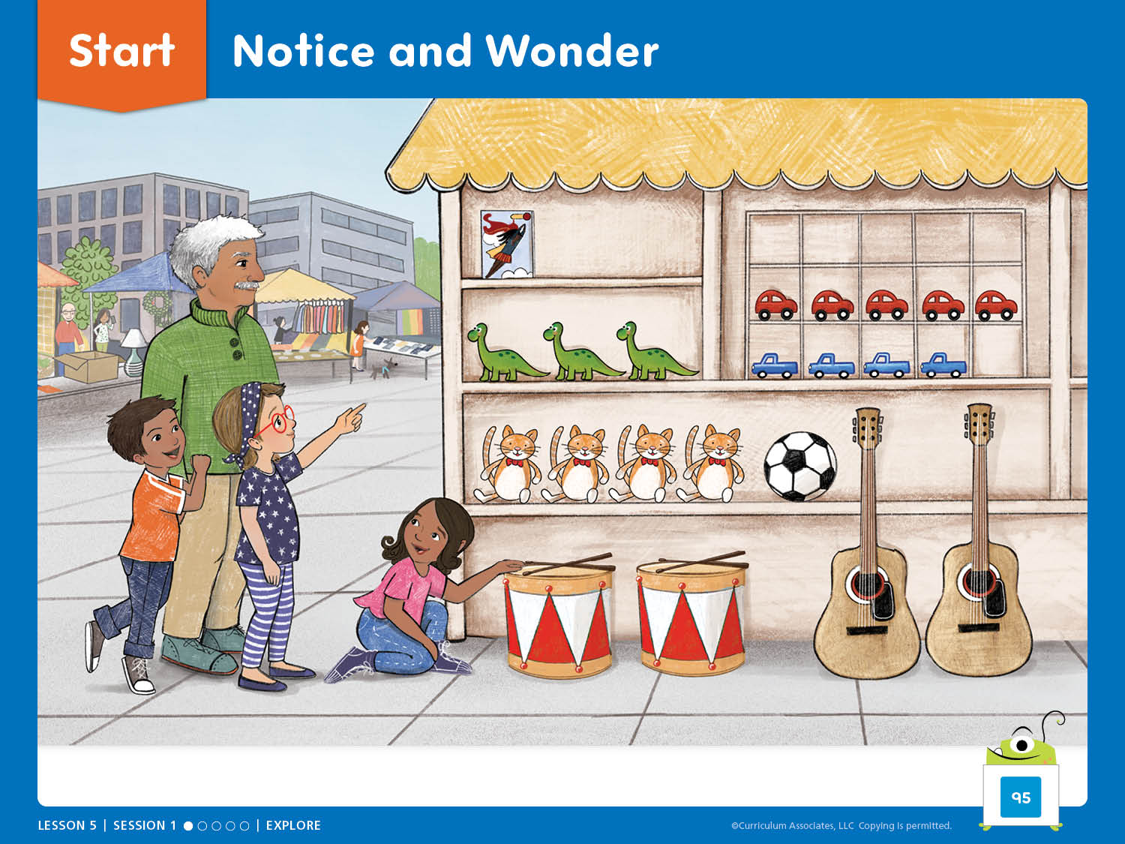
Start: Notice and Wonder
What do you notice? What do you wonder?
Notes:
START: Number Sense – Teacher’s Guide page 95
Notice and Wonder
ASK: What do you notice? What do you wonder?
Allow children time to explore the illustration before they share with a partner and then with the class. Accept all responses.
To support vocabulary, have children identify these items in the illustration: comic book, guitars.
Facilitate Whole Class Discussion
Encourage children to generate questions for discussion.
Choose two groups of things. How are they the same? How are they different?
Find a group of 3. Describe the group.

Slide 4
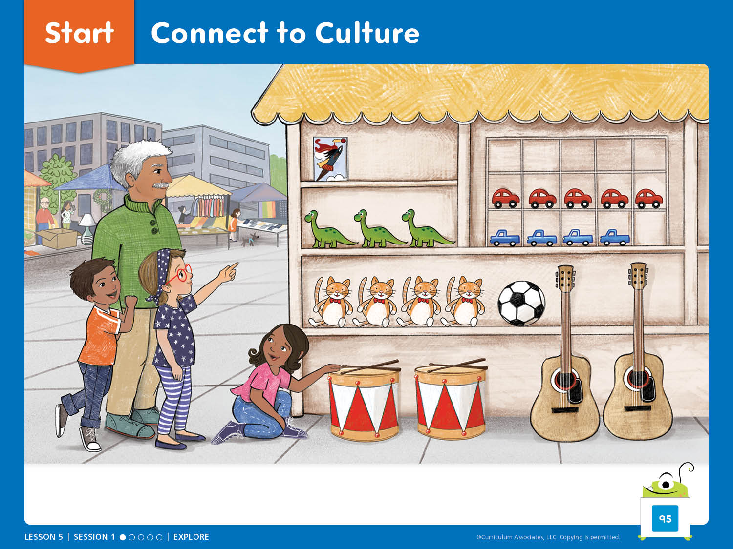
Start: Connect to Culture
What are some places families in our community go to get the things they need and want?
Notes:
Connect to Culture – Teacher’s Guide page 94b
After completing Notice and Wonder, have children share where families in their community get the things they want. Point out that places might be indoors or outdoors.
ASK: What are some places families in our community go to get the things they need and want?
Have children turn and talk with a partner to think of three places families might get food, clothing, etc. Call the class together and make a collaborative T-chart with columns labeled Place, Where (indoor or outdoor), and What We Get.

Slide 5

Discover It
Notes:
Discover It – Teacher’s Guide page 96a
How do you know which pile has more, less, or the same?
Materials (per class)
Connecting cubes (100 red, 100 blue)
Preparation: Place a pile of 2 to 15 connecting cubes on the floor for each child. Each pile should be all red cubes or all blue cubes. Have a pile of 10 red cubes in the middle. Ensure that some piles visibly have more or less than 10 cubes, and some piles have close or equal to 10 cubes.

Slide 6
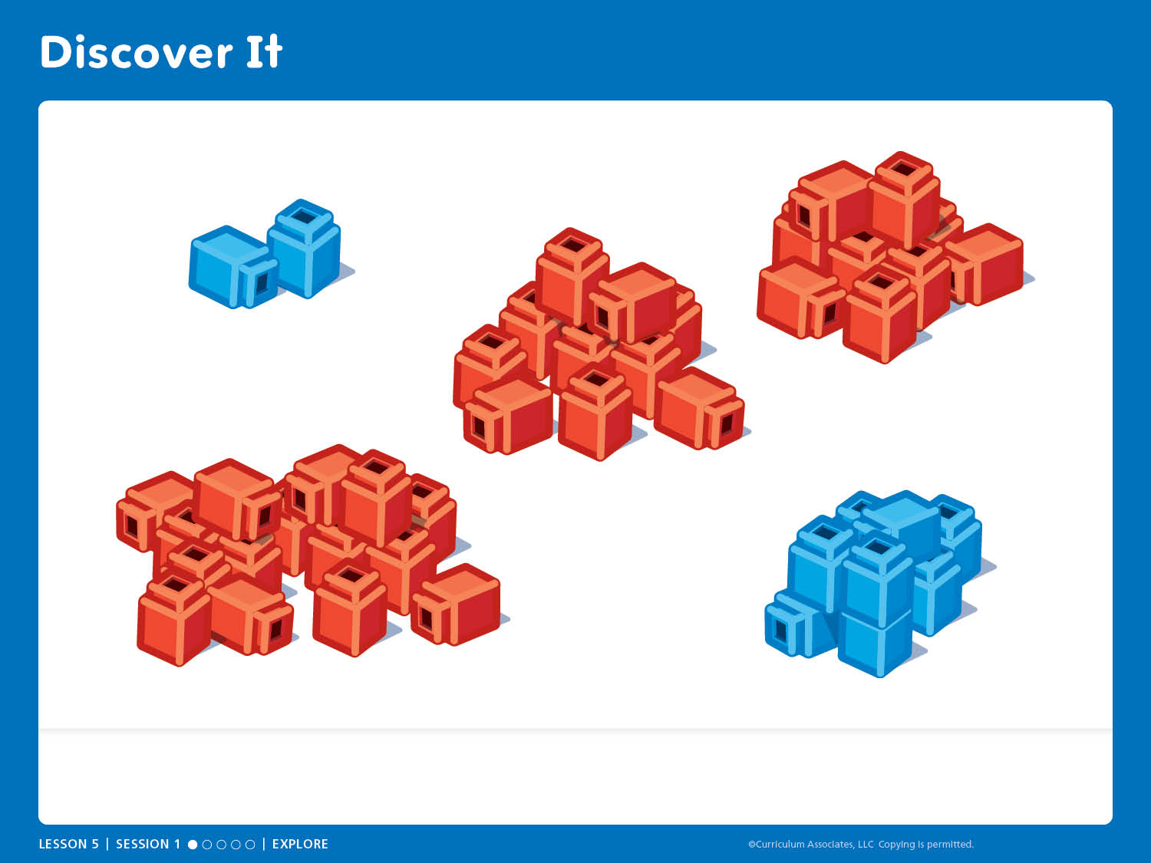
Discover It
Does your pile have more or less than the middle pile? How do you know?
Notes:
Discover It – Teacher’s Guide page 96a
How do you know which pile has more, less, or the same?
Children are visually comparing piles of cubes and deciding whether their pile shows more or less. Later, children will explore length and matching strategies to help them compare.
ASK:
Does your pile have more or less than the middle pile? How do you know?
If you are not sure whether your pile has more or less, how could you decide?
When could it be important to compare groups, or to know if some groups have more, less, or the same as other groups?
Have children make a cube train by connecting all the cubes in their pile to prepare for the Investigate It activity.

Slide 7

Investigate It
Notes:
Investigate It – Teacher’s Guide page 96b
How do you know which cube train shows more, less, or the same?
Materials (per class)
Connecting cubes (5-cube train for display; red and blue cube trains made during Discover It)
Crayons (1 red, 1 blue per child)
Preparation: Prepare a 5-cube red train for demonstration. Make sure each child has made a cube train by connecting all the cubes in their pile from the previous Discover It activity.

Slide 8
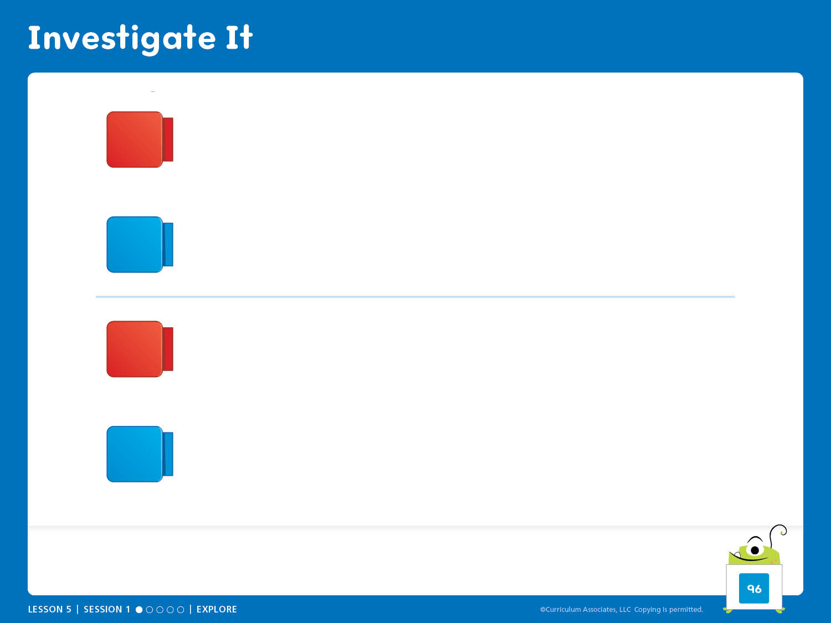
Investigate It
How did you decide if a cube train shows more, less, or
the same?
Notes:
Investigate It – Teacher’s Guide page 96b
How do you know which cube train shows more, less, or the same?
ASK:
How did you and you partner decide who had more and who had less?
Does [child name] have a cube train that shows more or less than mine, or are they the same? How do you know?
Why can there be more than one cube train that shows less (or more)?
Can you find a cube train that is less than 1 cube? Why or why not?
How did you compare the cube trains? How did you decide which trains show more, less, or the same?
Uncover Thinking
When children think the trains are the same, ask them how they can check. Encourage them to use a method other than the one they originally chose in order to see if they arrive at the same conclusion.

Slide 9
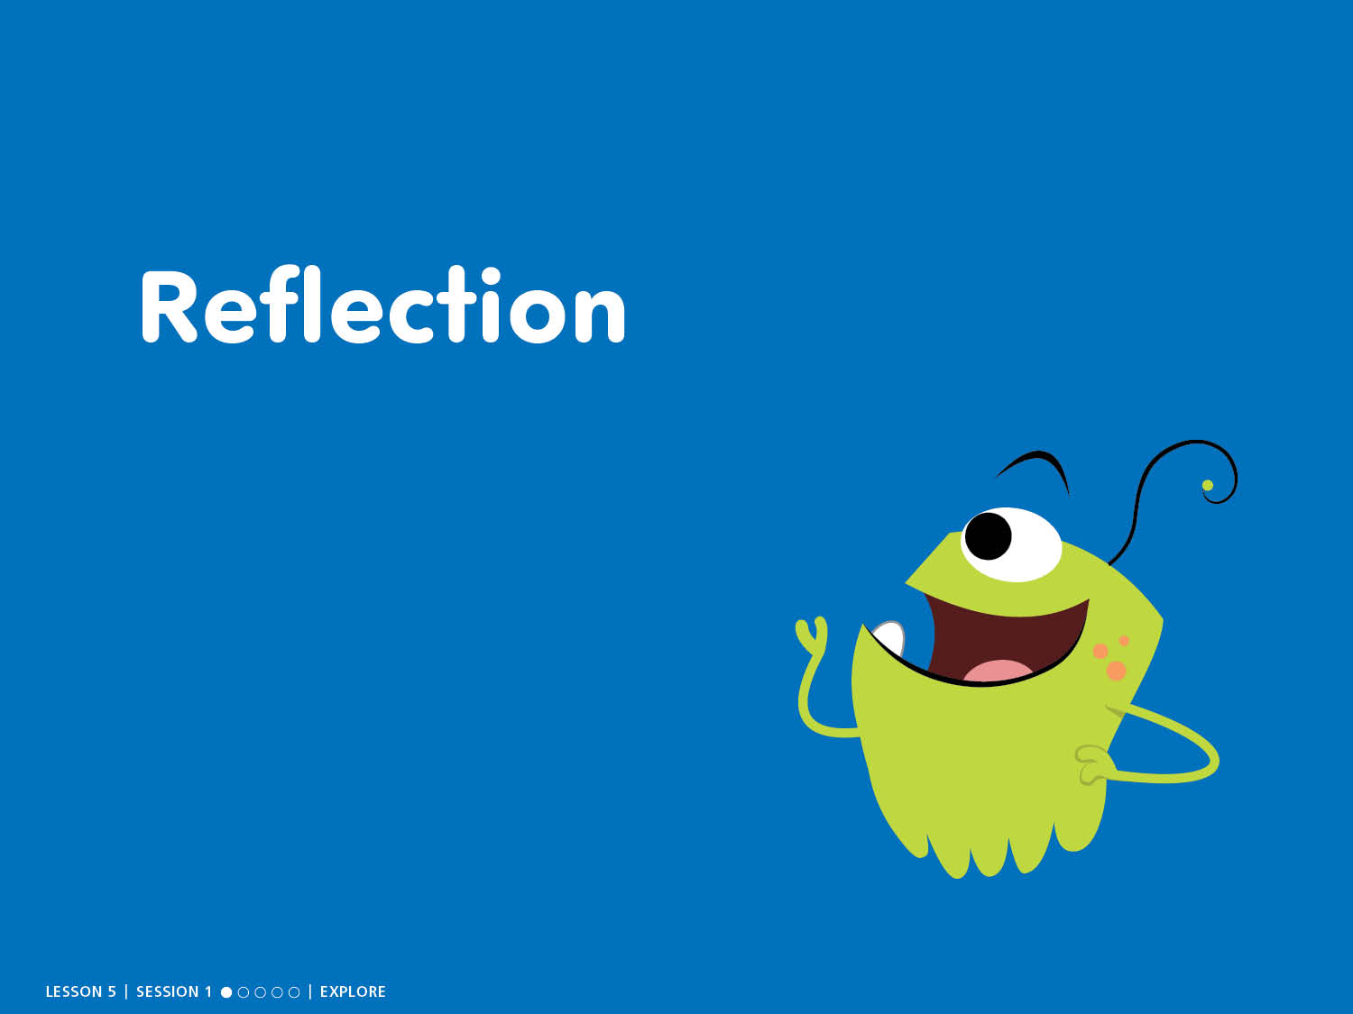
Reflection

Slide 10
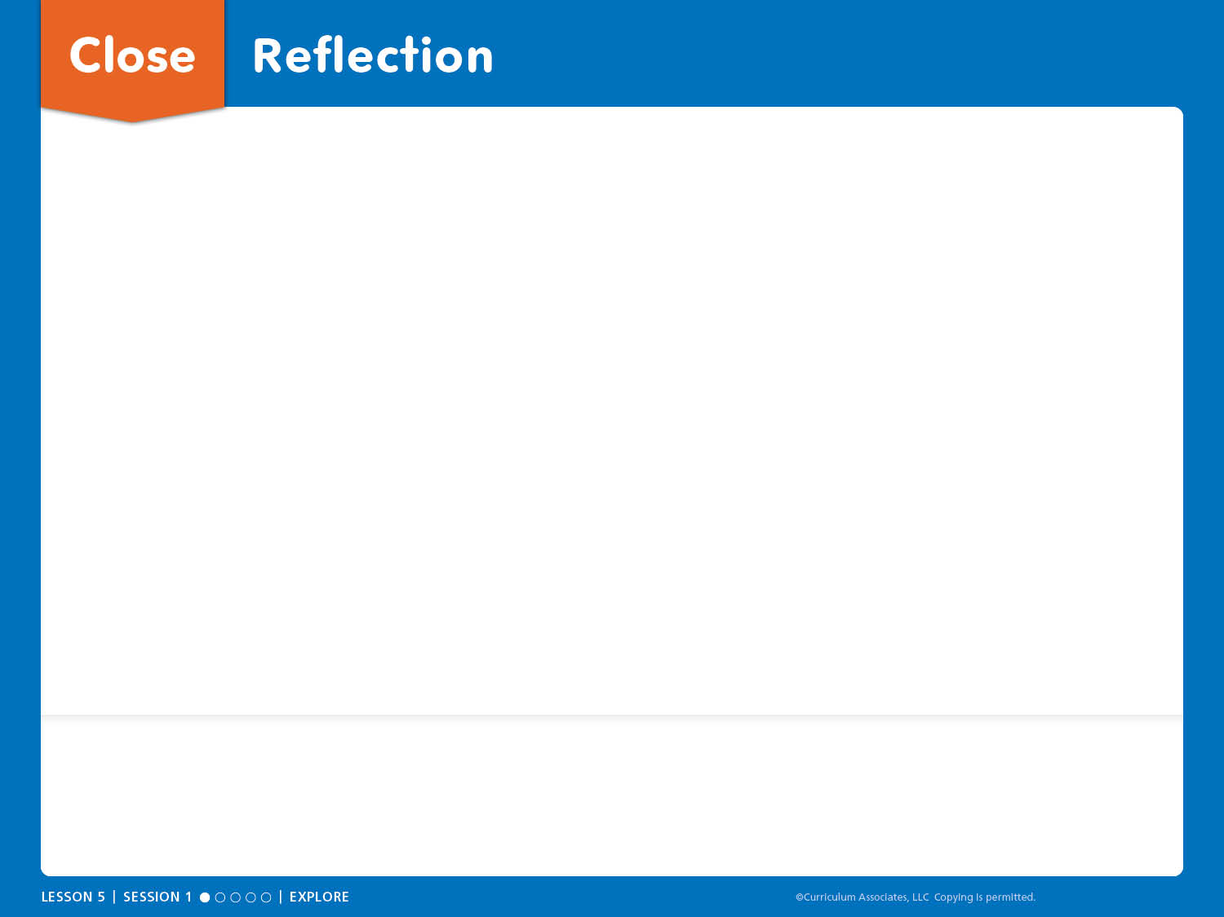
Close: Reflection
I learned . . .
I think . . .
I wonder . . .
MATH REFLECTION Was it easier to compare the piles or the trains? Why?
SELF REFLECTION Organization: What does it look like when things are neat and organized? What did you do to organize your connecting cubes?

Slide 11
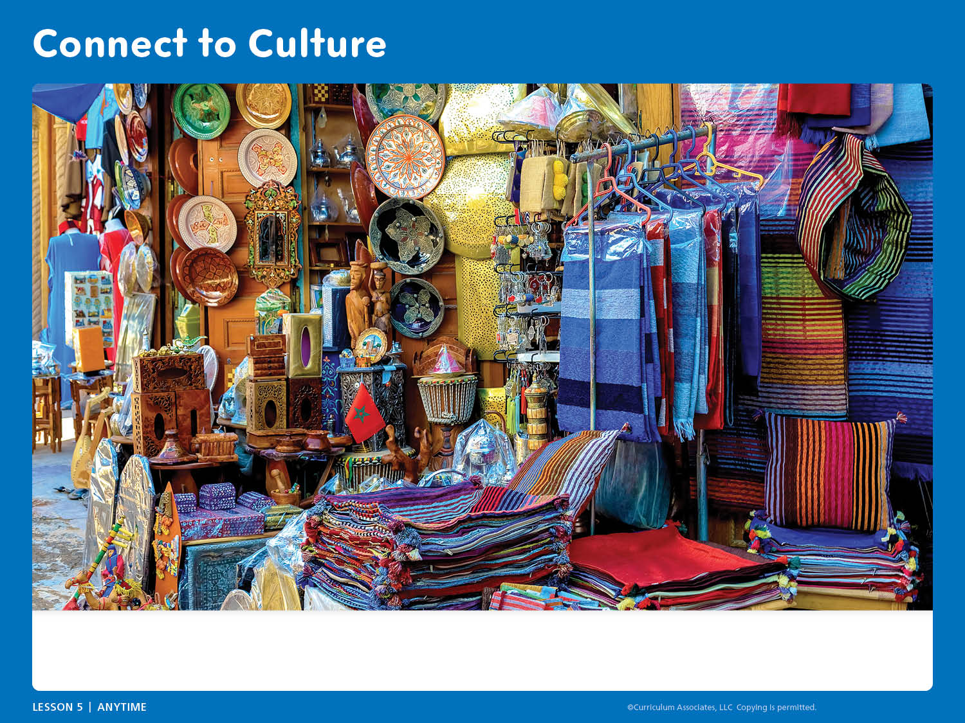
Connect to Culture
What do you notice? What questions do you have about markets where you live and in other places?
Notes:
Connect to Culture – Teacher’s Guide page 94b
ANYTIME DURING THE LESSON
During read-aloud or other whole class times, guide an exploration of different kinds of markets based on children’s questions and curiosity.
Show children the slide.
ASK: What do you notice? How is this market the same or different from markets you have seen?
Share that this is a market in Morocco, called a souk.
ASK: What do you wonder? What questions do you have about markets where you live and in other places?
Use videos, online searches, books, and information from children and families to explore kinds of markets.

