Slide 1
SESSION 2
Develop
Understanding of the Number of Solutions to a System of Linear Equations
Learning Targets
Understand what it means to solve a system of equations.
Use a graph or table to identify the solution to a system of linear equations.
Use a graph to determine the number of solutions to a system of linear equations.
LESSON 12 • Understand Systems of Linear Equations in Two Variables
Notes:
Purpose
Develop the idea that a system of linear equations can have exactly one solution, no solution, or infinitely many solutions.
Understand that the number of solutions a system has can be determined by examining the graph or the equations of the system.
Error Alert In this lesson, watch for students who:
confuse x- and y-coordinates when graphing equations.
misinterpret situations in which there are infinitely many solutions as having no solutions.
misrepresent given information about rates and initial values when writing equations to represent real-world scenarios.

Slide 2
Start
Which One Doesn’t Belong?
y = 3x – 4
y = 2x – 4
A
B
C
D
3x – y = 5
2 + 0.5y = 1.5x
Notes:
START (Teacher’s Guide page 275)
WHY? Reinforce the connection between a linear equation and key features of its graph.
Consider providing a sentence starter to help students express their thinking:
_______ does not belong because _______.
Possible Solutions
B is the only equation whose graph has a slope that is not 3.
C is the only equation whose graph does not cross the y-axis at (0, –4).
D is the only equation with decimal coefficients.

Slide 3
Model It
You have seen that a solution to a system of equations is represented on its graph as a point of intersection. The ordered pair for this point makes both equations true.
a. Graph the system y = x + 2 and y = x – 1.
b. Does this system have a solution? How do you know?
275
Notes:
As students complete problems 1–2, have them identify that a system of linear equations has no solution if the lines do not intersect.
Common Misconception If students think the lines could intersect eventually, ask them to identify the slopes. Have them explain what it means when two lines have the same slope and different y-intercepts. [the lines are parallel and do not intersect]

Slide 4
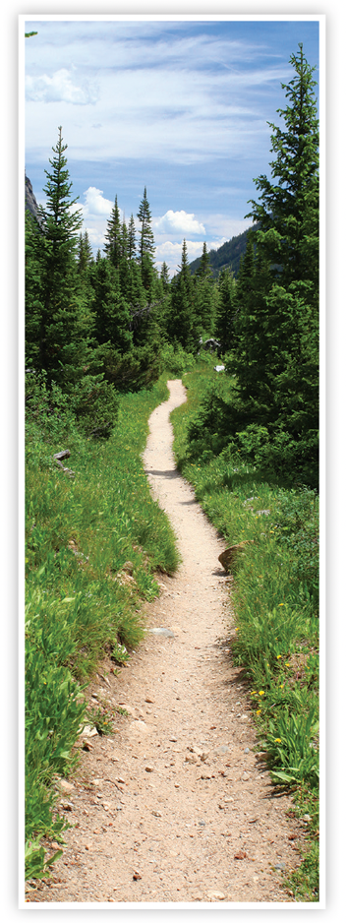
CONNECT TO CULTURE Optional
The Appalachian National Scenic Trail is a marked hiking trail that extends from Maine to Georgia. The full trail passes through 14 states and is approximately 2,200 miles long, which is about 5,000,000 steps.
What do you think is the farthest distance you have hiked in a single day?
Notes:
Connect to Culture (Teacher’s Guide page 269c)
Engage students in sharing what they know about the context before you add the information given here.
Ask if any of your students have hiked all or part of the Appalachian Trail or know someone who has. Invite them to share their experiences with the class. The Appalachian National Scenic Trail is a marked hiking trail that extends from Maine to Georgia. The full trail passes through 14 states and is approximately 2,200 miles long, which is about 5,000,000 steps. People who hike the entire trail within a calendar year are called thru-hikers, and most take about 6 months to complete their journey. Ask students to estimate the farthest distance they have hiked in a single day.

Slide 5
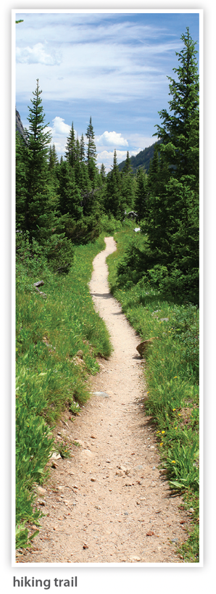
Model It
Charlotte and Paloma both hike the same trail at the same rate. Charlotte starts to hike first. The graph shows each girl’s distance along the trail for the first 40 minutes of Paloma’s hike.
a. Does Paloma catch up to Charlotte? How do you know?
b. Look at the system of equations. How can you tell by looking at the equations that the system has no solution?
Paloma: d = 50t
Charlotte: d = 50t + 500
275

Slide 6
Ask: How are the equations of the system in problem 1 like the equations of the system in problem 2?
Share: I can tell there is no solution if . . .
275
Notes:
Support Partner Discussion
After students complete problems 1 and 2, have them respond to Discuss It with a partner. Support as needed with questions such as:
The equations in each system are in the form y = mx + b. How do the values of m compare? How do the values of b compare?
What do the values of m and b tell you about how the lines are related?
Facilitate Whole Class Discussion
For each problem, have students talk about how the graph and equations of the system indicate that the system has no solution.
ASK How does the graph show that the system of equations has no solution?
LISTEN FOR The lines never intersect, so there is no point that lies on both lines.
ASK How could you use the equations to predict that the system has no solution?
LISTEN FOR The equations are in slope-intercept form, so I can identify the slope and y-intercept. The lines have the same slope and different y-intercepts, so they are different lines, and they are parallel. This means the system has no solution.

Slide 7
Model It
The graph of the equation y – 1 = 2x is shown.
a. Graph the equation y = 2x + 1 in the same coordinate plane to represent a system.
b. At which point(s) do the two lines intersect?
c. How many ordered pairs are solutions of the system? Explain.
276
Notes:
As students complete problem 3, have them compare the equations as well as the graphs. Students can make a table of values or rewrite the equation y – 1 = 2x in slope-intercept form to confirm that both equations represent the same line.

Slide 8
Ask: Suppose Charlotte and Paloma start at the same time in problem 2. Why would the system representing this context have infinitely many solutions?
Share: I can tell there are infinitely many solutions if . . .
276
Notes:
Support Partner Discussion
After students complete problem 3, have them respond to Discuss It with a partner. Support as needed with questions such as:
How would the equations change to model the new situation? How would the graphs change?
Facilitate Whole Class Discussion
Have students discuss strategies for comparing the equations in a system. Encourage them to add reasons or examples to ideas they agree with during discussion.
ASK How could you predict that a system will have infinitely many solutions without graphing?
LISTEN FOR I can write the equations in slope‑intercept form. If both equations have the same slope and the same y-intercept, then they represent the same line. The system will have an infinite number of solutions.

Slide 9
Look at problems 1–3. In each system of equations, both lines have the same slope. Can two lines with the same slope ever intersect at exactly one point? Explain.
276
Notes:
Student responses should show understanding that lines with the same slope are either different parallel lines or the same line.

Slide 10
Close: Exit Ticket
What values of m and b will result in a system with no solution?
y = 4x + 5
y = mx + b
276
Notes:
Look for understanding that for the system to have no solution, the lines must have the same slope but different y-intercepts.
Error Alert If students choose m and b so that the two equations have the same y-intercept and different slopes, have them sketch the graphs of the equations of the system they have created. They should observe that the lines intersect at the y-intercept, so the system has one solution. Ask students what m and b indicate about the line and what values of m and b would guarantee that the two lines do not intersect.

Slide 11
Practice
Example
How many solutions does each system of
equations have?
a.
b. y = 7x + 3
y = 7x
a. The lines intersect at one point. There is exactly one solution.
b. y cannot equal both 7x + 3 and 7x at the same time. There is no solution.
277

Slide 12
Practice
Look at the graph in the Example. What is the solution of the system shown in the graph?
277

Slide 13
Practice
Find a value for m that will give you a system of equations with exactly one solution.
y = 6x + 1
y = mx + 1
277

Slide 14
Practice
Find a value for b that will give you a system of equations with no solution.
y = 6x + 1
y = 6x + b
277

Slide 15
Practice
Draw a line in each coordinate plane so that the lines represent a system of equations with the given number of solutions.
a. no solution
b. exactly one solution
c. infinitely many solution
277

Slide 16
Practice
Use the equations below.
y = 4x + 2 y = 9x + 2 y = 9x + 5
a. Use two of the equations to write a system of equations with exactly one solution.
b. Use two of the equations to write a system of equations with no solution.
278

Slide 17
Practice
Tell whether each system of equations has no solution, one solution, or infinitely
a. y = x
–y = –x
b. y = 3x
y = 3x – 10
c. y = x
y = 2x
278

Slide 18
Practice
Four friends plan to meet at the top of the Eiffel Tower. Each arrives about the time the tower opens and starts climbing the stairs to the top. The graphs show the number of stairs each has climbed, s, in the m minutes since the tower opened. Tell how many solutions each system has. What does each solution mean in this context?
a.
b.
278

Slide 19
Take a moment to think on your own.
Notes:
Individual Think Time (10 seconds to 2 minutes)
Provide students a short time to think about a question or problem before discussing with a partner, a small group, or the whole class.
Three Reads
After each read, provide students with think time to read the question and consider their answer.
Connect It
Give students think time before discussing as a class.
Facilitate Whole Class Discussion
After each strategy, allow individual think time for students to process the ideas.
Understand lessons
Model It
Read the problem and allow students plenty of think time to determine their answer.

Slide 20
Turn and talk with your partner about . . .
Notes:
Turn and Talk (30 seconds to 1 minute)
Give students a purpose, prompt, or product so that they know what to talk about and why.

Slide 21
REPEAT
Restate the idea to give everyone a chance to hear it, or hear it again.
Notes:
Four Rs: Repeat
Use one or a combination the Four Rs to support students in processing information and to facilitate classroom discussion.

Slide 22
REPHRASE
Restate the idea in your own words.
Notes:
Four Rs: Rephrase
Use one or a combination the Four Rs to support students in processing information and to facilitate classroom discussion.

Slide 23
REWORD
Restate the idea using academic or mathematical language.
Notes:
Four Rs: Reword
Use one or a combination the Four Rs to support students in processing information and to facilitate classroom discussion.

Slide 24
RECORD
Record ideas using words, numbers or pictures.
Notes:
Four Rs: Record
Record students’ ideas for reference. Use words, numbers, or pictures.

Slide 25
THREE READS
Read 1: What is the problem about?
Read 2: What are you trying to find out?
Read 3: What information is important?

Slide 26
CO-CRAFT QUESTIONS
What is the problem about?
What questions can you ask that mathematics can answer?

Slide 27
NOTICE AND WONDER
What do you notice?
What do you wonder?

Slide 28
SAY IT ANOTHER WAY
How would you say this problem in your own words?

