Slide 1
SESSION 1
Explore
Systems of Linear Equations in Two Variables
Learning Targets
Understand what it means to solve a system of equations.
Use a graph or table to identify the solution to a system of linear equations.
Use a graph to determine the number of solutions to a system of linear equations.
LESSON 12 • Understand Systems of Linear Equations in Two Variables
Notes:
Purpose
Explore using a graph or a table to find the solution(s) common to two linear equations.
Understand that the solution of a system of equations is represented by the point(s) where the graphs of the equations intersect.
Error Alert In this lesson, watch for students who:
confuse x- and y-coordinates when graphing equations.
misinterpret situations in which there are infinitely many solutions as having no solutions.
misrepresent given information about rates and initial values when writing equations to represent real-world scenarios.

Slide 2
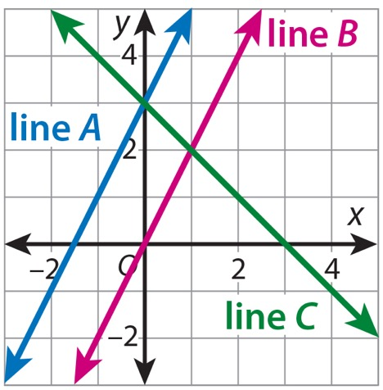
Start
Same and Different
Notes:
START (Teacher’s Guide page 271)
WHY? Prepare students to explore graphs of systems of linear equations by identifying slopes and y-intercepts of lines.
Consider providing sentence starters to help students express their thinking:
_______ is/are different because _______.
_______ is/are the same because _______.
Possible Solutions
Lines A and B have the same slope but different y-intercepts.
Lines A and C have different slopes but the same y-intercept.
Lines B and C have different slopes and different y-intercepts.

Slide 3
Pose the Question
UNDERSTAND: What does it mean to
solve a system of linear equations?
271

Slide 4
CONNECT TO CULTURE Optional
Schools and libraries often have reading contests to encourage students to improve their reading skills as they explore different types of books. In these contests, students record how many pages or how many books they have read.
What was the best thing you discovered about reading when you participated in a reading contest?
Notes:
Connect to Culture (Teacher’s Guide page 269c)
Engage students in sharing what they know about the context before you add the information given here.
Schools and libraries often have reading contests to encourage students to improve their reading skills as they explore different types of books. In these contests, students record how many pages or how many books they have read. Invite students to talk about a time that they tracked the number of pages or books they read over a certain time period. If students have participated in a reading contest, ask them to share the best thing they discovered about reading.

Slide 5
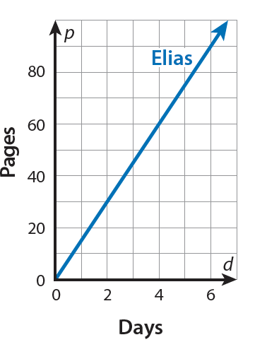
Model It
Elias reads 15 pages of a book in braille each day. The graph of p = 15d shows how many pages, p, Elias reads in d days.
a. Before Elias starts reading, Jaime has already read 20 pages of the same book in braille. Jaime then reads 10 pages each day. The equation p = 10d + 20 tells how many pages, p, Jaime has read since Elias started reading. Graph Jaime’s equation in the same coordinate plane as Elias’s graph. What point is on both lines?
b. On what day have both Elias and Jaime read the same number of pages? How many pages have they read on that day? Use your answer to problem 1a to explain.
271
Notes:
As you work on problems 1–2, tell students that they are going to use what they know about graphs of linear equations to investigate the solutions to systems of linear equations. Read the problems and call on students to rephrase them to confirm understanding. Have students turn and talk about how the equations of the lines and their graphs are related.
Error Alert If students get the wrong point of intersection, then they may have graphed the equations incorrectly or imprecisely. Review how to identify the slope and y-intercept from a linear equation and how to use these values to graph the line. Encourage use of a straightedge for better precision. Remind students that the process is the same when variables other than x and y are used.

Slide 6
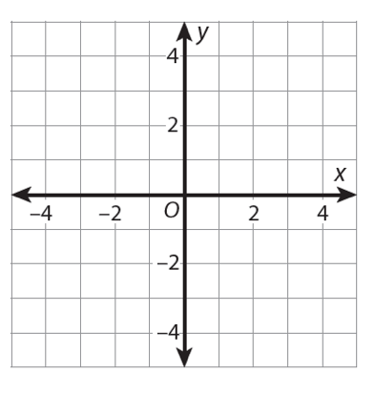
Model It
The related equations in problem 1 for which you found a common solution form a system of linear equations. You can graph the equations in a system to see if the lines intersect. Any point that is common to both lines represents a solution to the system of equations. This means that the ordered pair for this point makes both equations in the system true.
a. Graph the equations y = x + 2 and y = –x. Where do the lines intersect?
b. You cannot always know the exact coordinates of a point of intersection from a graph. How can you be sure that the point you identified in problem 2a is a solution to the system?
271

Slide 7
Ask: What can the graph of a system of equations tell you?
Share: Seeing the graphs of the equations is helpful because . . .
271
Notes:
Support Partner Discussion
After students complete problems 1 and 2, have them respond to Discuss It with a partner. Encourage them to think about what the graphs of the equations represent.
Listen for understanding that:
the line for each equation represents all the ordered pairs—(d, p) for problem 1 and (x, y) for problem 2—that make the equation true.
the point of intersection is on both lines, so its ordered pair makes both equations true.
Facilitate Whole Class Discussion
Have students look back at the graph for problem 1 and think about what information the graph reveals about the situation.
ASK For which days is Jaime’s line above Elias’ line? What does this mean?
LISTEN FOR Jaime’s line is above Elias’ line for days 0, 1, 2, and 3. This means that Jaime has read more pages than Elias on those days.

Slide 8
Model It
Another way to find a solution to a system of equations is to list ordered pairs that make each equation in the system true. An ordered pair that makes both equations true is a solution to the system.
Look at the system of equations below.
y = 2x
y = x – 1
a. Complete the table. For each equation, find the y-value for each x-value. What is the solution to the system of equations? How do you know?
x | –4 | –3 | –2 | –1 | 0 | 1 | 2 | 3 | 4
y = 2x | –8
y = x – 1 | –5
272
Notes:
As you work on problems 3, tell students that they will now think about using a table to find the solution to a system of linear equations. Prompt students to discuss how finding the solution using a table is similar to and different from using a graph.
Error Alert If students complete the table and think the solution of the system is (–2, –2), then ask them to read the labels for each row. Remind students that the second and third row each name y-coordinates of points that have the same x-coordinate, which is named in the first row.

Slide 9
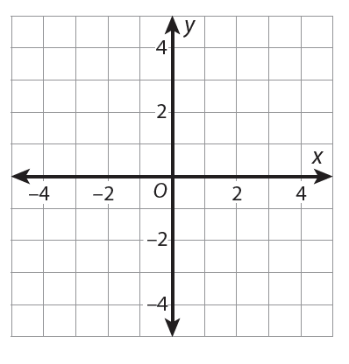
Model It
Another way to find a solution to a system of equations is to list ordered pairs that make each equation in the system true. An ordered pair that makes both equations true is a solution to the system.
Look at the system of equations below.
y = 2x
y = x – 1
b. Graph the system of equations to check that your answer to problem 3a is reasonable.
272

Slide 10
Ask: How does using a table help you find the solution to a system of equations?
Share: Using a table is different from using a graph because . . .
272
Notes:
Support Partner Discussion
After students complete problem 3a, have them respond to Discuss It with a partner. Encourage them to compare graphing and using a table.
Listen for understanding that:
when using a table to find a solution, you look for an x-value that has the same y-value for both equations.
a table shows only some of the ordered pairs that are solutions of each equation, while a graph represents all solutions.
Facilitate Whole Class Discussion
Prompt students to talk about using graphs and tables to identify solutions to systems of equations.
ASK What do you think are the advantages and disadvantages of using a table to find the solution to a system of equations? What do you think are the advantages and disadvantages of using a graph?
LISTEN FOR A table shows exact values, but the system’s solution may not be listed. The graph represents all solutions for each equation, but the solution of the system is an estimation, and you need to check that it makes both equations true.

Slide 11
Close: Exit Ticket
Reflect How is the solution to the system of equations in problem 3 related to the solutions of the individual equations y = 2x and y = x – 1?
272
Notes:
Look for understanding that the solution of a system is a solution of each of the individual equations.
Common Misconception If students think they can always identify an exact solution by graphing, then explain that sometimes the solution point will be between grid lines and must be estimated. Encourage students to always check a solution they find by graphing by substituting it into both equations.

Slide 12
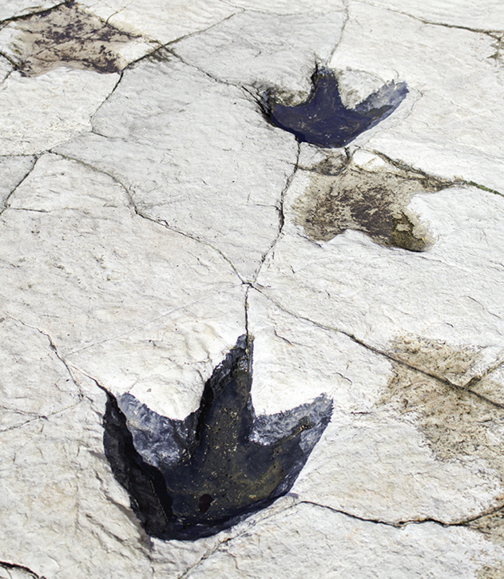
Real-World Connection
Paleontologists have discovered fossilized remains of dinosaur footprints, called trackways, preserved in rock. By using the lengths of the footprints and the distance between them, scientists can approximate how fast a dinosaur was moving when the tracks were made.
When might systems of linear equations be useful?
Notes:
Real-World Connection (Teacher’s Guide page 273)
Read the real-world example below. Then ask students to think of other real-world examples when systems of linear equations might be useful.
Paleontologists have discovered fossilized remains of dinosaur footprints, called trackways, preserved in rock. By using the lengths of the footprints and the distance between them, scientists can approximate how fast a dinosaur was moving when the tracks were made. By writing and solving systems of equation for two different sets of prints, scientists can hypothesize about whether one dinosaur would have been able to catch up to another. Ask students to think of other real-world examples in which systems of linear equations might be useful.

Slide 13
Vocabulary
What Is It?
What I Know About It
linear
equation
Examples
Examples
273
Notes:
Students should understand that a linear equation is an equation whose graph is a straight line. Student responses might include different forms of linear equations. Students may recognize that most linear equations can be written in slope-intercept form and that this form is useful for graphing the equation.

Slide 14
Practice
Graph the linear equation y = x – 2.
273

Slide 15
Practice
The graph of the system of linear equations below is shown in the coordinate plane.
4y = –3x – 1
2y = x – 13
Why is the point (5, –4) a solution to the system?
274

Slide 16
Practice
a. Graph the following system of equations.
y = –3x
y = x + 4
b. What does the graph show to be the solution of the system?
274

Slide 17
Practice
DeAndre and his sister Asha make origami cranes. Their goal is to complete 1,000 cranes by the end of the summer.
DeAndre already has 30 cranes and makes 5 more each day.
Asha already has 10 cranes and makes 15 more each day.
The graph shows how many cranes, c, each person has made after d days.
a. What does the graph show to be the solution of the system?
b. What does the solution mean in this context?
274

Slide 18
Take a moment to think on your own.
Notes:
Individual Think Time (10 seconds to 2 minutes)
Provide students a short time to think about a question or problem before discussing with a partner, a small group, or the whole class.
Three Reads
After each read, provide students with think time to read the question and consider their answer.
Connect It
Give students think time before discussing as a class.
Facilitate Whole Class Discussion
After each strategy, allow individual think time for students to process the ideas.
Understand lessons
Model It
Read the problem and allow students plenty of think time to determine their answer.

Slide 19
Turn and talk with your partner about . . .
Notes:
Turn and Talk (30 seconds to 1 minute)
Give students a purpose, prompt, or product so that they know what to talk about and why.

Slide 20
REPEAT
Restate the idea to give everyone a chance to hear it, or hear it again.
Notes:
Four Rs: Repeat
Use one or a combination the Four Rs to support students in processing information and to facilitate classroom discussion.

Slide 21
REPHRASE
Restate the idea in your own words.
Notes:
Four Rs: Rephrase
Use one or a combination the Four Rs to support students in processing information and to facilitate classroom discussion.

Slide 22
REWORD
Restate the idea using academic or mathematical language.
Notes:
Four Rs: Reword
Use one or a combination the Four Rs to support students in processing information and to facilitate classroom discussion.

Slide 23
RECORD
Record ideas using words, numbers or pictures.
Notes:
Four Rs: Record
Record students’ ideas for reference. Use words, numbers, or pictures.

Slide 24
THREE READS
Read 1: What is the problem about?
Read 2: What are you trying to find out?
Read 3: What information is important?

Slide 25
CO-CRAFT QUESTIONS
What is the problem about?
What questions can you ask that mathematics can answer?

Slide 26
NOTICE AND WONDER
What do you notice?
What do you wonder?

Slide 27
SAY IT ANOTHER WAY
How would you say this problem in your own words?

