Slide 1
SESSION 1
Explore
Unit Rates
Learning Targets
Use division to find unit rates.
Use unit rates to find equivalent ratios and compare ratios.
Use unit rates to convert measurement units.
LESSON 16 • Use Unit Rates to Solve Problems
Notes:
Purpose
Explore the idea that a rate contains information about equivalent ratios.
Understand that equivalent ratios have the same unit rate.
Error Alert In this lesson, watch for students who:
reverse the quantities in equivalent ratios.
miscalculate the unit rate from an equivalent ratio, or vice versa.
confuse multiplication and division when converting between measurement units.

Slide 2
Start
Which Would You Rather?
Run for . . .
mile 5 times per week
$$\text{miles}$$
3 times per week
A
B
C
mile
7 times per week
Notes:
START (Teacher’s Guide page 359)
WHY? Support students’ understanding of comparing ratios and rates.
Consider providing a sentence starter to help students express their thinking:
I would rather ________ because ________.
Possible Solutions
A because it is the least mileage per week.
B because it is the fewest number of times to run.
C because it is healthy to exercise every day.

Slide 3
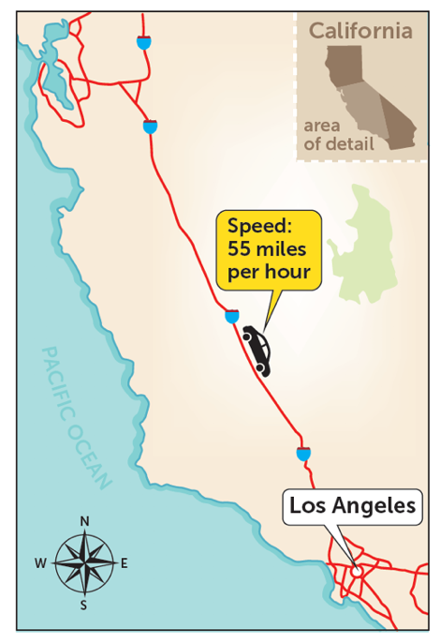
CONNECT TO CULTURE Optional
The speed limit is the maximum legal speed that a vehicle can drive on the road. In 1901, Connecticut was the first state to adopt a speed limit law.
What are some pros and cons of raising the speed limit on roads in your community?
Notes:
Connect to Culture (Teacher’s Guide page 357c)
Engage students in sharing what they know about the context before you add the information given here.
The speed limit is the maximum legal speed that a vehicle can drive on the road. In 1901, Connecticut was the first state to adopt a speed limit law. The maximum speed was 12 miles per hour (mph) on city roads and 15 mph on country roads. At that time, the driving experience was much different than it is now. Horse-drawn buggies were still widely used and shared the roads with cars—a luxury reserved for wealthy families. Cars had no seatbelts or lights. Roads did not have stop signs or lines distinguishing separate lanes. As the technologies for both cars and roads have advanced, speed limits have risen. Ask students to generate a list of pros and cons for raising the speed limit on roads in their community.

Slide 4
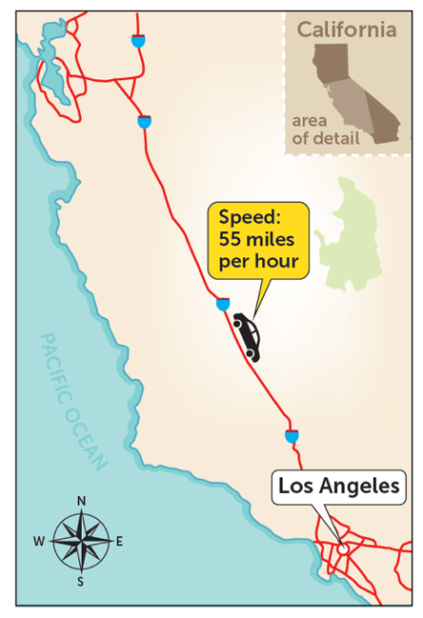
Make sense of the problem
Chloe is driving on the freeway. She is 200 miles from Los Angeles. She drives at a constant speed of 55 miles per hour.
How would you say this problem in your own words?
359
Notes:
Say It Another Way
Listen for understanding that Chloe is driving at a constant speed and wants to know if she can reach her destination in less than 3 1/2 hours.

Slide 5
Make sense of the problem
Chloe is driving on the freeway. She is 200 miles from Los Angeles. She drives at a constant speed of 55 miles per hour. Can Chloe get to Los Angeles in less than
hours?
What information is important based on what you need to find?
359

Slide 6
Solve and support your thinking
Chloe is driving on the freeway. She is 200 miles from Los Angeles. She drives at a constant speed of 55 miles per hour. Can Chloe get to Los Angeles in less than
hours?
Math Toolkit double number lines, grid paper
359

Slide 7
Share your thinking with a partner
Ask: How is your strategy similar to mine? How is it different?
Share: My strategy is similar to yours because . . . It is different because . . .
359
Notes:
Common Misconception Listen for students who identify 192 1/2 miles as the distance Chloe can travel in 3 1/2 hours but conclude that since the distance is less than 200, the time to reach the destination would also be less. As students share their strategies, ask them to apply their reasoning to explain the steps they used to solve the problem.
Select and Sequence Student Strategies
Select 2–3 samples that represent the range of student thinking in your classroom. Here is one possible order for class discussion:
tables of equivalent ratios that show the number of miles traveled each hour and half hour when moving at a constant speed of 55 miles per hour
(misconception) strategies that identify the distance of 192 1/2 miles in 3 1/ 2 hours but conclude that since the distance is less than 200 miles, the time to reach the destination would be less
double number lines that show the number of miles traveled in 3 1/2 hours when traveling at a constant speed of 55 miles per hour
equations that find the number of miles Chloe can travel in 3 1/2 hours when traveling at a constant speed of 55 miles per hour

Slide 8
Compare class strategies
Chloe is driving on the freeway. She is 200 miles from Los Angeles. She drives at a constant speed of 55 miles per hour. Can Chloe get to Los Angeles in less than
hours?
359
Notes:
Call on students to share selected strategies. Prompt students to describe what they noticed or assumed about the problem, what they decided to do as a result, and why.
Guide students to Compare and Connect the representations. Allow time for students to think by themselves before starting the discussion.
ASK How does [student name]’s strategy use the rate given in the problem?
LISTEN FOR The given rate is 55 miles in 1 hour. Use the rate and equivalent ratios to find how many miles Chloe can drive in 3 1/2 hours.

Slide 9
Make connections and explain your thinking
Look Back Can Chloe get to Los Angeles in
less than hours? Explain.
360
Notes:
Look for understanding that the rate is used to find the distance in miles Chloe can travel in 3 1/2 hours. This distance is then compared with 200 miles to answer the question.

Slide 10
Make connections and explain your thinking
Look Ahead Chloe’s constant speed of 55 miles per hour is a rate. The numerical part of the rate, 55, is called the unit rate.
a. What does the unit rate 55 tell you in this situation?
b. On another trip, Chloe drives at a constant speed of 60 miles per hour. What is Chloe’s unit rate? What does the unit rate tell you?
360
Notes:
Point out that a unit rate is constant. Students should understand that the given ratio of miles to hours, 240 : 4, is equivalent to 60 : 1, so 60 is the unit rate. As students complete the table, they should recognize that when you divide the pairs of numbers in equivalent ratios, the result is the same unit rate.
Ask a volunteer to rephrase the definition of unit rate. Support student understanding by discussing another common rate, such as an hourly wage. A wage of $15 per hour has a unit rate of 15.

Slide 11
Make connections and explain your thinking
Look Ahead Chloe’s constant speed of 55 miles per hour is a rate. The numerical part of the rate, 55, is called the unit rate.
c. The table shows that Chloe travels 240 miles in 4 hours. Complete the equivalent ratios in the first two columns. Where do you see Chloe’s unit rate?
Miles, a | Hours, b
 | 1
 | 2
180
240 | 4 | = 240 4 = 60
d. The third column of the table shows the quotient of the numbers in each equivalent ratio. Complete the third column. What do you notice?
360

Slide 12
Close: Exit Ticket
Reflect How could you use unit rates to help you identify equivalent ratios?
360
Notes:
Look for understanding of how to use a given rate to generate a series of equivalent ratios, as well as understanding that a unit rate is the same for equivalent ratios.
Common Misconception If students divide the units in the wrong order to find and compare unit rates, then remind them to look for the word per in the problem. The quantity that comes before per is typically the dividend and the quantity that comes after is typically the divisor. With the constant speed 55 miles per hour, 55 is the dividend and 1 is the divisor.

Slide 13
Real-World Connection
Builders need to budget the costs for new projects before beginning the physical work. The National Association of Home Builders keeps records on the average cost per square foot for homes across the United States.
When might it be useful to examine rates?
Notes:
Real-World Connection (Teacher’s Guide page 361)
Read the real-world example below. Then ask students to think of other real-world examples when examining rates might be useful.
Builders need to budget the costs for new projects before beginning the physical work. The National Association of Home Builders keeps records on the average cost per square foot for homes across the United States. The cost per square foot is calculated by dividing the cost of the land, materials, and labor used to build the home by the number of square feet of the home. The largest factor that influences a home’s cost per square foot is the value of the land. For example, a home in a major metropolitan area may have a higher land value than a home in a rural area. Ask students to think of other real‑world examples when examining rates might be useful.

Slide 14
Vocabulary
What Is It?
What I Know About It
rate
Examples
Examples
361
Notes:
Students should understand that a rate is a ratio that tells the number of units of one quantity for 1 unit of the other quantity. Student responses may include rates involving miles per gallon or miles per hour because those are familiar rates to many students. Students should recognize that two rates can be written for any ratio relationship, since either number in a ratio can be 1.

Slide 15
Practice
What two rates can you write for the ratios shown by the double number line? What do they tell you?
361

Slide 16
Practice
Deon feeds his Great Dane 62 cups of dog food per week. He has a new bag with
160 cups of dog food.
a. Deon will pick up more dog food at the pet
store in weeks. Will the new bag of food last until then? Show your work.
362
Notes:
Suggest that students use Say It Another Way, asking themselves the following questions to help promote understanding:
How could you paraphrase the text?
Is the paraphrase complete and accurate? If it is not, what is inaccurate or missing?

Slide 17
Practice
Deon feeds his Great Dane 62 cups of dog food per week. He has a new bag with
160 cups of dog food.
b. Check your answer to problem 3a. Show your work.
362

Slide 18
Take a moment to think on your own.
Notes:
Individual Think Time (10 seconds to 2 minutes)
Provide students a short time to think about a question or problem before discussing with a partner, a small group, or the whole class.
Three Reads
After each read, provide students with think time to read the question and consider their answer.
Connect It
Give students think time before discussing as a class.
Facilitate Whole Class Discussion
After each strategy, allow individual think time for students to process the ideas.
Understand lessons
Model It
Read the problem and allow students plenty of think time to determine their answer.

Slide 19
Turn and talk with your partner about . . .
Notes:
Turn and Talk (30 seconds to 1 minute)
Give students a purpose, prompt, or product so that they know what to talk about and why.

Slide 20
REPEAT
Restate the idea to give everyone a chance to hear it, or hear it again.
Notes:
Four Rs: Repeat
Use one or a combination the Four Rs to support students in processing information and to facilitate classroom discussion.

Slide 21
REPHRASE
Restate the idea in your own words.
Notes:
Four Rs: Rephrase
Use one or a combination the Four Rs to support students in processing information and to facilitate classroom discussion.

Slide 22
REWORD
Restate the idea using academic or mathematical language.
Notes:
Four Rs: Reword
Use one or a combination the Four Rs to support students in processing information and to facilitate classroom discussion.

Slide 23
RECORD
Record ideas using words, numbers or pictures.
Notes:
Four Rs: Record
Record students’ ideas for reference. Use words, numbers, or pictures.

Slide 24
THREE READS
Read 1: What is the problem about?
Read 2: What are you trying to find out?
Read 3: What information is important?

Slide 25
CO-CRAFT QUESTIONS
What is the problem about?
What questions can you ask that mathematics can answer?

Slide 26
NOTICE AND WONDER
What do you notice?
What do you wonder?

Slide 27
SAY IT ANOTHER WAY
How would you say this problem in your own words?

