Slide 1
SESSION 2
Develop
Adding Fractions
Learning Targets
Add fractions with the same denominator.
Subtract fractions with the same denominator.
Write a fraction as a sum in more than one way.
LESSON 20 • Add and Subtract Fractions
Notes:
Purpose
Develop strategies for adding fractions with like denominators.
Recognize that adding fractions with like denominators is adding parts from the same whole: the numerators (parts) are added and the denominator (whole) does not change.
Error Alert In this lesson, watch for students who:
add instead of subtracting or vice versa.
add or subtract denominators.
interpret units on the number line incorrectly.

Slide 2
Start
Same and Different
A
B
C
D
Notes:
START (Teacher’s Guide page 417)
WHY? Support students’ facility with adding fractions by adding with unit fractions.
Consider providing sentence starters to help students express their thinking:
_______ is/are different because _______.
_______ is/are the same because _______.
Possible Solutions
All show adding fifths.
A, C, and D have two addends.
B has three addends.
A, B, and D are less than 1.

Slide 3
Make sense of the problem
Francisca and Nahele are painting a fence green. Francisca starts at one end and paints of the fence. Nahele starts at the other end and paints of the fence.
How would you say this problem in your own words?
417
Notes:
Say It Another Way
Read the problem aloud. Then ask students to paraphrase the problem. Have them explain what the fractions tell about the problem as well as what the problem asks them to find.

Slide 4
Make sense of the problem
Francisca and Nahele are painting a fence green. Francisca starts at one end and paints of the fence. Nahele starts at the other end and paints of the fence. What fraction of the fence do they paint altogether?
What information is important based on what you need to find?
417

Slide 5
Solve and support your thinking
Francisca and Nahele are painting a fence green. Francisca starts at one end and paints of the fence. Nahele starts at the other end and paints of the fence. What fraction of the fence do they paint altogether?
Math Toolkit fraction circles, fraction tiles, fraction bars, number lines, index cards, fraction models
417

Slide 6
Share your thinking with a partner
Ask your partner: How did you get started?
Tell your partner: A model I used was . . . It helped me . . .
417
Notes:
Encourage students to use the term tenths as they discuss their solutions.
Support as needed with questions such as:
How did you get started?
How would you describe your model?
Common Misconception Look for students who write a fraction comparing the painted parts to the unpainted parts and write 7/3, instead of comparing to the whole.
Select and Sequence Student Strategies
One possible order for whole class discussion:
physical parts showing tenths
drawings representing tenths
whole-number solutions showing that 7 out of 10 parts are painted (7/10)
number lines marked in tenths

Slide 7
Compare class strategies
Francisca and Nahele are painting a fence green. Francisca starts at one end and paints of the fence. Nahele starts at the other end and paints of the fence. What fraction of the fence do they paint altogether?
417
Notes:
Call on students to share selected strategies. Recognize when students justify responses by explaining the reasons for their ideas.
Guide students to Compare and Connect the representations. Reword any unclear statements, or ask a student to do so.
ASK Where does your model show the total number of equal parts in the fence? the part Francisca paints? the part Nahele paints? the total number of tenths the two friends paint?
LISTEN FOR Students should recognize that accurate responses include fractions with a denominator of 10 and representations that show equal parts. Responses may include 10 as the total number of equal parts, 3/10 as the part Francisca paints, 4/10 as the part Nahele paints, and 7/10 as the total number of parts both friends paint.

Slide 8
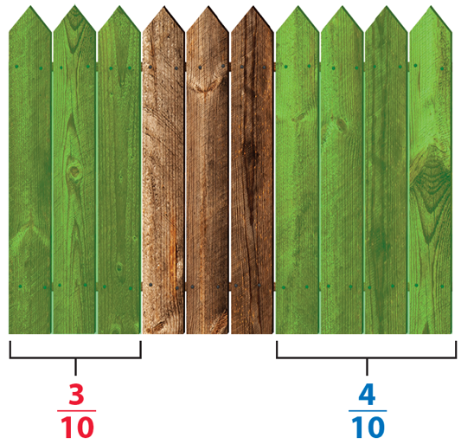
Compare strategies
You can use a picture to help understand the problem.
Think what the fence might look like if it has 10 equal-size parts.
They paint 3 tenths and 4 tenths of the fence.
Each part is of the whole.
418
Notes:
For a sketch of the fence, prompt students to identify how the fence is labeled to represent the problem.
Is there any way that this picture is more or less helpful than the one drawn by [student name]?
How is it helpful that the fence has 10 boards?

Slide 9
Compare class strategies
You can also use a number line to help understand the problem.
The number line below is divided into tenths with a point at .
Start at and count 4 tenths to the right to add .
418
Notes:
For a number line model, prompt students to identify the greatest number on the number line as well as the number of divisions.
How is the number line divided?
Why is it done that way?

Slide 10
Make connections and explain your thinking
Look at Picture It. How do you know that each
section of fence is of the whole fence?
What do the numerators, 3 and 4, tell you?
How many tenths of the fence do Francisca
and Nahele paint altogether?
419
Notes:
Check for understanding that:
10 is the number of equal parts
3 and 4 tell how many parts each friend paints
7 is the total number of parts painted

Slide 11
Make connections and explain your thinking
Complete the equations to show what fraction of the fence Francisca and Nahele painted altogether.
Use words: 3 tenths + 4 tenths = tenths
Use fractions: + =
What would be the sum if the fractions were and ?
419
Notes:
Tell students that problem 4 will prepare them to provide the explanation required in problem 6.
Be sure students understand that the problem is asking them to represent the same equation twice: once with words and once with fractions.
ASK What part of the problem do each of the fractions in the equations show?
LISTEN FOR 3/10 is the fraction of the fence Francisca paints. 4/10 is the fraction Nahele paints. 7/10 is the fraction they paint altogether.
ASK What is the same about the two equations?
LISTEN FOR The numerators, 3, 4, and 7, are numbers in each equation; the denominators are words in one equation and numbers in the other.
ASK How could you predict if the sum of 3/10 and 5/10 is greater than or less than the sum of 3/10 and 4/10 without doing the computation?
LISTEN FOR I think it is greater because 3/10 is the same in both problems, but 5/10 is greater than 4/10.
Explain that problem 5 is asking about adding two different fractions not shown in the fence problem.

Slide 12
Make connections and explain your thinking
Explain how you add fractions that have the same denominator.
419
Notes:
Look for the idea that you add the numerators and keep the same denominator because the size of the parts does not change when you add them.

Slide 13
Reflect on what you have learned
Look back at your Try It, strategies by classmates, and Picture It and Model It. Which models or strategies do you like best for adding fractions? Explain.
419
Notes:
Have all students focus on the strategies used to solve this problem. If time allows, have students share their responses with a partner.

Slide 14
Apply your thinking to a new problem
Melisenda and Caleb help their mom clean the house. Melisenda cleans of the house. Caleb cleans of the house. What fraction of the house do Melisenda and Caleb clean altogether? Show your work.
Solution
420

Slide 15
CONNECT TO CULTURE Optional
A Tsikuri (see KOO ree) is made by weaving string or yarn across two crossed sticks. The design originated with the Huichol (wee CHOHL) peoples in northwestern Mexico and symbolizes the power to see and understand things unknown.
What other yarn designs have you seen?
Notes:
Connect to Culture (Teacher’s Guide page 412a)
Engage students in sharing what they know about the context before you add the information given here.
A Tsikuri (see KOO ree) is made by weaving string or yarn across two crossed sticks. The design originated with the Huichol (wee CHOHL) peoples in northwestern Mexico and symbolizes the power to see and understand things unknown. The four points represent earth, air, fire, and water. Ask students if they have ever made or seen a Tsikuri.

Slide 16
Apply your thinking to a new problem
Jacy and Tallulah each use string to make
a Tsikuri. Jacy’s string is of a meter long.
Tallulah’s string is of a meter long.
How long are the two strings combined?
Show your work.
of a meter
420

Slide 17
Close: Exit Ticket
Estes makes a fruit smoothie. He uses of a
pound of strawberries and of a pound of
blueberries. How many pounds of fruit does
Estes use? Show your work.
Solution
420
Notes:
Students’ solutions should indicate understanding of:
adding, or joining, parts that refer to the same whole
accurate use of visual fraction models or equations to represent the problem
Error Alert If students’ solutions are 6/16, then review the structure of fractions to help them see that only numerators should be combined. Explain that denominators tell the kind of parts that are being added. Have them write 2 apples + 4 apples = 6 apples on an index card and then write below it 2 eighths + 4 eighths = 6 eighths.

Slide 18
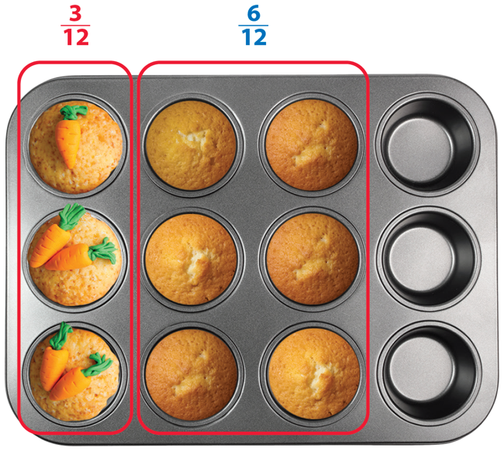
Practice
EXAMPLE
Clara has a muffin pan that holds
12 muffins. She fills of the pan
with carrot muffin batter. Then she
fills with pumpkin muffin batter.
What fraction of the pan does she fill?
So, she fills of the muffin pan.
421

Slide 19
Practice
Owen fills of another pan with berry
muffin batter. Shade of the muffin pan
diagram at the right.
Then Owen fills with bran muffin batter.
Shade of the diagram to show this.
In problem 2, what fraction of the pan is filled now?
Write an equation for this problem that includes your answer.
421

Slide 20
Practice
Lilia runs of a mile and rests. Then she runs
another of a mile.
Divide the number line below to show eighths.
Label on the number line above.
Use arrows to show + on the number line.
422

Slide 21
Practice
Lilia runs of a mile and rests. Then she runs
another of a mile.
What is the total distance Lilia runs?
Write an equation for this problem that includes your answer.
422

Slide 22
Practice
Gavin cleans of the patio before lunch and of
the patio after lunch. What fraction of the patio does
Gavin clean altogether? Show your work.
Solution
422

Slide 23
Take a moment to think on your own.
Notes:
Individual Think Time (10 seconds to 2 minutes)
Provide students a short time to think about a question or problem before discussing with a partner, a small group, or the whole class.
Three Reads
After each read, provide students with think time to read the question and consider their answer.
Connect It
Give students think time before discussing as a class.
Facilitate Whole Class Discussion
After each strategy, allow individual think time for students to process the ideas.
Understand lessons
Model It
Read the problem and allow students plenty of think time to determine their answer.

Slide 24
Turn and talk with your partner about . . .
Notes:
Turn and Talk (30 seconds to 1 minute)
Give students a purpose, prompt, or product so that they know what to talk about and why.

Slide 25
REPEAT
Restate the idea to give everyone a chance to hear it, or hear it again.
Notes:
Four Rs: Repeat
Use one or a combination the Four Rs to support students in processing information and to facilitate classroom discussion.

Slide 26
REPHRASE
Restate the idea in your own words.
Notes:
Four Rs: Rephrase
Use one or a combination the Four Rs to support students in processing information and to facilitate classroom discussion.

Slide 27
REWORD
Restate the idea using academic or mathematical language.
Notes:
Four Rs: Reword
Use one or a combination the Four Rs to support students in processing information and to facilitate classroom discussion.

Slide 28
RECORD
Record ideas using words, numbers or pictures.
Notes:
Four Rs: Record
Record students’ ideas for reference. Use words, numbers, or pictures.

Slide 29
THREE READS
Read 1: What is the problem about?
Read 2: What are you trying to find out?
Read 3: What information is important?

Slide 30
CO-CRAFT QUESTIONS
What is the problem about?
What questions can you ask that mathematics can answer?

Slide 31
NOTICE AND WONDER
What do you notice?
What do you wonder?

Slide 32
SAY IT ANOTHER WAY
How would you say this problem in your own words?

