Slide 1
SESSION 1
Explore
Adding and Subtracting Fractions
Learning Targets
Add fractions with the same denominator.
Subtract fractions with the same denominator.
Write a fraction as a sum in more than one way.
LESSON 20 • Add and Subtract Fractions
Notes:
Purpose
Explore the idea that adding and subtracting fractions is like adding and subtracting whole numbers.
Understand that adding fractions means joining equal parts of a whole and subtracting fractions means taking away equal parts of a whole.
Error Alert In this lesson, watch for students who:
add instead of subtracting or vice versa.
add or subtract denominators.
interpret units on the number line incorrectly.

Slide 2
Start
Same and Different
1
A
B
C
D
Notes:
START (Teacher’s Guide page 413)
WHY? Support students’ understanding of fractions as a part of a whole.
Consider providing sentence starters to help students express their thinking:
_______ is/are different because _______.
_______ is/are the same because _______.
Possible Solutions
All represent 1 whole.
B is not in fraction form.
C is a single fraction that represents 1 whole.
A and D are sums that represent 1 whole.

Slide 3
Make sense of the problem
Aisha, Rosalind, and Cristobal share a pack of 12 cards. Aisha gets 4 cards, Rosalind gets 3 cards, and Cristobal gets the rest of the cards.
What do you notice?
What do you wonder?
413
Notes:
Notice and Wonder
Have students ask themselves: What do you notice? What are you wondering that mathematics can answer? After reading the problem, return to students’ ideas to see if any of them relate to the problem.

Slide 4
Make sense of the problem
Aisha, Rosalind, and Cristobal share a pack of 12 cards. Aisha gets 4 cards, Rosalind gets 3 cards, and Cristobal gets the rest of the cards. What fraction of the pack does Cristobal get?
What information is important based on what you need to find?
413

Slide 5
Solve and support your thinking
Aisha, Rosalind, and Cristobal share a pack of 12 cards. Aisha gets 4 cards, Rosalind gets 3 cards, and Cristobal gets the rest of the cards. What fraction of the pack does Cristobal get?
Math Toolkit counters, fraction circles, fraction tiles, fraction bars, number lines, fraction models
413

Slide 6
Share your thinking with a partner
Ask your partner: Why did you choose that strategy?
Tell your partner: At first, I thought . . .
413
Notes:
Common Misconception Look for students who are not comfortable with twelfths and who try to use 3 or 4 as the denominator. As students present solutions, be sure to have them specify why they used 12 as the denominator.
Select and Sequence Student Strategies
One possible order for whole class discussion:
physical parts showing twelfths
drawings representing twelfths
number lines marked in twelfths
whole-number equations to find 5 out of 12 cards are left (5/12)

Slide 7
Compare class strategies
Aisha, Rosalind, and Cristobal share a pack of 12 cards. Aisha gets 4 cards, Rosalind gets 3 cards, and Cristobal gets the rest of the cards. What fraction of the pack does Cristobal get?
413
Notes:
Call on students to share selected strategies. Prompt students to connect ideas by showing how they are alike and how they are different.
Guide students to Compare and Connect the representations.
ASK How do [student name]’s and [student name]’s models show the whole and the parts?
LISTEN FOR 12 is the denominator of all the fractions. 12/12 shows the whole. The parts are 4/12, 3/12, 7/12, and 5/12.

Slide 8
Make connections and explain your thinking
Explain how you can find the fraction of the pack that Cristobal gets.
414
Notes:
Look for understanding that the whole set of cards is 12 twelfths and that only some of those twelfths, 5/12, are left for Cristobal.

Slide 9
Make connections and explain your thinking
In the problem on the previous page, the whole is the pack of cards.
Since there are 12 cards in the pack, each card represents of the
whole. Look at the whole shown here. The whole is the fruit pizza. It is a single object.
a. How many equal parts is the pizza cut into?
b. What fraction can you use to
describe each piece of pizza?
c. What fraction can you use to
describe the whole?
d. Suppose three pieces are eaten.
What fraction can you use to describe
the 3 pieces eaten?
414
Notes:
Point out that sometimes students will encounter a whole that does not look like it is composed of fractional parts. Students may have to imagine the whole being cut into equal parts.
Students should be able to use fraction language to describe the whole fruit pizza in terms of eighths, to discuss taking eighths away from the whole pizza when slices are eaten, and to determine how many eighths are left. Students will spend more time learning about fractions in the Additional Practice.

Slide 10
Close: Exit Ticket
How does knowing about equal parts help you add and subtract fractions?
414
Notes:
Look for understanding of adding or subtracting fractions as joining together or taking away parts referring to the same whole. Student responses should include references to the whole, joining equal parts of the whole to add, and taking away equal parts of the whole to subtract. Some students may use the terms numerator and denominator in their explanations.
Common Misconception If students do not reference the whole or are unclear in their explanations that they are adding or subtracting equal parts of the whole, then provide fraction tiles and have students “join” tiles to add and “take away” tiles to subtract. Discuss what students notice about the numerators and denominators.

Slide 11
Real-World Connection
Archaeologists study human activities and civilizations from the past. They dig or excavate sites of human civilizations and examine the items they find to learn more about how these people lived.
When might it be useful to add or subtract fractions?
Notes:
Real-World Connection (Teacher’s Guide page 415)
Read the real-world example below. Then ask students to think of other real-world examples when adding or subtracting fractions might be useful.
Archaeologists study human activities and civilizations from the past. They dig or excavate sites of human civilizations and examine the items they find to learn more about how these people lived. During an excavation, an archaeologist divides a site into equal parts. Each part is labeled and carefully examined for items. The exact location of each item is recorded. Say one section of a site is divided into 8 equal-size parts and pottery pieces are found in 1 part and then in 2 other parts of the section. The archaeologist can add 1/8 and 2/8 to determine that 3/8 of the section contain pottery. They can similarly subtract to report that 5/8 of the sections does not contain pottery. Ask students to think of other real-world examples when adding or subtracting fractions might be useful.

Slide 12
Vocabulary
fraction
415
Notes:
Ask students to circle frac in the word fraction. Share with students that frac is a Latin root that means “break.” Point out that in math, a fraction is a part of a whole. Ask students if they know of other words that have the root word frac (or frag). Provide examples, such as fracture and fragment.
If students struggle completing any part of the graphic organizer, have them use manipulatives, such as fraction tiles or fraction bars, to break a whole into parts.

Slide 13
Practice
Does the model below show eighths?
Why or why not?
415

Slide 14
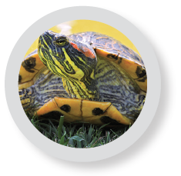
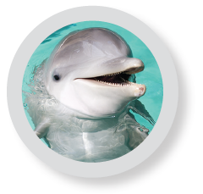
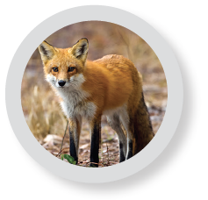
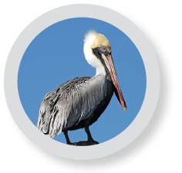
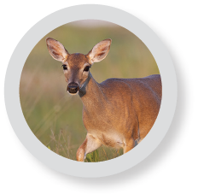
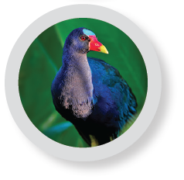
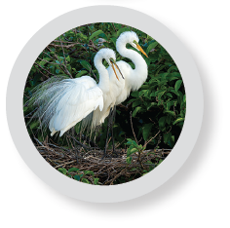
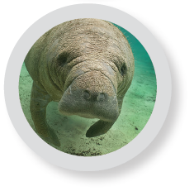
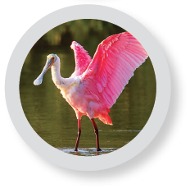
Practice
Solve the problem. Show your work.
Senalda, Agustin, and Davis share a set of 10 animal stickers. Senalda gets 2 stickers, Agustin gets 4 stickers, and Davis gets the rest of the stickers. What fraction of the stickers does Davis get?
416
Notes:
Suggest that students use Notice and Wonder, asking themselves the following questions each time:
What do you notice about the group of stickers?
What are you wondering that mathematics can answer?

Slide 15
Practice
Check your answer. Show your work.
416

Slide 16
Take a moment to think on your own.
Notes:
Individual Think Time (10 seconds to 2 minutes)
Provide students a short time to think about a question or problem before discussing with a partner, a small group, or the whole class.
Three Reads
After each read, provide students with think time to read the question and consider their answer.
Connect It
Give students think time before discussing as a class.
Facilitate Whole Class Discussion
After each strategy, allow individual think time for students to process the ideas.
Understand lessons
Model It
Read the problem and allow students plenty of think time to determine their answer.

Slide 17
Turn and talk with your partner about . . .
Notes:
Turn and Talk (30 seconds to 1 minute)
Give students a purpose, prompt, or product so that they know what to talk about and why.

Slide 18
REPEAT
Restate the idea to give everyone a chance to hear it, or hear it again.
Notes:
Four Rs: Repeat
Use one or a combination the Four Rs to support students in processing information and to facilitate classroom discussion.

Slide 19
REPHRASE
Restate the idea in your own words.
Notes:
Four Rs: Rephrase
Use one or a combination the Four Rs to support students in processing information and to facilitate classroom discussion.

Slide 20
REWORD
Restate the idea using academic or mathematical language.
Notes:
Four Rs: Reword
Use one or a combination the Four Rs to support students in processing information and to facilitate classroom discussion.

Slide 21
RECORD
Record ideas using words, numbers or pictures.
Notes:
Four Rs: Record
Record students’ ideas for reference. Use words, numbers, or pictures.

Slide 22
THREE READS
Read 1: What is the problem about?
Read 2: What are you trying to find out?
Read 3: What information is important?

Slide 23
CO-CRAFT QUESTIONS
What is the problem about?
What questions can you ask that mathematics can answer?

Slide 24
NOTICE AND WONDER
What do you notice?
What do you wonder?

Slide 25
SAY IT ANOTHER WAY
How would you say this problem in your own words?

