Slide 1
SESSION 1
Explore
Equivalent Fractions
Learning Targets
Find equivalent fractions.
Write a whole number as a fraction.
LESSON 23 • Find Equivalent Fractions
Notes:
Purpose
Explore the idea that equivalent fractions have the same area in area models and are the same distance from 0 on a number line.
Understand that fractions that represent the same value are equivalent.
Error Alert In this lesson, watch for students who:
think that any two fractions with the same numerators are equivalent.
count the tick marks on a number line instead of the spaces between them.
think that n/n, n/1, and/or 1/n always represent the same amount.

Slide 2
Start
Which One Doesn’t Belong?
A
B
C
D
Notes:
START (Teacher’s Guide page 495)
WHY? Support students’ understanding of modeling fractions with an area model.
Consider providing a sentence starter to help students express their thinking:
_______ does not belong because _______.
Possible Solutions
A because it has two sections shaded.
B because the parts are not equal parts.
C because the whole is smaller.
D because it does not use vertical or horizontal lines to make the equal groups.

Slide 3
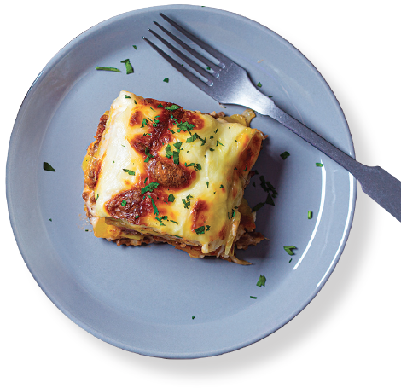
CONNECT TO CULTURE Optional
Moussaka (moo sah KAH) is a Greek dish. It is made from sliced eggplant and layers of meat, usually lamb or beef.
What is your favorite food?
Notes:
Connect to Culture (Teacher’s Guide page 494a)
Engage students in sharing what they know about the context before you add the information given here.
Ask students to think of their favorite food. Then take an informal poll about the different foods. Tell students that moussaka (moo sah KAH) is a Greek dish. It is made from sliced eggplant and layers of meat, usually lamb or beef. Sometimes it also has layers of potatoes or zucchini. A layer of sauce is placed on top. Sometimes cheese, parsley, or other toppings are added. The word moussaka may have come from the Arabic word for chop.

Slide 4
Make sense of the problem
Tara’s mom makes a pan of moussaka. She puts parsley on half and no parsley on the other half. Then Tara’s mom cuts the moussaka into fourths so that each fourth has either has parsley or no parsley.
What is the problem about?
495
Notes:
Three Reads
After the first read, ask students what the problem is about. After the second read, have students tell what the question is asking them to find. For the third read, ask: How can you describe each of the fourths?

Slide 5
Make sense of the problem
Tara’s mom makes a pan of moussaka. She puts parsley on half and no parsley on the other half. Then Tara’s mom cuts the moussaka into fourths so that each fourth has either has parsley or no parsley.
What fraction other than names the part
of the moussaka with parsley?
What are you trying to find out?
What information is important?
495

Slide 6
Solve and support your thinking
Tara’s mom makes a pan of moussaka. She puts parsley on half and no parsley on the other half. Then Tara’s mom cuts the moussaka into fourths so that each fourth has either has parsley or no parsley.
What fraction other than names the part
of the moussaka with parsley?
Math Toolkit fraction circles, 1-inch grid paper, index cards, crayons, fraction models, number lines
495

Slide 7
Share your thinking with a partner
Ask your partner:
Can you explain that again?
Tell your partner:
I knew . . . so I . . .
495
Notes:
Common Misconception Look for students who are not comfortable with visualizing how the pan of moussaka is cut. As students present solutions, have them specify how they think the moussaka is cut.
Select and Sequence Student Strategies
One possible order for whole class discussion:
models that have been cut apart
freehand drawings or drawings on grid paper of the pan of moussaka
solutions with no drawing or visual model

Slide 8
Compare class strategies
Tara’s mom makes a pan of moussaka. She puts parsley on half and no parsley on the other half. Then Tara’s mom cuts the moussaka into fourths so that each fourth has either has parsley or no parsley.
What fraction other than names the part
of the moussaka with parsley?
495
Notes:
Call on students to share selected strategies. Prompt students to connect two different strategies by explaining how they are alike and different.
Guide students to Compare and Connect the representations. Encourage students to speak clearly and loudly by asking others to repeat what is said.
ASK How do [student name]’s and [student name]’s models show which part(s) of the pan of moussaka have parsley?
LISTEN FOR One half, or two fourths, of the pan should be shaded or somehow marked to indicate parsley.

Slide 9
Make connections and explain your thinking
What fraction other than names the part of
the moussaka with parsley?
How did you get your answer?
496
Notes:
Look for understanding that the amount of moussaka with parsley stays the same whether it is cut into halves or fourths.

Slide 10
Make connections and explain your thinking
You have seen many different types of fraction models, such as area models, number lines, and fractions bars. You can find equivalent fractions by dividing the same model in different ways.
a. Each pan below shows fourths. Draw lines on one of the pans of moussaka to show eighths.
b. How many pieces of the moussaka have
parsley now?
496
Notes:
Point out that no matter how the pan of moussaka is cut into fourths, there are 2 pieces with parsley. No matter how the pan of moussaka is cut into eighths, there are 4 pieces with parsley.
Note that the pan diagrams and the number line are different types of fraction models. In the Additional Practice, students will spend more time learning about the different types of fraction models.

Slide 11
Make connections and explain your thinking
You have seen many different types of fraction models, such as area models, number lines, and fractions bars. You can find equivalent fractions by dividing the same model in different ways.
c. You can also look at different equal-size parts on a number line to find equivalent fractions. Fill in the fraction for fourths that is
equivalent to .
496
Notes:
Point out that no matter how the pan of moussaka is cut into fourths, there are 2 pieces with parsley. No matter how the pan of moussaka is cut into eighths, there are 4 pieces with parsley.
Note that the pan diagrams and the number line are different types of fraction models. In the Additional Practice, students will spend more time learning about the different types of fraction models.

Slide 12
Close: Exit Ticket
Why does it make sense that and can name the same amount?
496
Notes:
Look for understanding that 1/2 and 2/4 represent the same quantity divided into different numbers of parts.
Common Misconception If students are confused by the single number line, then draw two number lines, one labeled with 0, 1/2, and 1, and the other directly beneath it labeled with 0, 1/4, 2/4, 3/4, and 1. Explain that combining the two number lines, as in problem 2c, makes identifying equivalent fractions easier.

Slide 13
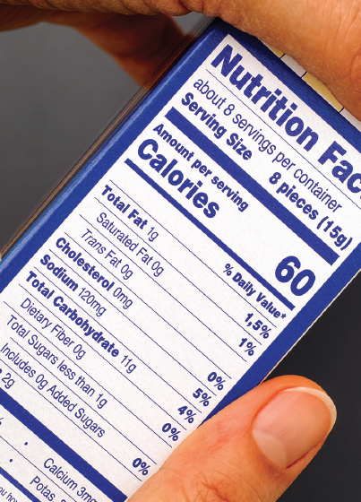
Real-World Connection
A dietitian or nutritionist may work in schools, hospitals, and nursing homes to make sure each serving of food meets the nutritional needs for each person. Dietitians may use the information on nutrition labels that are found on food packaging.
When might it be useful to identify equivalent fractions?
Notes:
Real-World Connection (Teacher’s Guide page 497)
Read the real-world example below. Then ask students to think of other real-world examples when identifying equivalent fractions might be useful.
A dietitian or nutritionist may work in schools, hospitals, and nursing homes to make sure each serving of food meets the nutritional needs for each person. Dietitians may use the information on nutrition labels that are found on food packaging. This information is based on a serving size, which is a part of the whole. Sometimes the serving size is the whole package, but the serving size could also be a half, third, fourth, or other fractional amount of the whole. The dietitian may need to use knowledge of equivalent fractions when the serving size on a package is different from the amount needed for a person’s meal. Ask students to think of other real-world examples when identifying equivalent fractions might be useful.

Slide 14
Vocabulary
fraction models
497
Notes:
Have students point at and say the phrase fraction models. Point out that a model of a fraction can be a picture. Ask: What models have you used in previous lessons to represent fractions? [number lines, area models, fraction bars] What shapes have you used to represent fractions? [rectangles, squares, circles] What fractions can you represent? [possible responses include: unit fractions, 2/3, and 3/4] List students’ responses to the questions as a scaffold.

Slide 15
Practice
Each fraction model below shows thirds.
Draw lines on each model to show sixths.
497

Slide 16
Practice
Solve the problem. Show your work.
Andres, Jessie, and their adoptive mom each have a strip of construction paper. Each strip is the same size and a different color—red, yellow, and blue. They tape the strips together to make a rectangle
They divide the rectangle into sixths so that each
sixth is one color. What fraction other than names the part of the rectangle that is red?
498
Notes:
Suggest that students use Three Reads asking themselves one of the following questions each time:
What is this problem about?
What is the question I am trying to answer?
What information is important?

Slide 17
Practice
Check your answer. Show your work.
498

Slide 18
Take a moment to think on your own.
Notes:
Individual Think Time (10 seconds to 2 minutes)
Provide students a short time to think about a question or problem before discussing with a partner, a small group, or the whole class.
Three Reads
After each read, provide students with think time to read the question and consider their answer.
Connect It
Give students think time before discussing as a class.
Facilitate Whole Class Discussion
After each strategy, allow individual think time for students to process the ideas.
Understand lessons
Model It
Read the problem and allow students plenty of think time to determine their answer.

Slide 19
Turn and talk with your partner about . . .
Notes:
Turn and Talk (30 seconds to 1 minute)
Give students a purpose, prompt, or product so that they know what to talk about and why.

Slide 20
REPEAT
Restate the idea to give everyone a chance to hear it, or hear it again.
Notes:
Four Rs: Repeat
Use one or a combination the Four Rs to support students in processing information and to facilitate classroom discussion.

Slide 21
REPHRASE
Restate the idea in your own words.
Notes:
Four Rs: Rephrase
Use one or a combination the Four Rs to support students in processing information and to facilitate classroom discussion.

Slide 22
REWORD
Restate the idea using academic or mathematical language.
Notes:
Four Rs: Reword
Use one or a combination the Four Rs to support students in processing information and to facilitate classroom discussion.

Slide 23
RECORD
Record ideas using words, numbers or pictures.
Notes:
Four Rs: Record
Record students’ ideas for reference. Use words, numbers, or pictures.

Slide 24
THREE READS
Read 1: What is the problem about?
Read 2: What are you trying to find out?
Read 3: What information is important?

Slide 25
CO-CRAFT QUESTIONS
What is the problem about?
What questions can you ask that mathematics can answer?

Slide 26
NOTICE AND WONDER
What do you notice?
What do you wonder?

Slide 27
SAY IT ANOTHER WAY
How would you say this problem in your own words?

