Slide 1
SESSION 1
Explore
Adding Two-Digit Numbers
Learning Targets
Add two-digit numbers by adding tens and adding ones.
Add two-digit numbers by making a ten.
Explain how to add two-digit numbers.
LESSON 6 • Add Two-Digit Numbers
Notes:
Purpose
Explore the idea that place value can be used to add two-digit numbers.
Understand that addends can be broken apart to make a ten when adding two-digit numbers.
Error Alert In this lesson, watch for students who:
have difficulty identifying what they know and what they need to find out in word problems.
add or subtract single-digit numbers incorrectly.
regroup incorrectly or forget to regroup.
decompose numbers incorrectly.
add the correct number to an addend to make the next ten but forget to adjust the other addend.

Slide 2
Start
Same and Different
13 + 7
A
B
C
D
10 + 10
10 + 3 + 7
Notes:
START (Teacher’s Guide page 141)
WHY? Support students’ facility with putting together numbers to add with tens.
Consider providing sentence starters to help students express their thinking:
_______ is/are different because _______.
_______ is/are the same because _______.
Possible Solutions
All have a sum of 20.
A and B both have the addends 13 and 7.
C and D both have the addend 10.
B and D both have the addend 7.

Slide 3
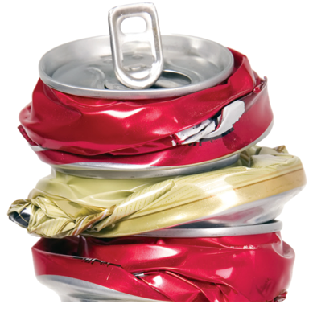
Make sense of the problem
Kelvin recycles 27 cans on Thursday.
He recycles 15 cans on Friday.
How would you say this problem in your own words?
141
Notes:
Say It Another Way
Ask students to think about how the cans from Thursday and 15 cans from Friday are related to the total number of cans.

Slide 4
Make sense of the problem
Kelvin recycles 27 cans on Thursday.
He recycles 15 cans on Friday. How many
cans does Kelvin recycle in all?
What information is important based on what you need to find?
141

Slide 5
Solve and support your thinking
Kelvin recycles 27 cans on Thursday.
He recycles 15 cans on Friday. How many
cans does Kelvin recycle in all?
Math Toolkit base-ten blocks, open number lines, tens place-value mats
141

Slide 6
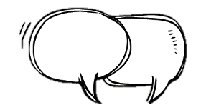
Share your thinking with a partner
Ask your partner:
Why did you choose that strategy?
Tell your partner:
I started by . . .
141
Notes:
Common Misconception Look for students who say that adding 2 + 7 + 1 + 5 will give the total because those are the digits in the numbers. When students present solutions, have them specify the value of the tens and ones in each group.
Select and Sequence Student Strategies
One possible order for whole class discussion:
visual models for 27 and 15 using base-ten blocks
visual models for 27 and 15 using a quick draw model
27 and 15 written in expanded form with the tens and ones regrouped
27 and 15 decomposed to make a ten to add

Slide 7
Compare class strategies
Kelvin recycles 27 cans on Thursday.
He recycles 15 cans on Friday. How many
cans does Kelvin recycle in all?
141
Notes:
Call on students to share selected strategies. Prompt students to look at the speaker and try to strategies their thinking during the discussion. Record responses that show regrouping of tens and ones for students to refer to during the discussion.
Guide students to Compare and Connect the representations.
ASK How do [student name]’s and [student name]’s models show the addition?
LISTEN FOR Both show a group of 27 and 15 or the numbers 27 and 15 broken into parts. 42 is shown as 3 tens and 12 ones, 30 + 12, 27 + 3 + 10 + 2, or 37 + 5.

Slide 8
Make connections and explain your thinking
How many cans does Kelvin find in all?
142
Notes:
Look for understanding of decomposing numbers to add.

Slide 9
Make connections and explain your thinking
Here are some ways to find 27 + 15.
Use base-ten blocks.
a.
2 tens and 7 ones
1 ten and 5 ones
tens and
ones
142
Notes:
Point out that the models shown on the Student Worktext page are all ways of representing the same addition problem. Students should recognize that using base-ten blocks, going to the next ten, and adding tens and then ones are all strategies for adding two-digit numbers.
ASK How is 30 shown in each method?
LISTEN FOR 30 is shown as 3 tens, the sum of 27 + 3, and the sum of 20 + 10.
ASK Which of the models helps you add in your head?
LISTEN FOR Different students will find different strategies helpful. Some will be more comfortable adding tens and then adding ones and combining the two results. Others will prefer counting to the next ten.

Slide 10
Make connections and explain your thinking
Here are some ways to find 27 + 15.
Go to the next ten.
b. 27 + 3 = 30 + 10 = 40 + 2 =
Add tens, then ones.
c.
+ = 42
142
Notes:
Point out that the models shown on the Student Worktext page are all ways of representing the same addition problem. Students should recognize that using base-ten blocks, going to the next ten, and adding tens and then ones are all strategies for adding two-digit numbers.
ASK How is 30 shown in each method?
LISTEN FOR 30 is shown as 3 tens, the sum of 27 + 3, and the sum of 20 + 10.
ASK Which of the models helps you add in your head?
LISTEN FOR Different students will find different strategies helpful. Some will be more comfortable adding tens and then adding ones and combining the two results. Others will prefer counting to the next ten.

Slide 11
Close: Exit Ticket
Why is adding 3, 10, and 2 the same as adding 15?
142
Notes:
Look for understanding that a number can be broken into parts without changing the total value of the number. Student responses should include adding 3 + 10 + 2 to show that the sum is 15, and drawing the conclusion that adding parts with the total value of 15 is the same as adding 15.
Common Misconception If students are unclear in their explanations that adding a number in 3 parts is the same as adding the number all at once, then have students use counters to show that 3 + 10 = 13 and that 13 + 2 = 15.

Slide 12
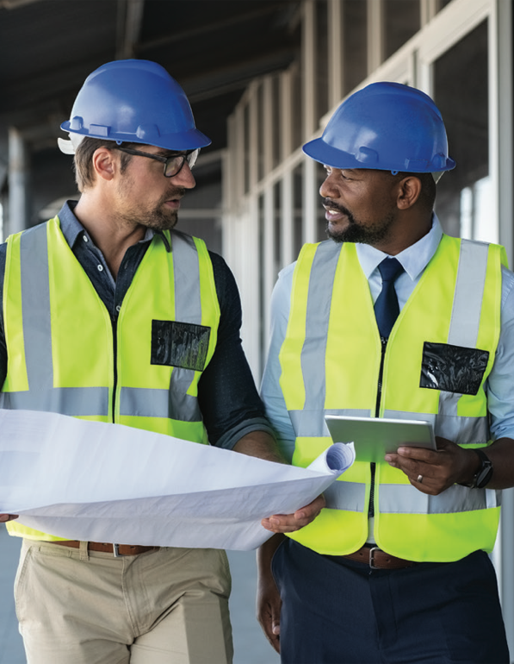
Real-World Connection
Construction site managers direct other workers on a project about what needs to be done. There can be multiple crews of people
working at the same time, such as plumbers and
electricians.
When might it be useful to add two-digit numbers?
Notes:
Real-World Connection (Teacher’s Guide page 143)
Read the real-world example below. Then ask students to think of other real-world examples when adding two-digit numbers might be useful.
Construction site managers direct other workers on a project about what needs to be done. There can be multiple crews of people working at the same time, such as plumbers and electricians. The manager may need to add to know how many people are working each day. They also make sure that all the crews are safe. Everyone working needs to wear the right safety equipment on the job site. Usually this includes a hard hat and safety glasses. Other types of safety equipment, such as yellow vests, may be needed on road construction projects. The construction site manager may need to add to find the total number of each kind of safety equipment. Ask students to think of other real-world examples when adding two-digit numbers might be useful.

Slide 13
Vocabulary
regroup
143
Notes:
Ask students to circle the group in the word regroup. Share with students that group can mean to put together. Ask students to think of examples where objects or people were grouped together. Explain that a group is made up of smaller units, or parts. Use student responses to scaffold possible answers for the boxes in the graphic organizer. Have students underline the prefix re- in the word regroup. Tell students to practice saying the prefix re-. Explain that a prefix changes the meaning of a word. The prefix re- means “again” or “once more.” Encourage students to think of other words with the prefix re- such as reread, remake, reorganize, and resend.

Slide 14
Practice
Why is adding 6, 10, and 5 to a number the same as adding 21 to that number?
143

Slide 15
Practice
Solve the problem. Show your work.
Nasha has 38 pennies. Her friend Pala gives her 17 pennies. How many pennies does Nasha have now?
144
Notes:
Suggest that students use Three Reads, asking themselves one of the following questions each time:
What is this problem about?
What is the question I am trying to answer?
What information is important?

Slide 16
Practice
Check your answer. Show your work.
144

Slide 17
Take a moment to think on your own.
Notes:
Individual Think Time (10 seconds to 2 minutes)
Provide students a short time to think about a question or problem before discussing with a partner, a small group, or the whole class.
Three Reads
After each read, provide students with think time to read the question and consider their answer.
Connect It
Give students think time before discussing as a class.
Facilitate Whole Class Discussion
After each strategy, allow individual think time for students to process the ideas.
Understand lessons
Model It
Read the problem and allow students plenty of think time to determine their answer.

Slide 18
Turn and talk with your partner about . . .
Notes:
Turn and Talk (30 seconds to 1 minute)
Give students a purpose, prompt, or product so that they know what to talk about and why.

Slide 19
REPEAT
Restate the idea to give everyone a chance to hear it, or hear it again.
Notes:
Four Rs: Repeat
Use one or a combination the Four Rs to support students in processing information and to facilitate classroom discussion.

Slide 20
REPHRASE
Restate the idea in your own words.
Notes:
Four Rs: Rephrase
Use one or a combination the Four Rs to support students in processing information and to facilitate classroom discussion.

Slide 21
REWORD
Restate the idea using academic or mathematical language.
Notes:
Four Rs: Reword
Use one or a combination the Four Rs to support students in processing information and to facilitate classroom discussion.

Slide 22
RECORD
Record ideas using words, numbers or pictures.
Notes:
Four Rs: Record
Record students’ ideas for reference. Use words, numbers, or pictures.

Slide 23
THREE READS
Read 1: What is the problem about?
Read 2: What are you trying to find out?
Read 3: What information is important?

Slide 24
CO-CRAFT QUESTIONS
What is the problem about?
What questions can you ask that mathematics can answer?

Slide 25
NOTICE AND WONDER
What do you notice?
What do you wonder?

Slide 26
SAY IT ANOTHER WAY
How would you say this problem in your own words?

