Slide 1
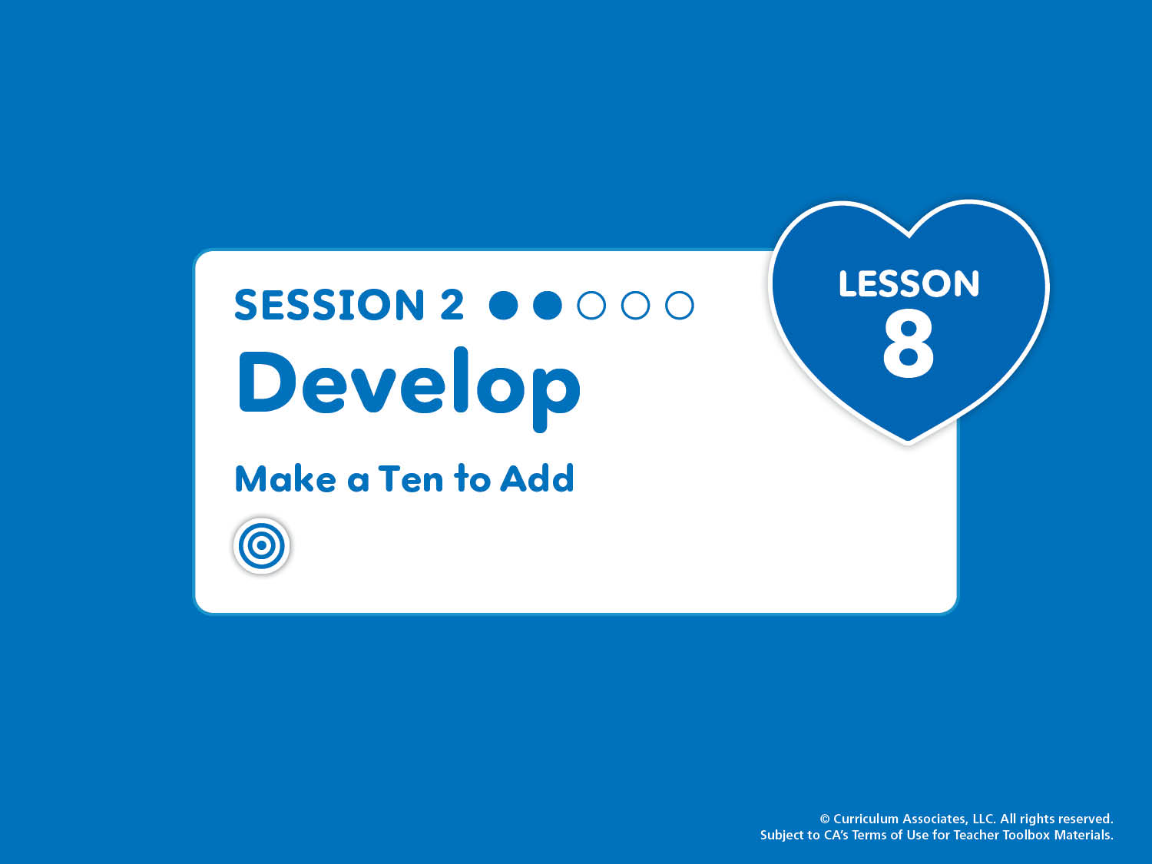
Lesson 8, Session 2: Develop
Make a Ten to Add
Break apart a number to make a ten. Use this strategy to add.
Notes:
Purpose
Develop ideas about breaking an addend into parts to make a ten.
Recognize that filling a 10-frame with counters shows how to make a ten.
Math Toolkit
Make available for use at any time in the lesson:
Two-color counters
10-Frames Workmat
Number Bonds Workmat

Slide 2

NUMBER SENSE
Quick Images
Notes:
START: Number Sense – Teacher’s Guide page 185a
Quick Images
ASK: How many dots do you see? How do you know?
Counting Tip
PASS AND COUNT Have children count forward by ones from 1 to 20 as they pass a bean bag around the circle. Then have them reverse direction and count backward from 20 to 0.

Slide 3
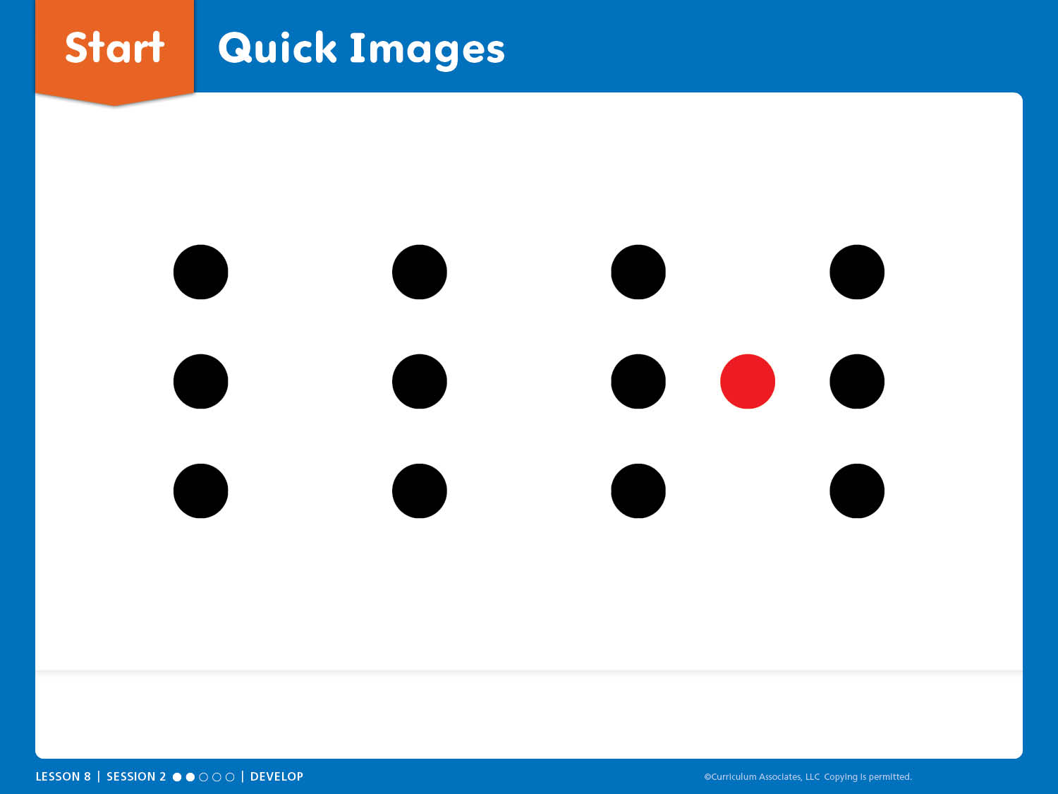
Start: Quick Images
How many dots do you see? How do you know?
Notes:
START: Number Sense – Teacher’s Guide page 185a
Quick Images
ASK: How many dots do you see?
Encourage children to look carefully at the slide.
Remove the slide, give children time to think, and briefly show the slide again.
Have children turn and talk about what they saw and how they saw it.
Listen for a variety of solutions for whole class sharing.
Facilitate Whole Class Discussion
Display the slide and allow children to explain how they see it.
Did anyone see it a different way?

Slide 4
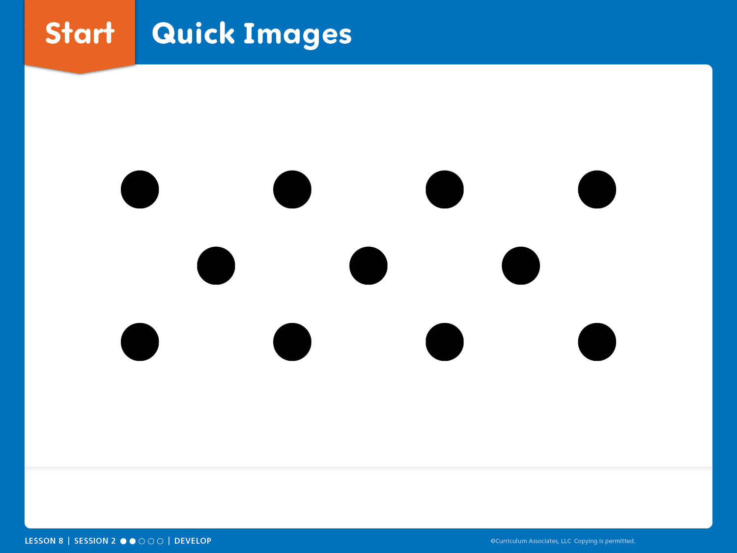
Start: Quick Images
How many dots do you see? How do you know?
Notes:
START: Number Sense – Teacher’s Guide page 185a
Quick Images
ASK: How many dots do you see?
Encourage children to look carefully at the slide.
Remove the slide, give children time to think, and briefly show the slide again.
Have children turn and talk about what they saw and how they saw it.
Listen for a variety of solutions for whole class sharing.
Facilitate Whole Class Discussion
Display the slide and allow children to explain how they see it.
Did anyone see it a different way?

Slide 5
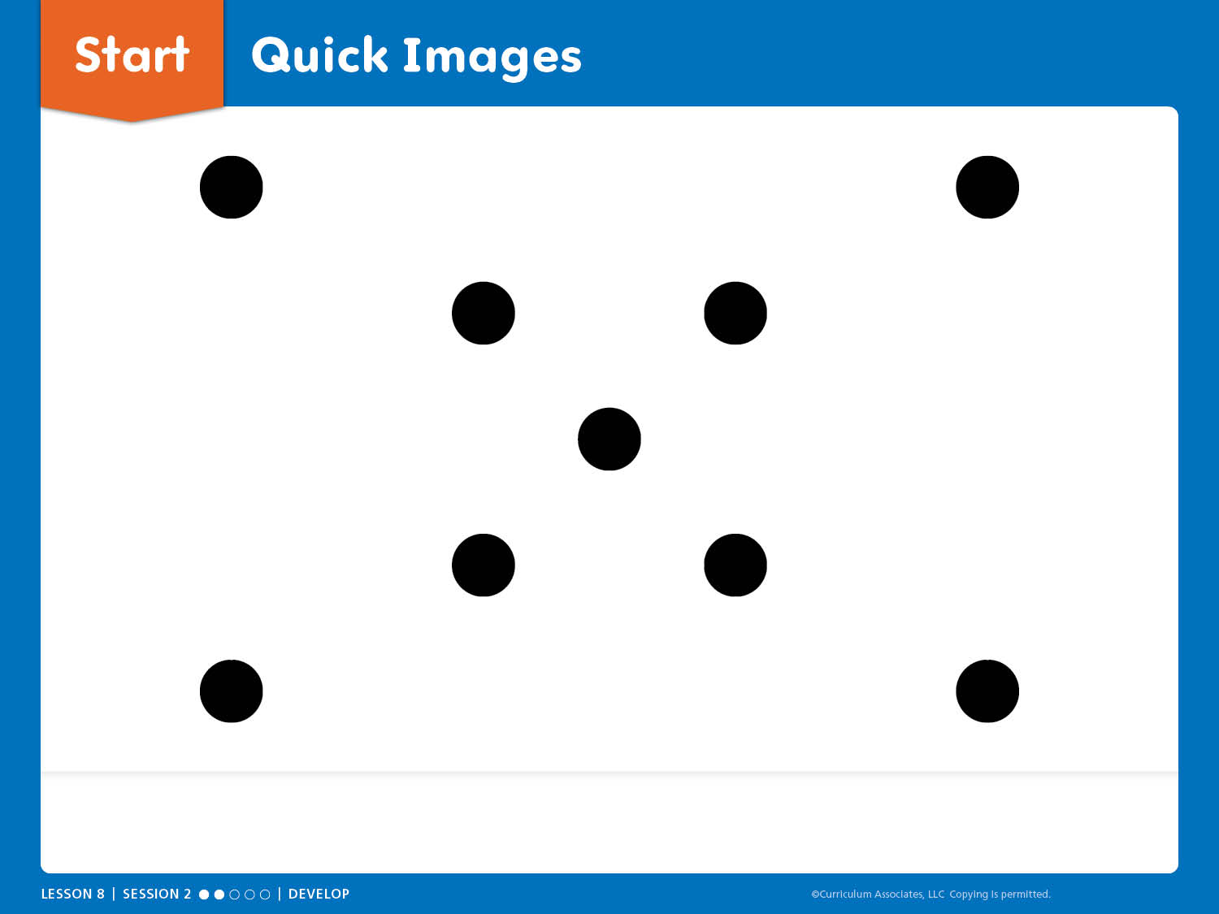
Start: Quick Images
How many dots do you see? How do you know?
Notes:
START: Number Sense – Teacher’s Guide page 185a
Quick Images
ASK: How many dots do you see?
Encourage children to look carefully at the slide.
Remove the slide, give children time to think, and briefly show the slide again.
Have children turn and talk about what they saw and how they saw it.
Listen for a variety of solutions for whole class sharing.
Facilitate Whole Class Discussion
Display the slide and allow children to explain how they see it.
Did anyone see it a different way?

Slide 6
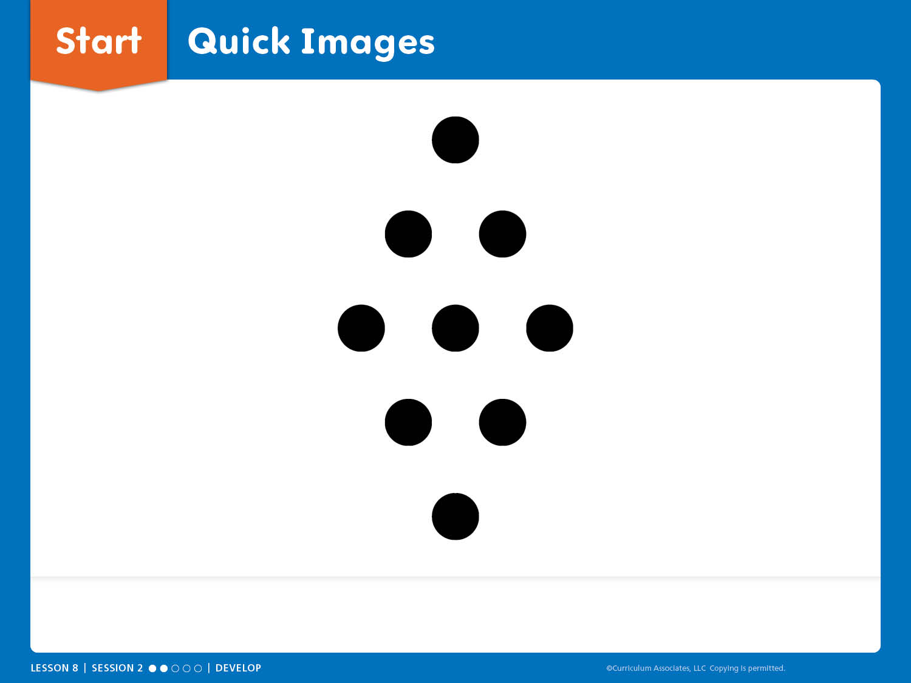
Start: Quick Images
How many dots do you see? How do you know?
Notes:
START: Number Sense – Teacher’s Guide page 185a
Quick Images
ASK: How many dots do you see?
Encourage children to look carefully at the slide.
Remove the slide, give children time to think, and briefly show the slide again.
Have children turn and talk about what they saw and how they saw it.
Listen for a variety of solutions for whole class sharing.
Facilitate Whole Class Discussion
Display the slide and allow children to explain how they see it.
Did anyone see it a different way?

Slide 7

Try-Discuss-Connect
Notes:
Try-Discuss-Connect – Teacher’s Guide page 185
How can making a ten help you solve a problem?
Math Toolkit
Two-color counters
10-Frames Workmat
Number Bonds Workmat

Slide 8
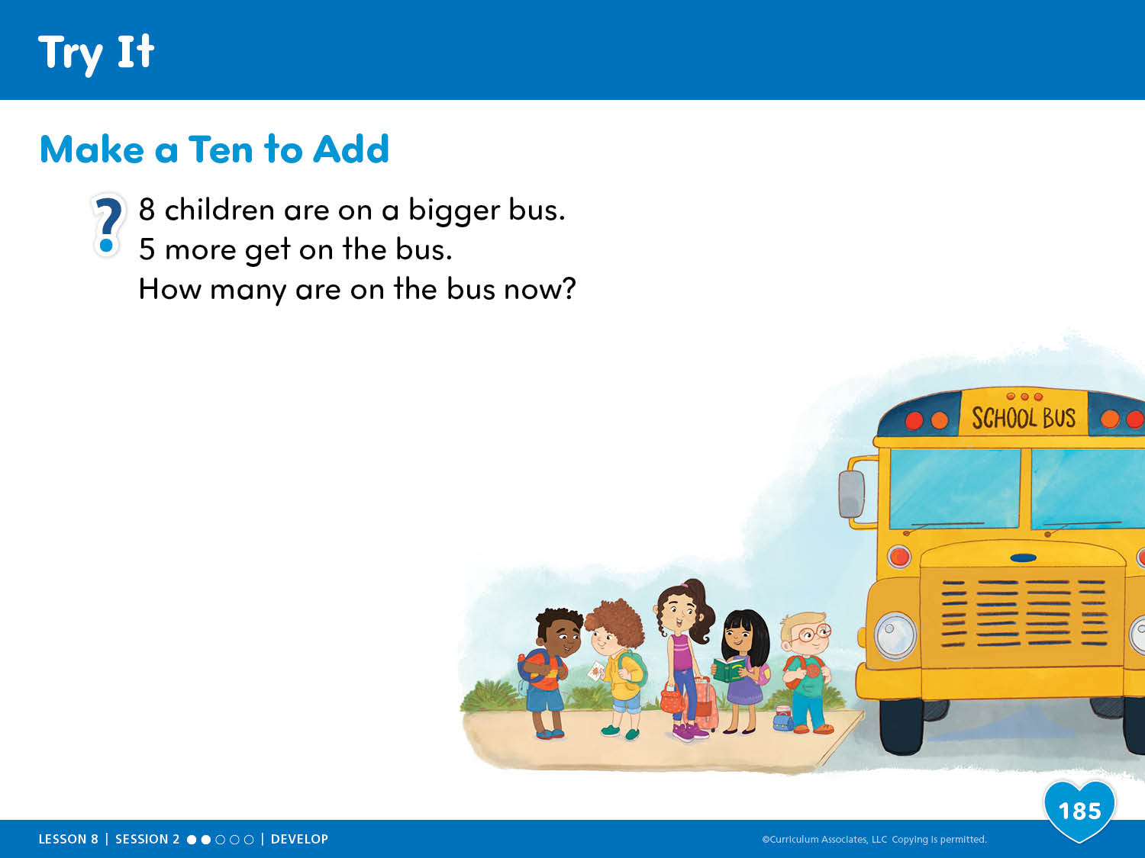
Try It
Notes:
Try-Discuss-Connect – Teacher’s Guide page 185
How can making a ten help you solve a problem?
Try It
Read the problem aloud:
8 children are on a bigger bus. 5 more get on the bus. How many are on the bus now?
Use Say It Another Way to help children make sense of the problem. Ensure children understand that there are different ways to model and solve the problem. Have children work independently on Try It.

Slide 9
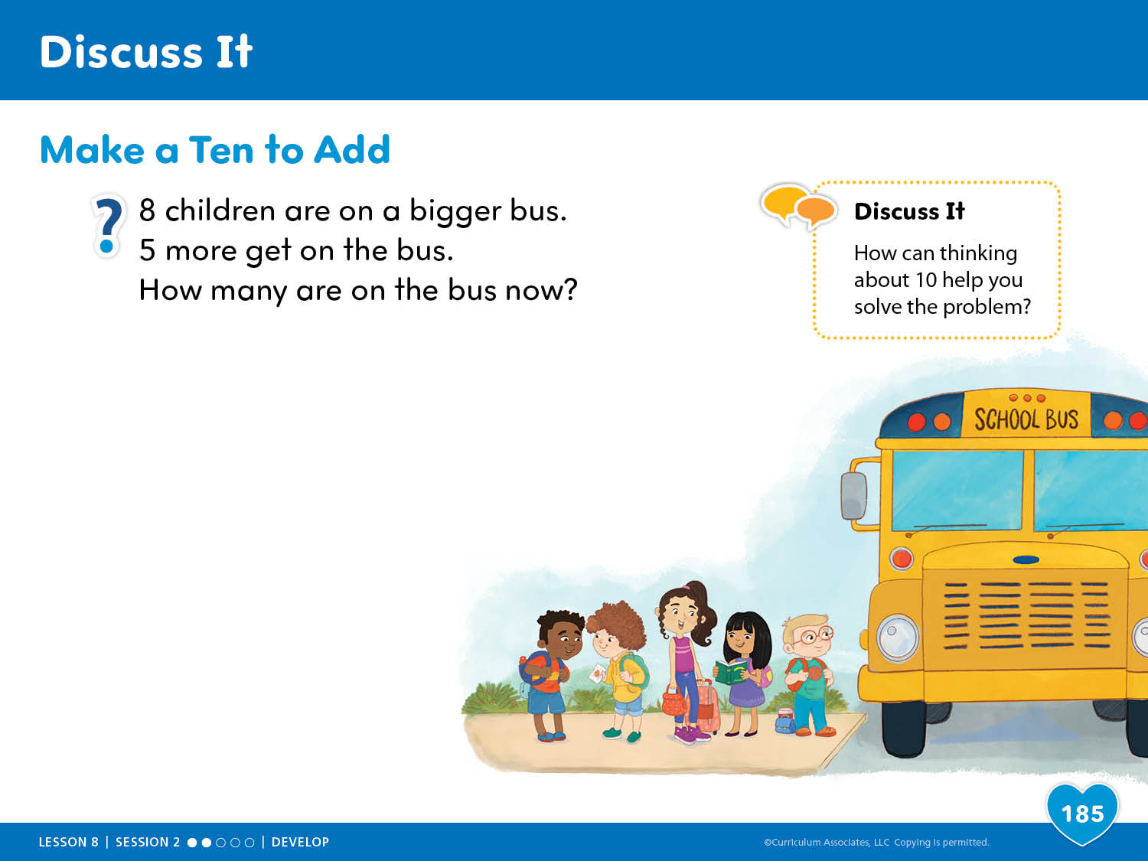
Discuss It
Notes:
Try-Discuss-Connect – Teacher’s Guide page 185
How can making a ten help you solve a problem?
Discuss It
Have children respond to Discuss It with a partner:
How can thinking about 10 help you solve the problem?
Select and Sequence Strategies
One possible order for whole class discussion:
Counting all
Counting on
Making a ten
ASK:
How does [child name]’s model show all the children on the bus?
Guide children to Compare and Connect the strategies.

Slide 10
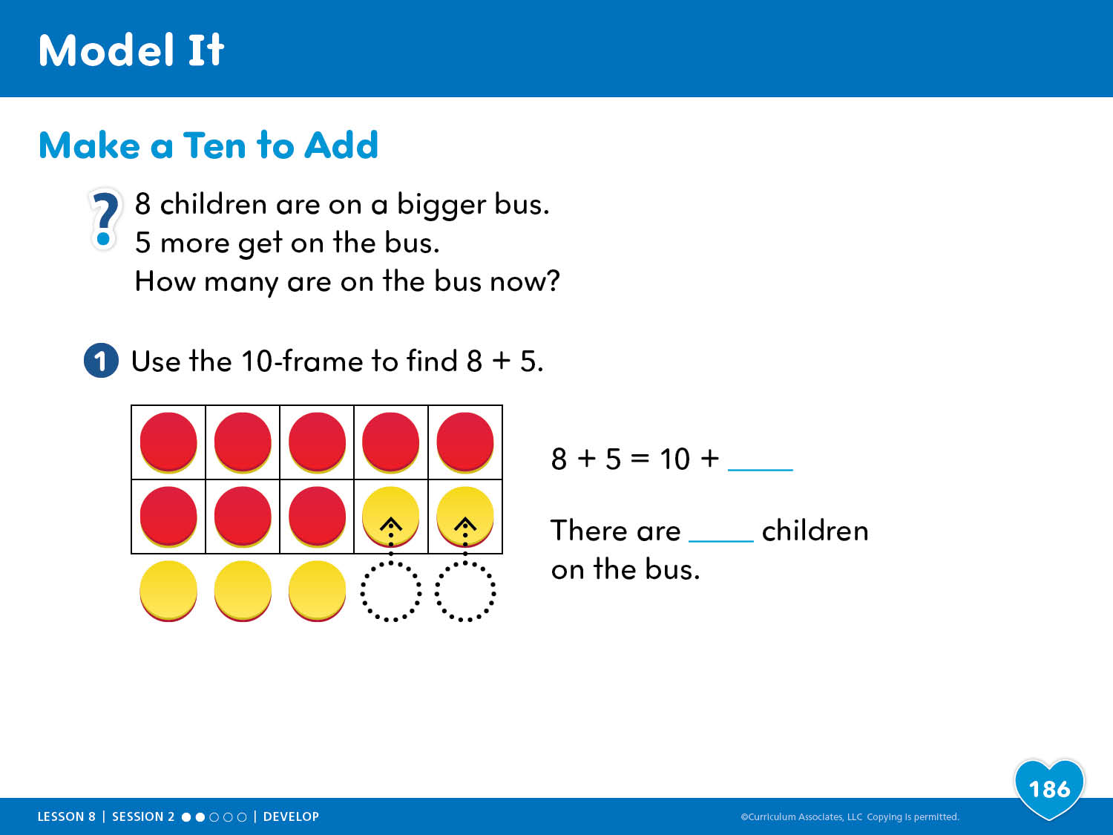
Model It
Notes:
Model It – Teacher’s Guide page 186
How can making a ten help you solve a problem?
ASK:
Where in the model are the children who are already on the bus represented?
Why are there 3 children left after 10 children are on the bus?
How could you know that 10 and 3 more is 13 without counting at all?

Slide 11
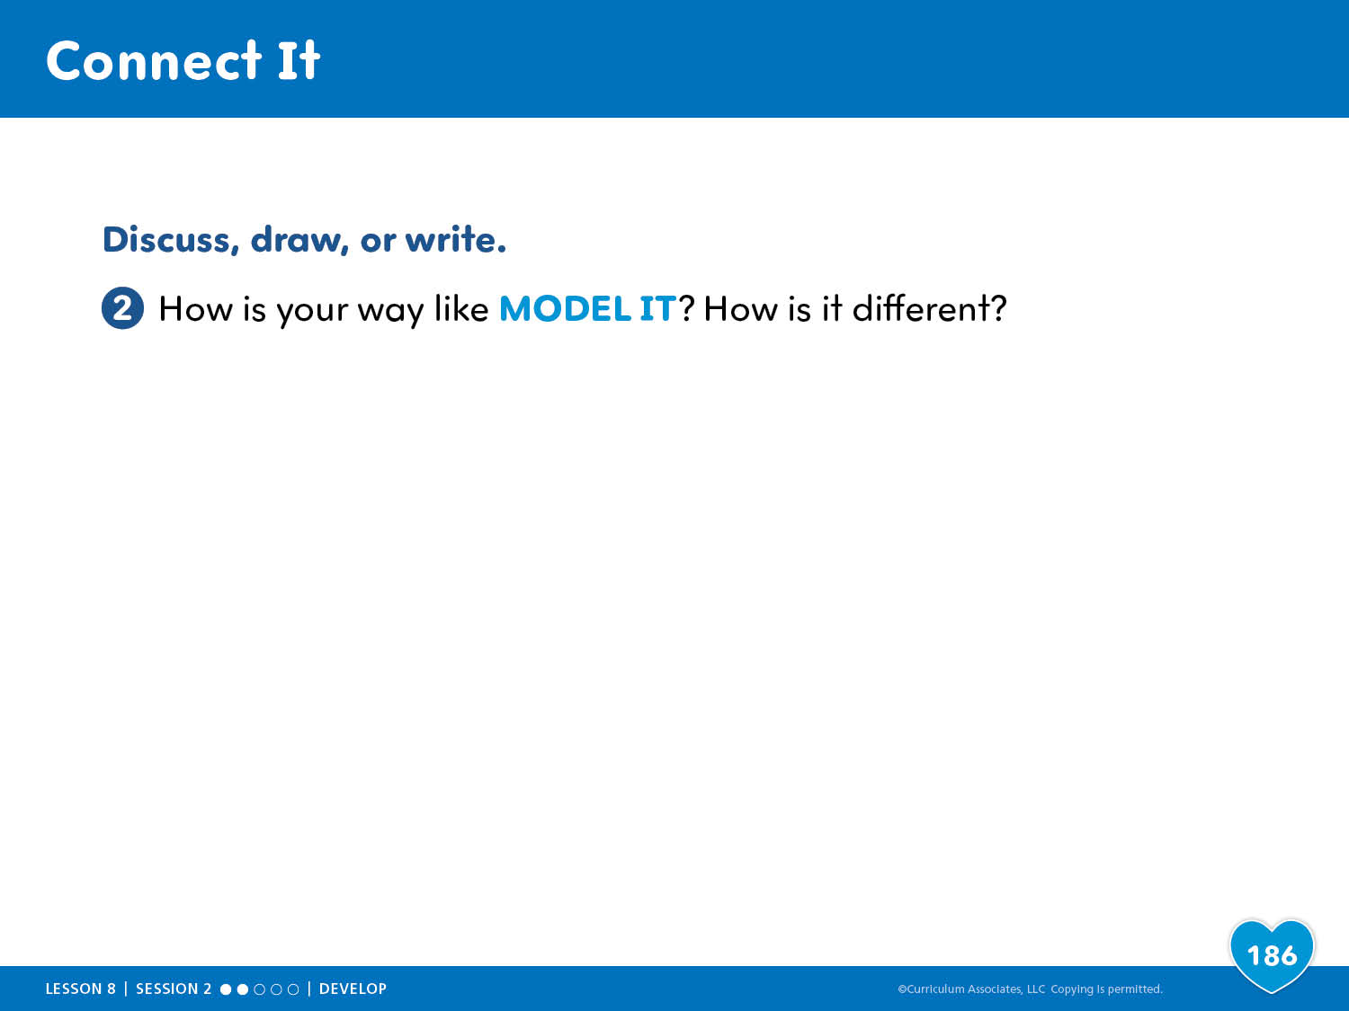
Connect It
Notes:
Connect It – Teacher’s Guide page 186
How can making a ten help you solve a problem?
ASK:
How did you show 8 and 5? How does Model It show 8 and 5?

Slide 12
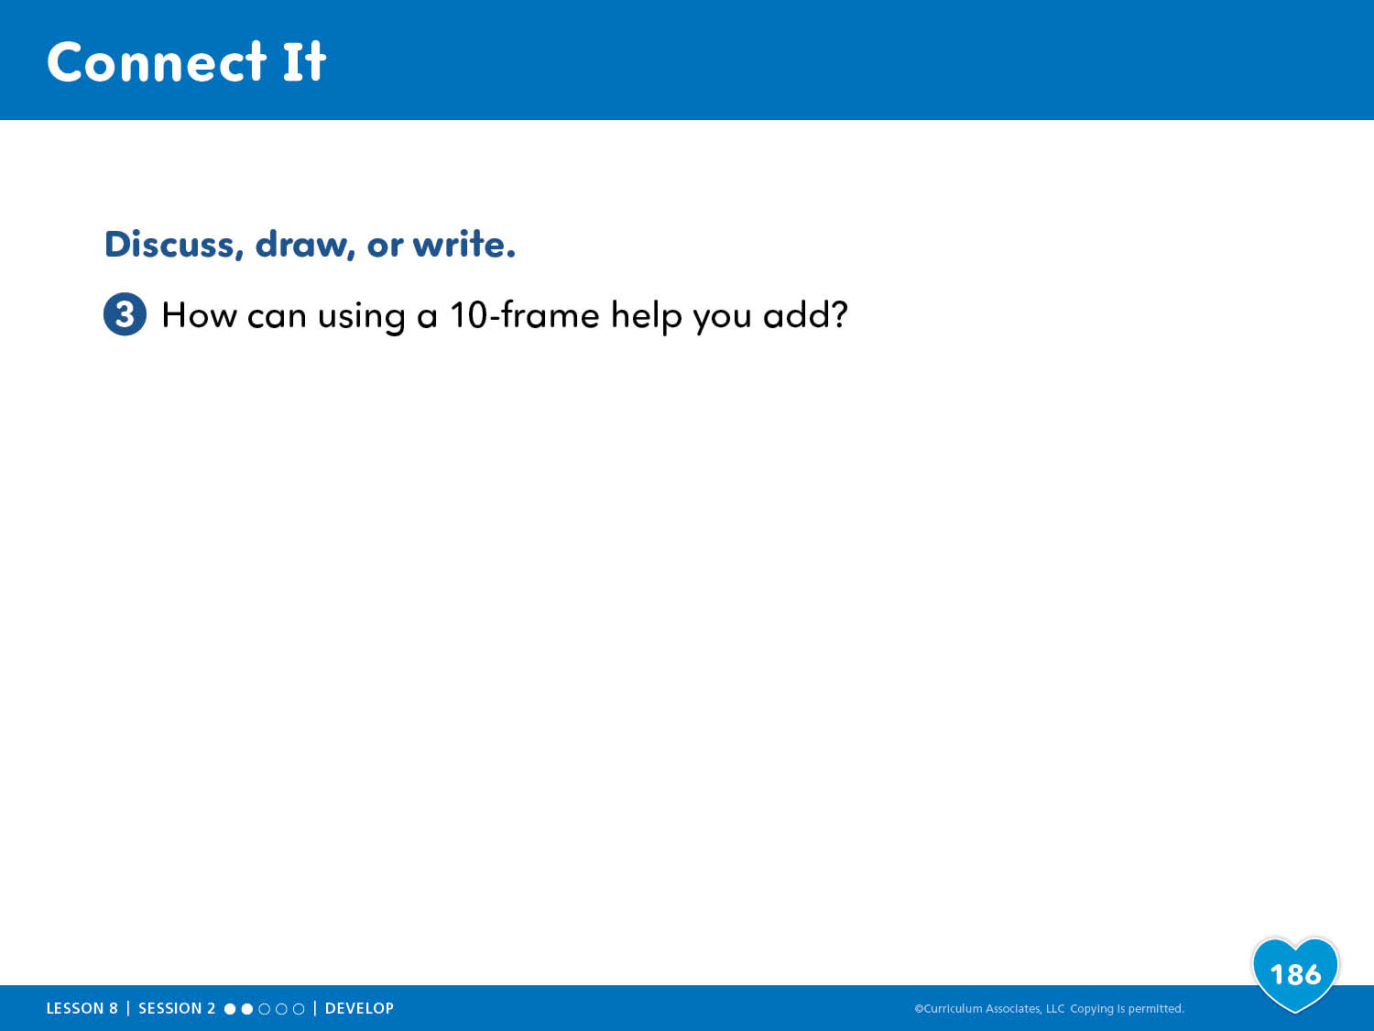
Connect It
Notes:
Connect It – Teacher’s Guide page 186
How can making a ten help you solve a problem?
ASK:
How can a 10-frame help you show making a ten to add?

Slide 13
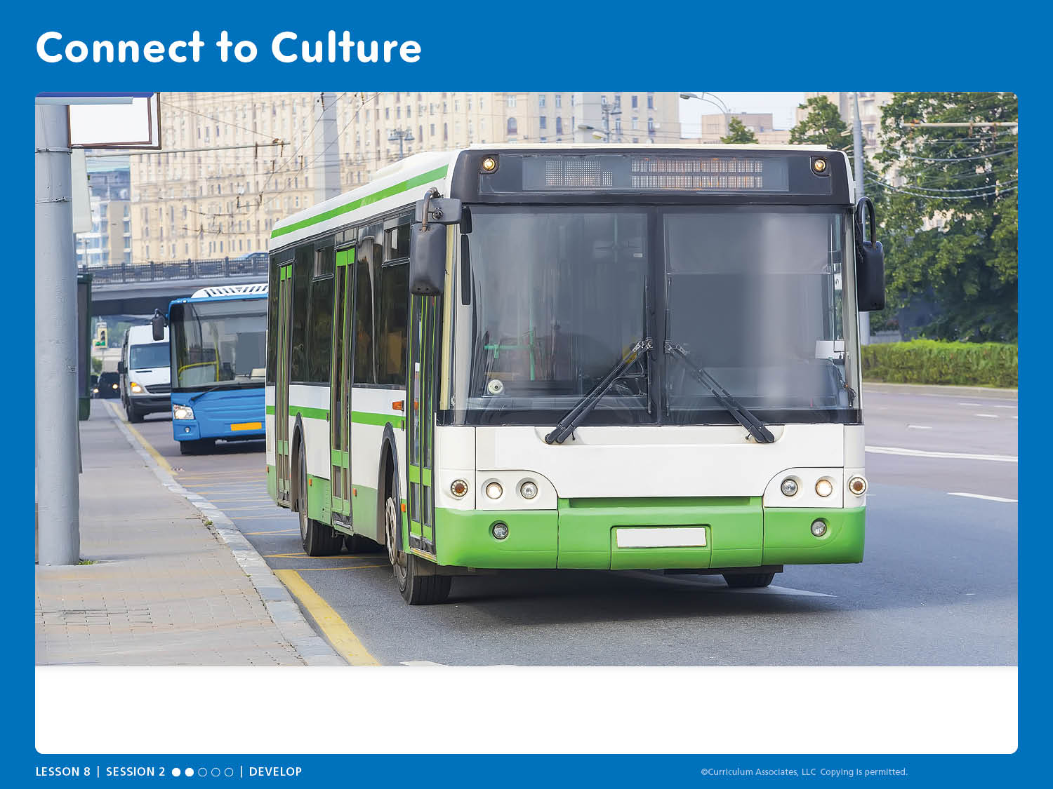
Connect to Culture
What would you like about riding a bus? When would you take a bus and not walk or use a car?
Notes:
Connect to Culture – Teacher’s Guide page 182b
Show the slide to start a conversation.
Invite children who ride a school bus to share their experiences. Then ask children to name other types of buses that they have seen or ridden on.
ASK: What would you like about riding a bus? When would you take a bus and not walk or use a car?
After children share, help them compare and contrast buses with cars and other ways to get around.

Slide 14

Apply It
Notes:
Apply It – Teacher’s Guide page 187
How can you break apart a number to make a ten and find totals?
Choose and Roll to Add
Materials (per pair)
Two-color counters (20)
Number cubes 4 to 9 (1)
10-Frame Cards 6 to 9 (1)
10-Frames Workmat (1)
Preparation: Make a deck of cards for each pair with 10-frame number cards 6 to 9. Cover the numbers 1, 2, and 3 on the number cubes with stickers and write 7, 8, and 9 on the stickers.

Slide 15
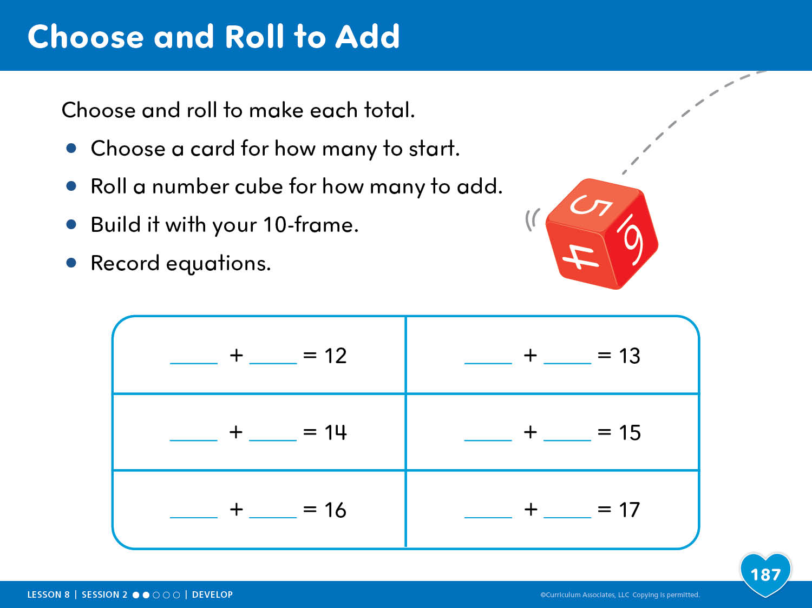
Choose and Roll to Add
Notes:
Apply It – Teacher’s Guide page 187
How can you break apart a number to make a ten and find totals?
Choose and Roll to Add
This activity gives children opportunities to add two single-digit numbers by decomposing one of the digits to make a ten.
ASK:
How did making a ten help you add?
What totals could you make with the number cubes that are not on the page? What did you roll to make those totals?

Slide 16

Centers and Practice
Session Centers
Apply It Problems
Centers Library
Practice
Notes:
Session Centers: Choose and Roll to Add
Apply It Problems 1–4
Centers Library: Shake and Spill, Counting Collections
Practice: Example, Problems 1–6

Slide 17

Choose and Roll to Add

Slide 18
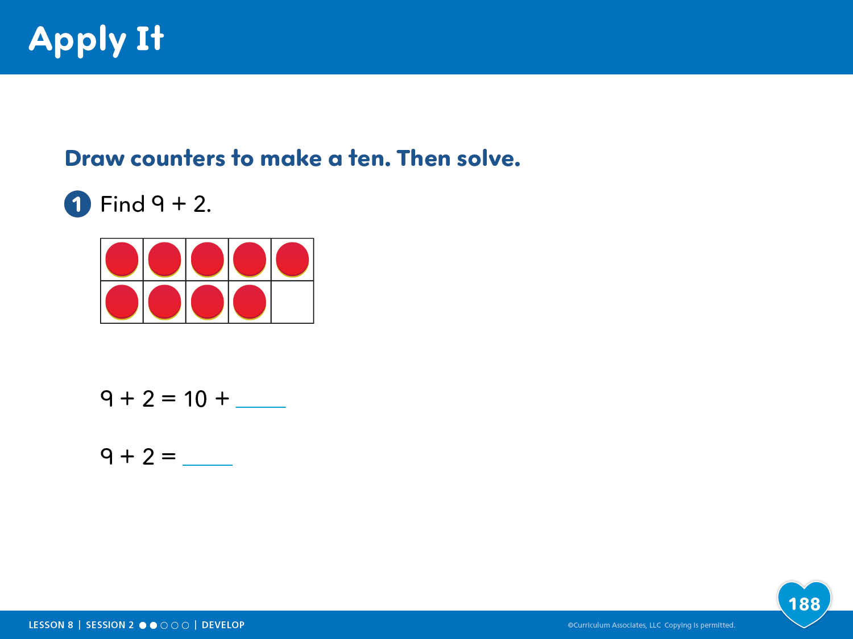
Apply It

Slide 19
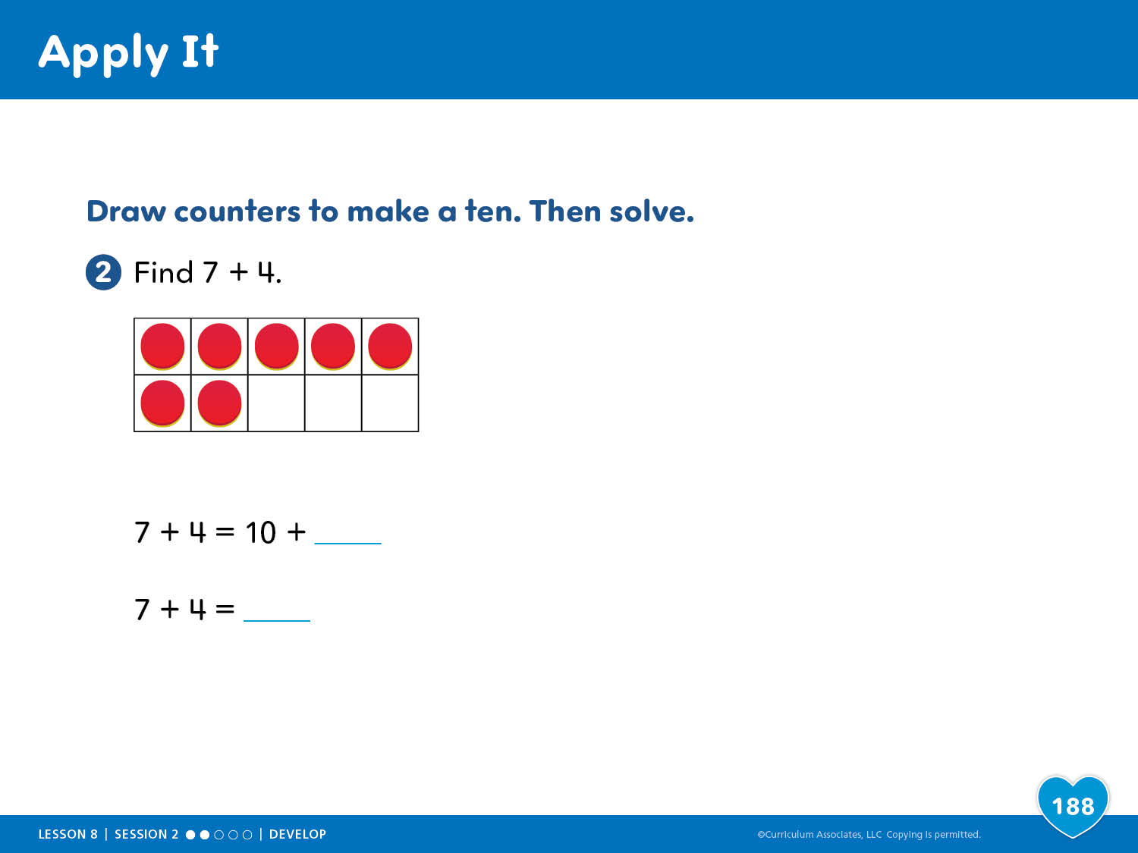
Apply It

Slide 20
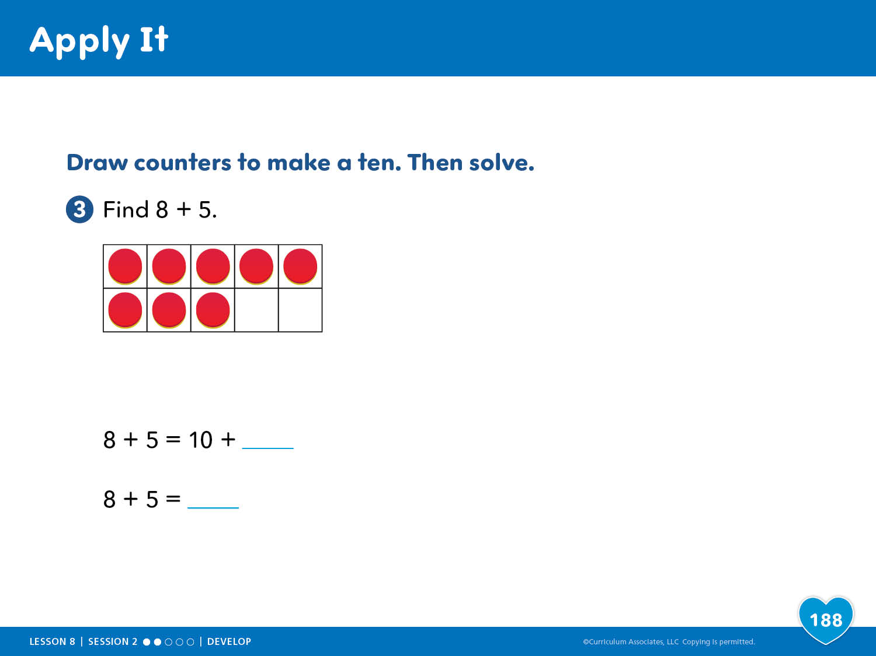
Apply It

Slide 21
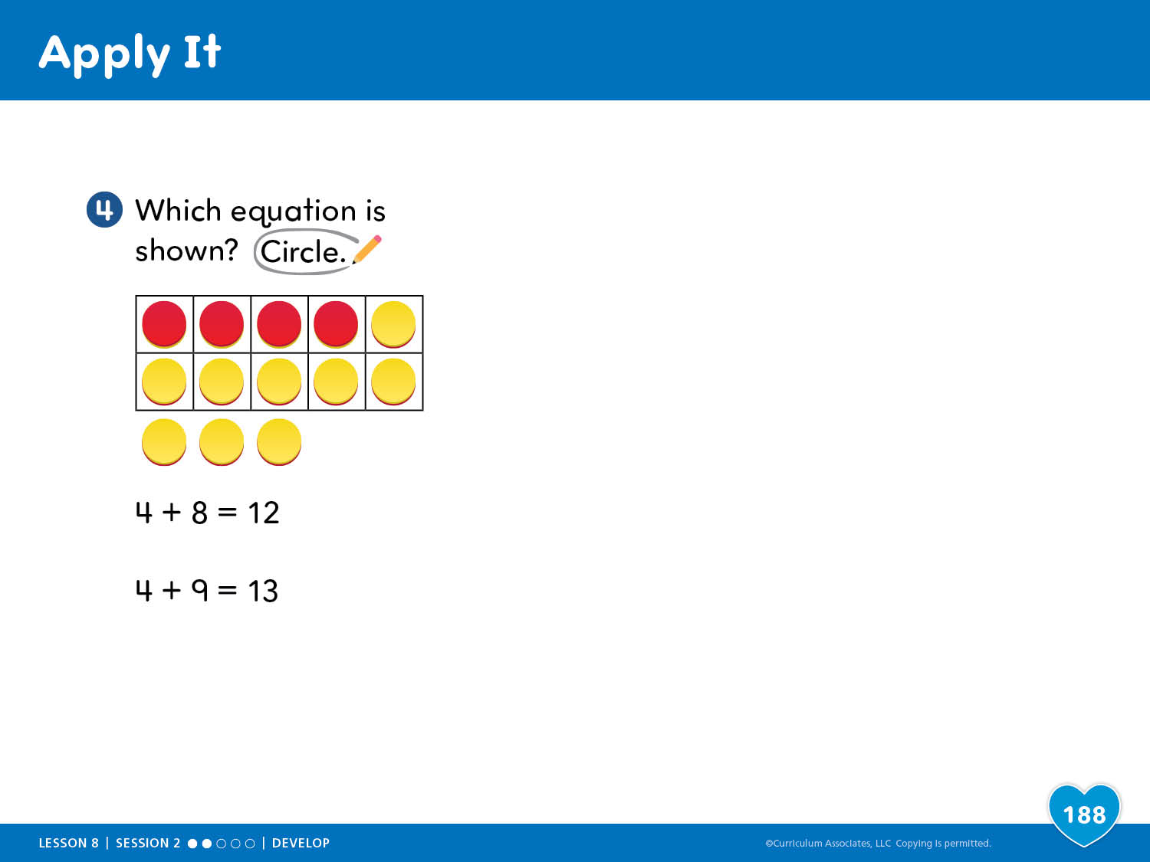
Apply It

Slide 22
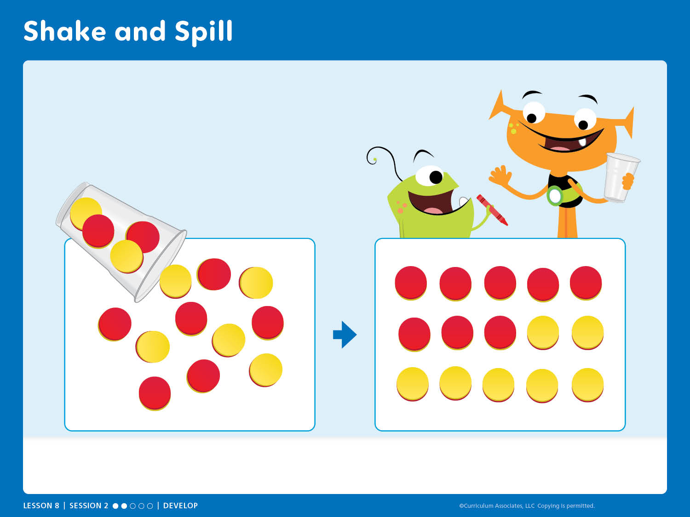
Shake and Spill
Centers Library
SKILL REVIEW Shake and Spill, Card 1

Slide 23
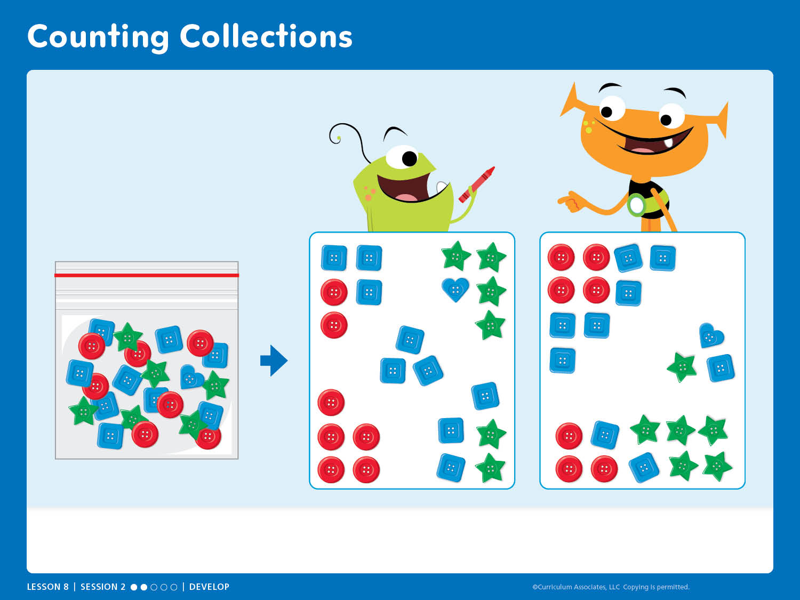
Counting Collections
Centers Library
FLUENCY Counting Collections, Card 11

Slide 24
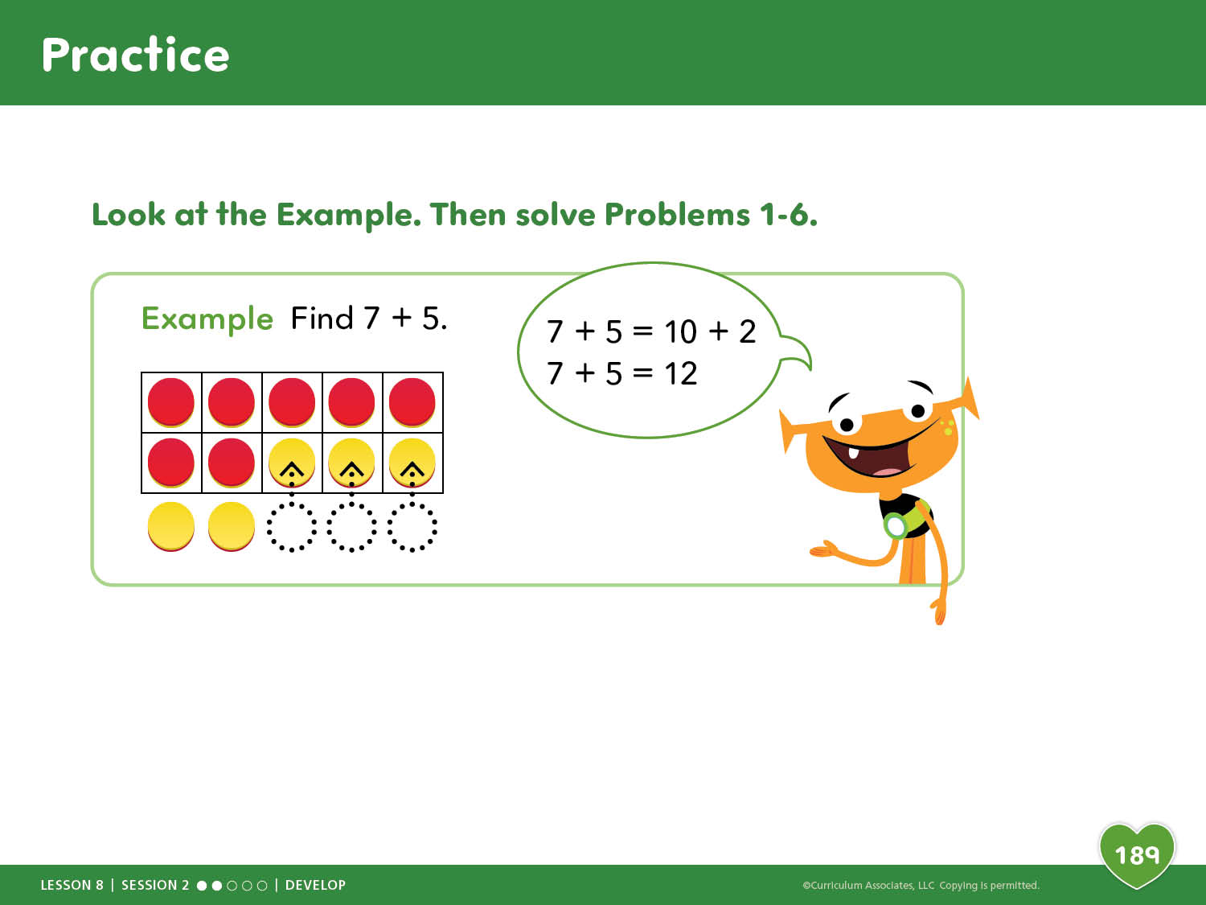
Practice

Slide 25
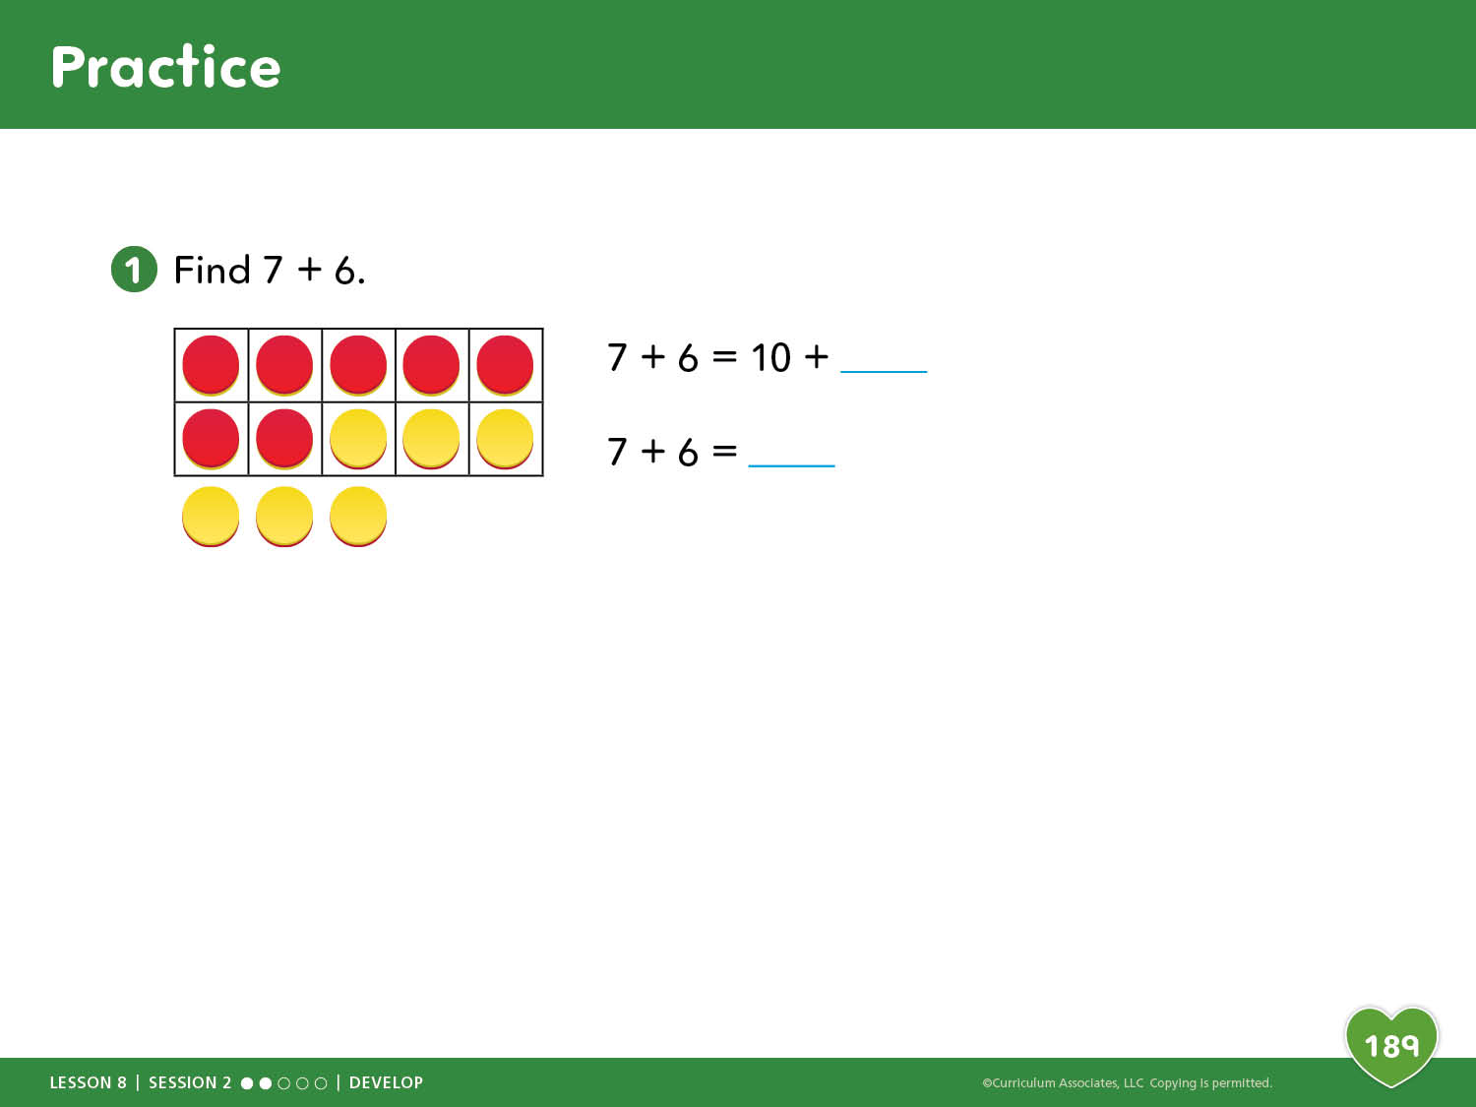
Practice

Slide 26
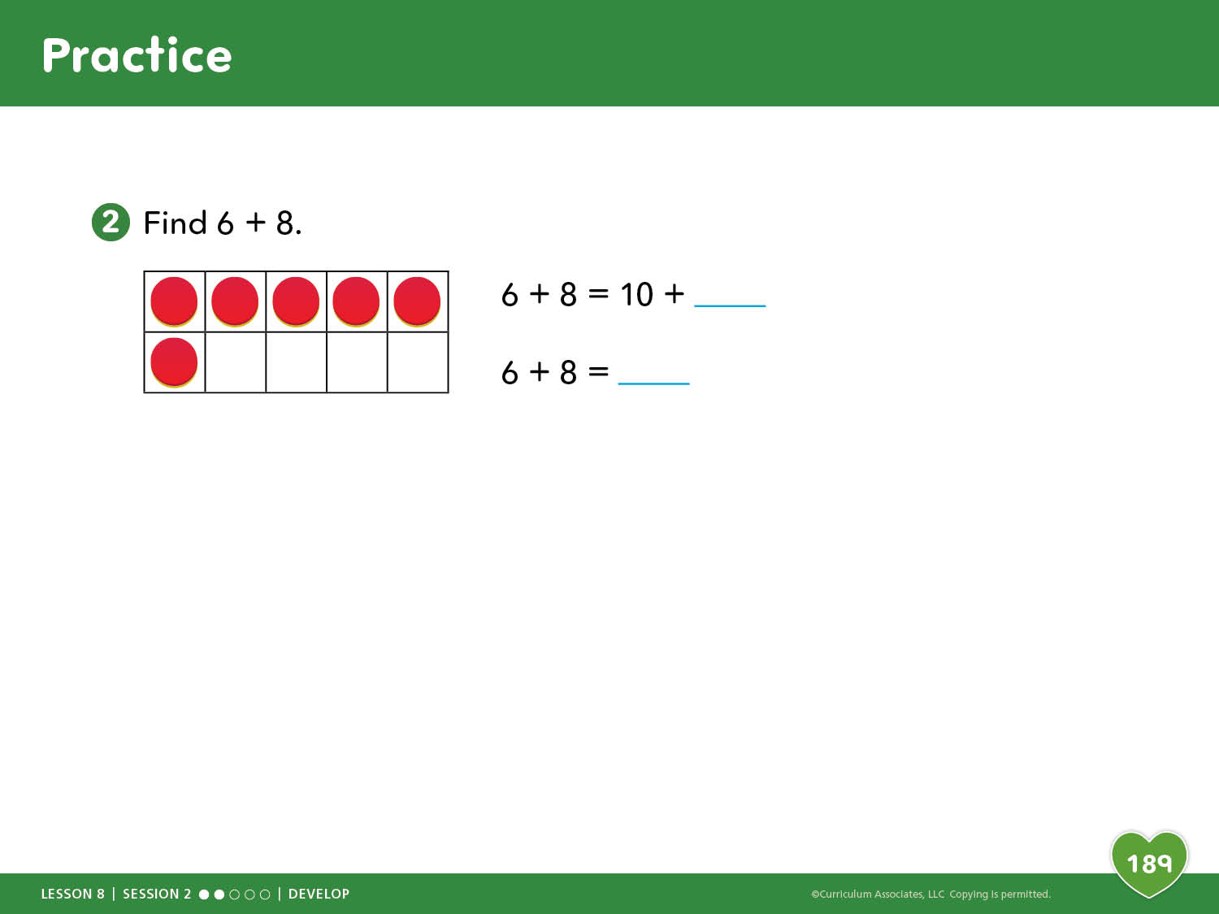
Practice

Slide 27
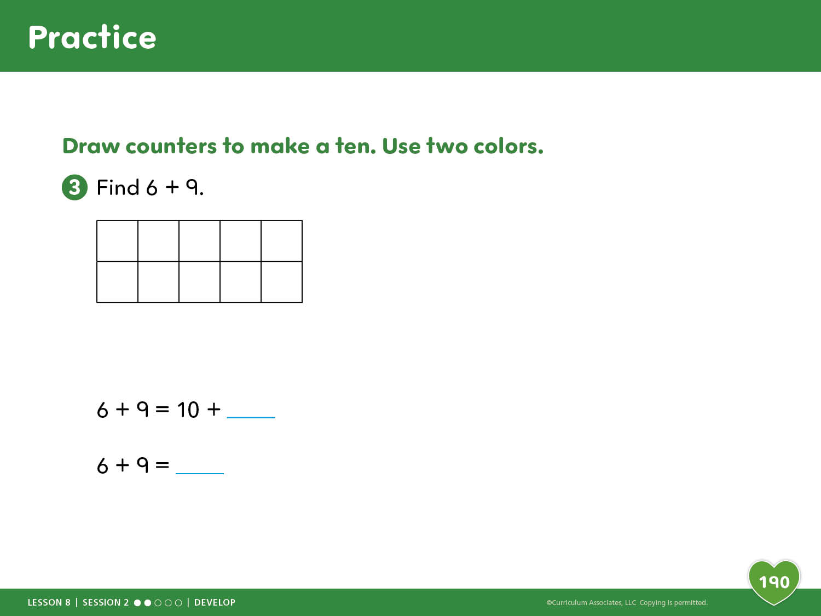
Practice

Slide 28
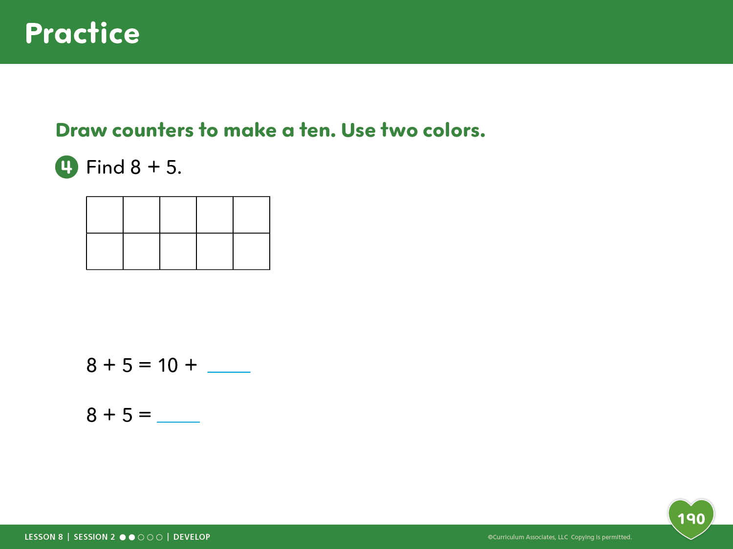
Practice

Slide 29

Practice

Slide 30
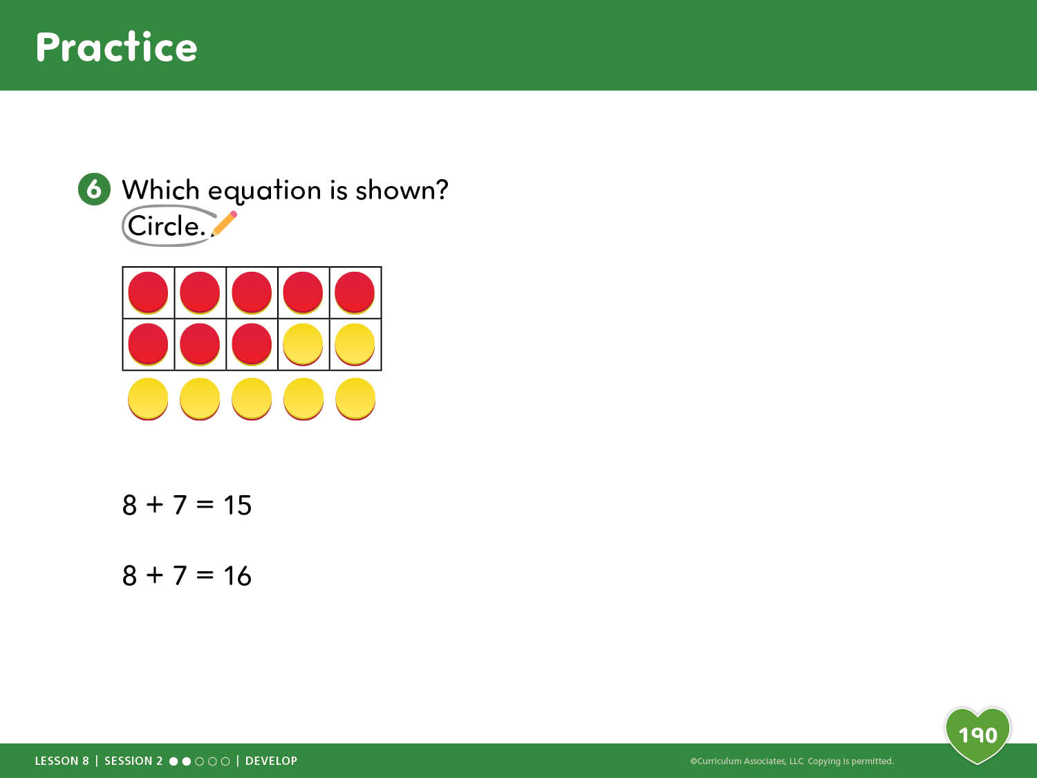
Practice

Slide 31

Reflection

Slide 32
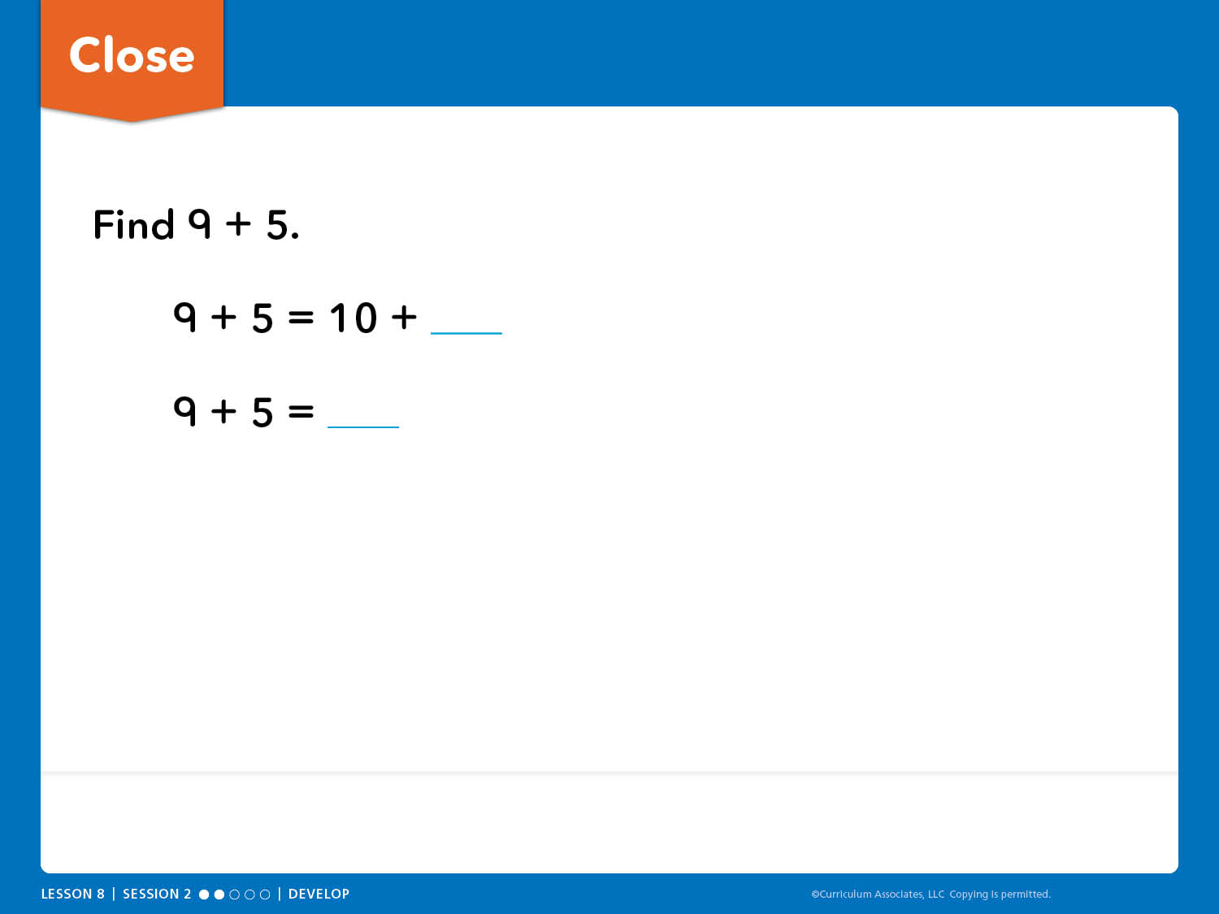
Close
Math Toolkit: counters, 10-frames, number bonds

Slide 33

Connect to Culture
Would you like to travel to school by boat? What do you wonder about how children in other places get to school?
Notes:
Connect to Culture – Teacher’s Guide page 182b
ANYTIME DURING THE LESSON
During read-aloud or other whole class times, guide an exploration of ways children around the world get to school based on children’s questions and curiosity.
Show the slide and tell children that in Cambodia (a country in Asia), some children get to school by boat.
ASK: Would you like to get to school by boat? What do you wonder about how children in other places get to school?
Using videos, books, online searches, and information from children and their families, investigate ways children get to school around the world.

