Slide 1
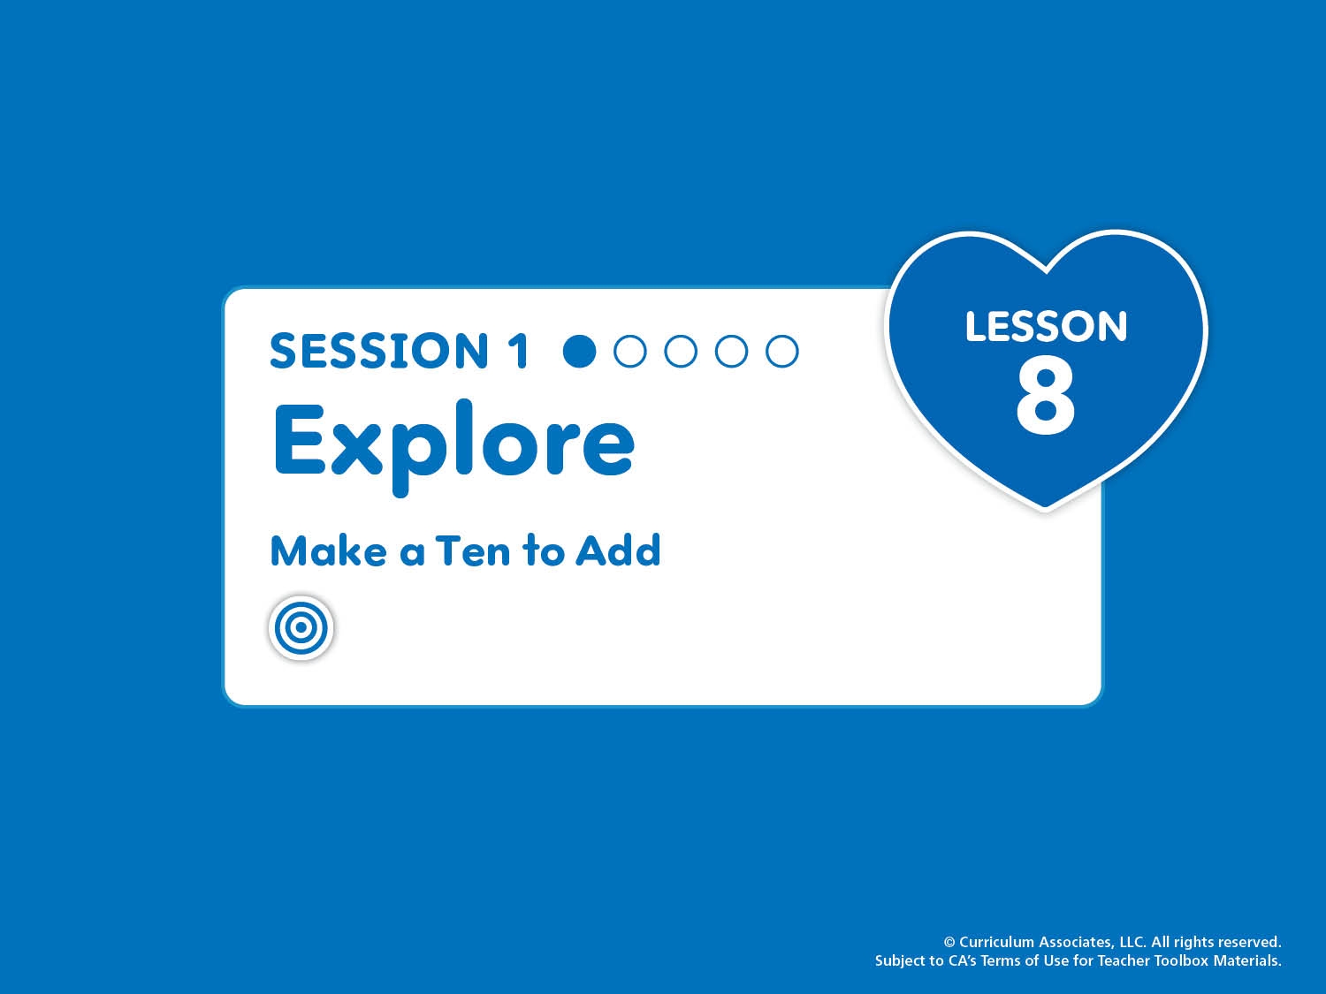
Lesson 8, Session 1: Explore
Make a Ten to Add
Break apart a number to make a ten. Use this strategy to add.
Notes:
Purpose
Explore how to break apart an addend to make a ten.
Explore patterns when making a ten to add on to 8 and 9.
Math Toolkit
Make available for use at any time in the lesson:
Two-color counters
10-Frames Workmat
Number Bonds Workmat

Slide 2
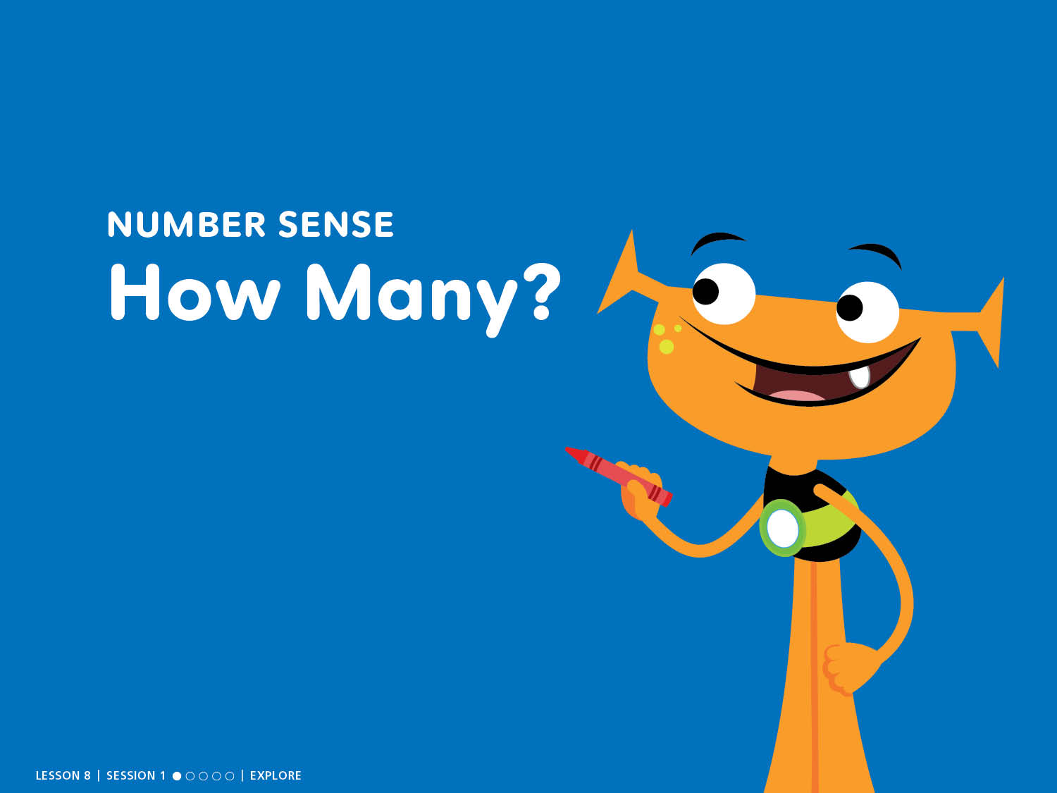
NUMBER SENSE
How Many?
Notes:
START: Number Sense – Teacher’s Guide page 183a
How Many?
ASK: What can you count? How many do you see?
Counting Tip
RHYME AND COUNT (chant) Counting forward and backward is fun as can be. It helps me with math and that's great for me! Have children count forward by ones from 1 to 20. Then have them count back from 20 to 0.

Slide 3
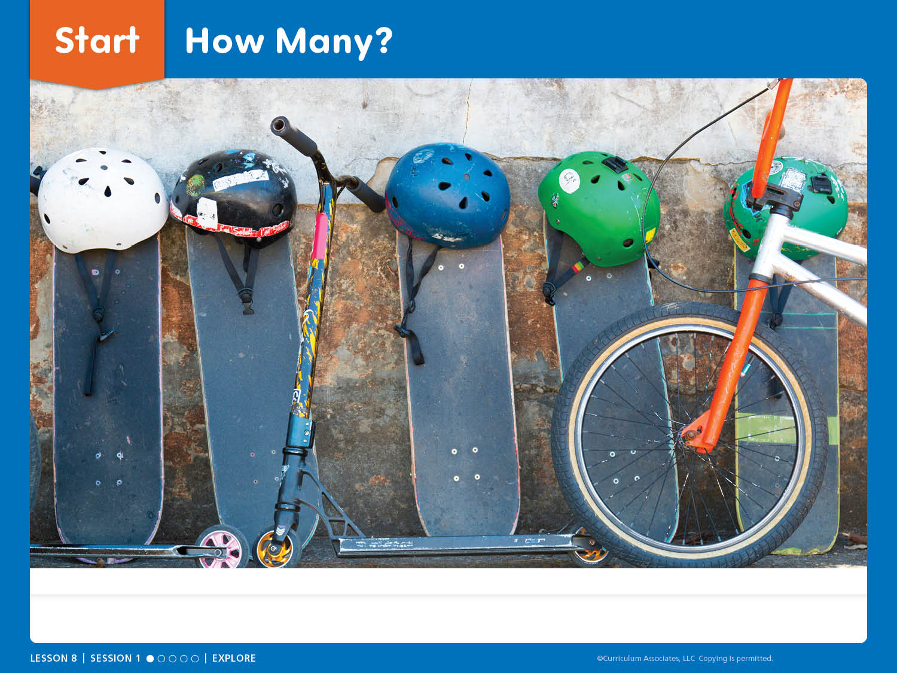
Start: How Many?
What can you count? How many do you see?
Notes:
START: Number Sense – Teacher’s Guide page 183a
How Many?
ASK: What can you count? How many do you see?
Encourage children to take time and look at the picture.
Have children turn and talk about what items they counted and how many they saw.
Listen and look for a variety of solutions for whole class sharing.
Facilitate Whole Class Discussion
What things did you and your partner count?
How many did you see?
Are there more helmets or skateboards? How do you know?

Slide 4
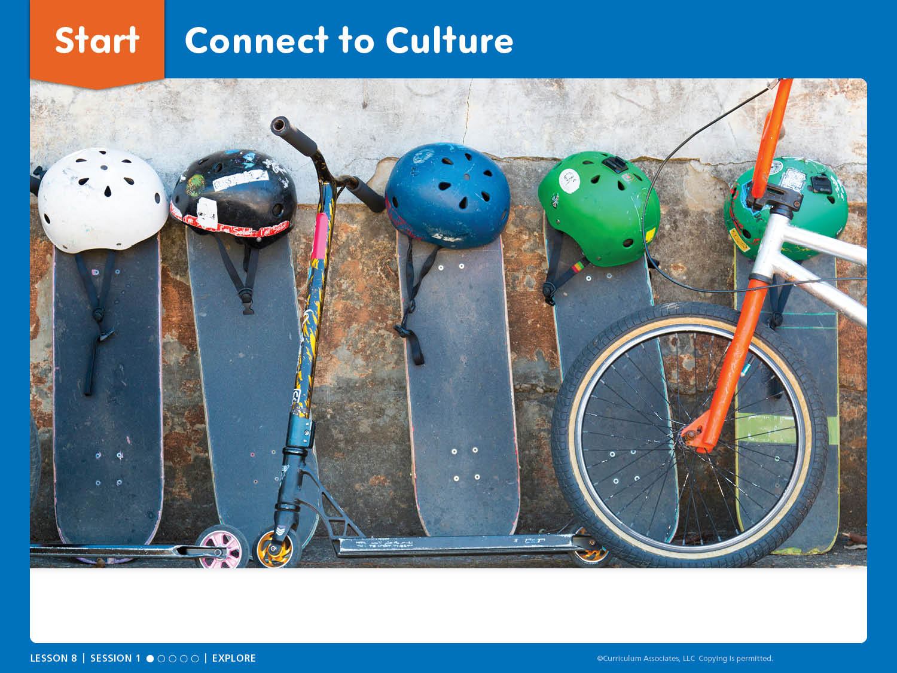
Start: Connect to Culture
When have you worn a helmet? When have you seen other people wearing helmets?
Notes:
Connect to Culture – Teacher’s Guide page 182b
After completing How Many?, encourage children to make personal connections to the helmets in the image.
ASK: When have you worn a helmet? When have you seen other people wearing helmets?
Have children turn and talk to share responses with a partner.
ASK: What do you notice about the times people wear helmets?
Guide children to notice people often wear helmets for safety when they are moving fast and might fall or crash.

Slide 5

Discover It
Notes:
Discover It – Teacher’s Guide page 183b
How can you make a ten?
Materials (per class)
Chairs (10)
Preparation: Place 10 chairs in 2 rows of 5.

Slide 6
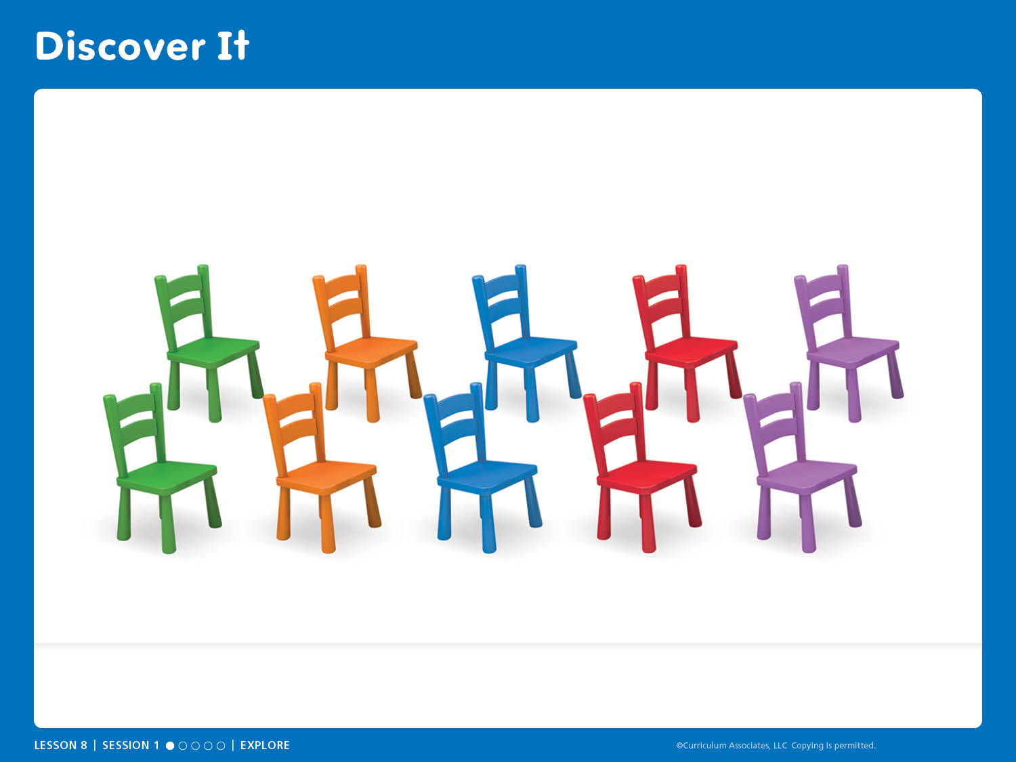
Discover It
What happens when you try to add more riders to the bus?
Notes:
Discover It – Teacher’s Guide page 183b
How can you make a ten?
Arrange 10 chairs in a 10-frame configuration. This models the context of the bus and connects it to the mathematics of making a ten.
ASK:
How many people can ride this bus?
What happens when you try to add more riders to the bus?
How can you tell there are riders who cannot find seats and have to wait for another bus?

Slide 7

Investigate It
Notes:
Investigate It – Teacher’s Guide page 183
How many are left over after you make a ten?
Materials (per pair)
Two-color counters (20)
Number cubes 1 to 6 (1)
10-Frames Workmat (1)

Slide 8
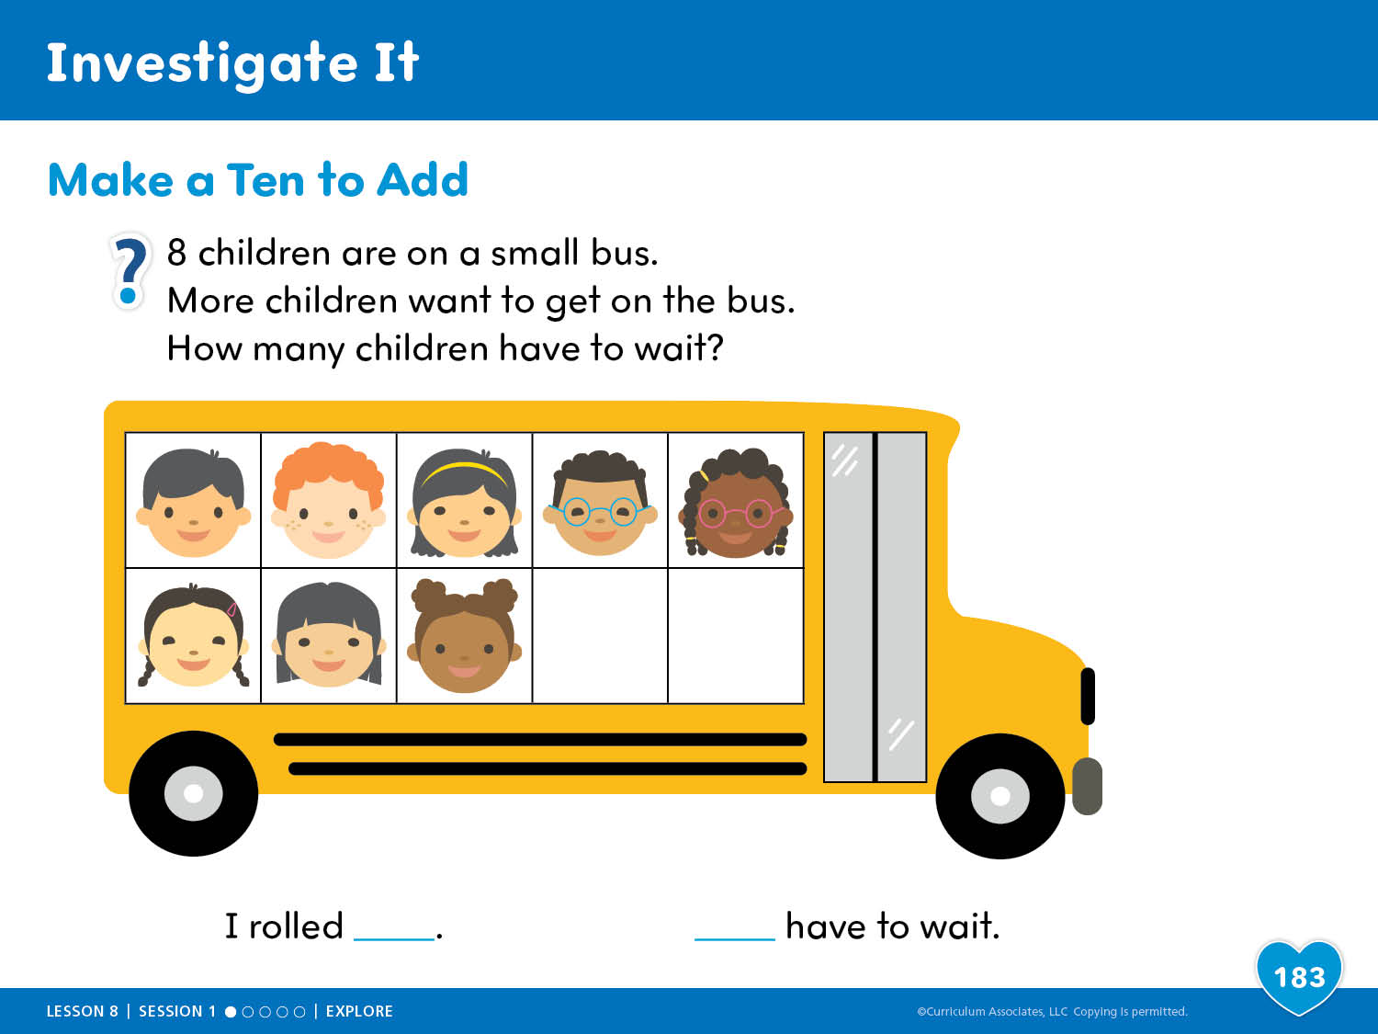
Investigate It
Notes:
Investigate It – Teacher’s Guide page 183
How many are left over after you make a ten?
ASK:
How many children have to wait? How do you know?
What patterns do you see in the number of riders who have to wait when you start with 8?
Uncover Thinking
When children identify how many new riders will have to wait, ask them how they can prove their thinking. Children may note that they can always use 2 counters to fill the 10-frame. They may immediately remove 2 counters from the set that represents new riders and count how many are left without using the 10-frame.

Slide 9
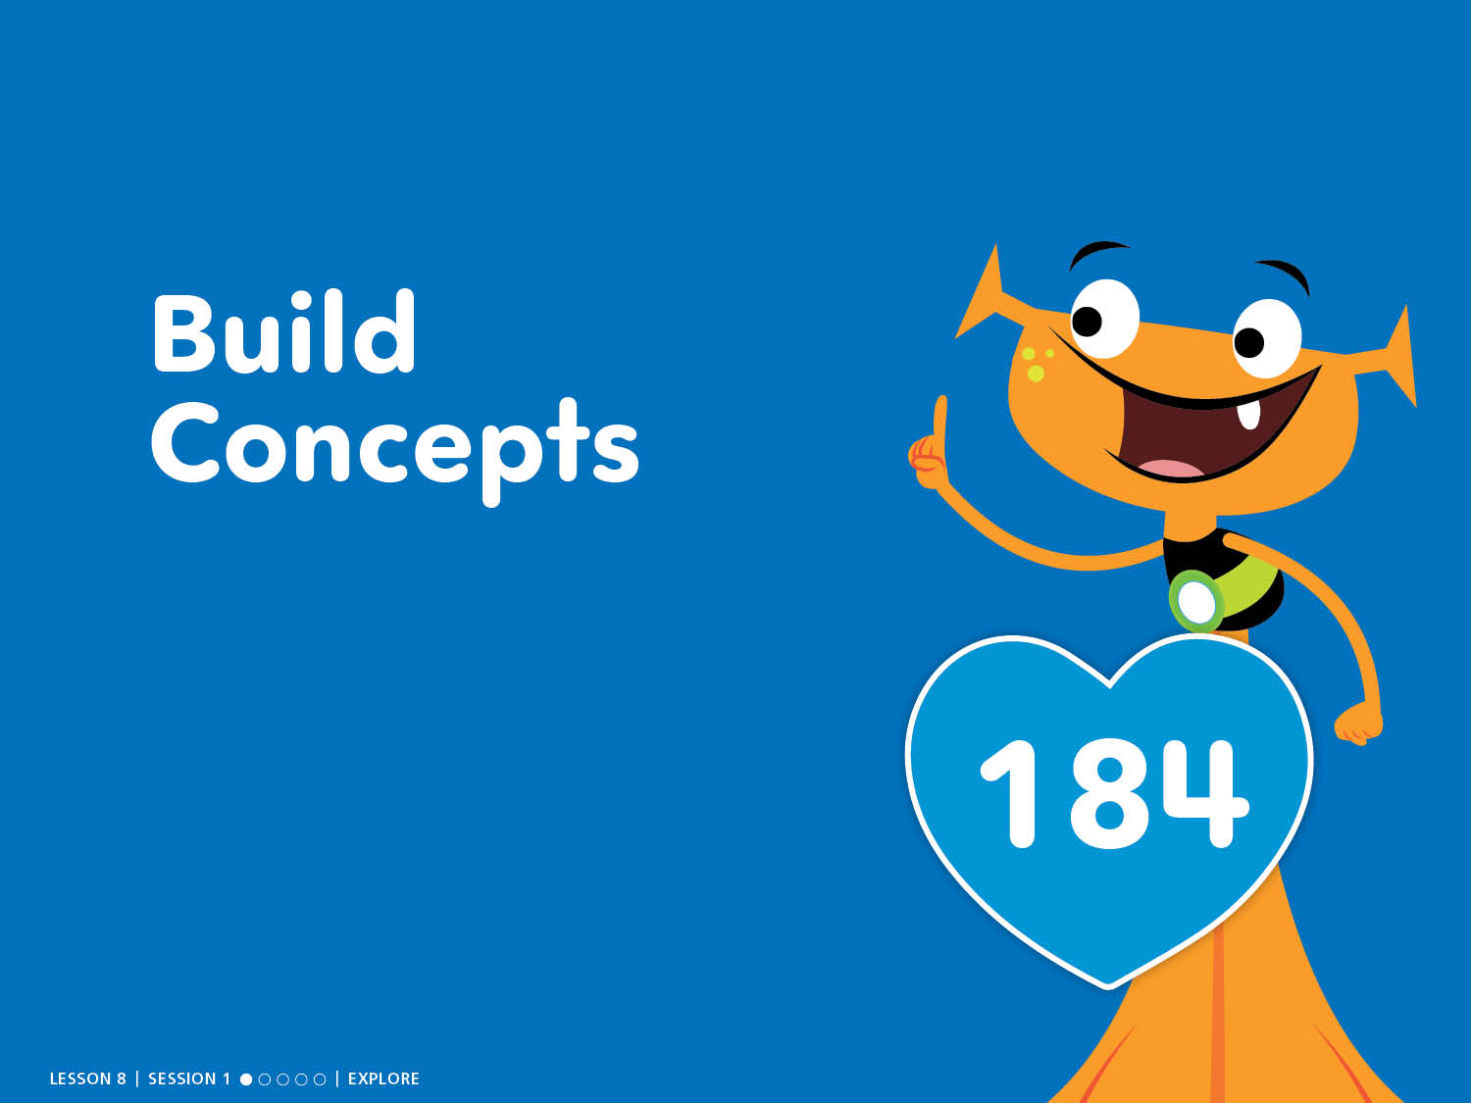
Build Concepts
Notes:
Build Concepts – Teacher’s Guide page 184
What does it mean when you say make a ten?

Slide 10
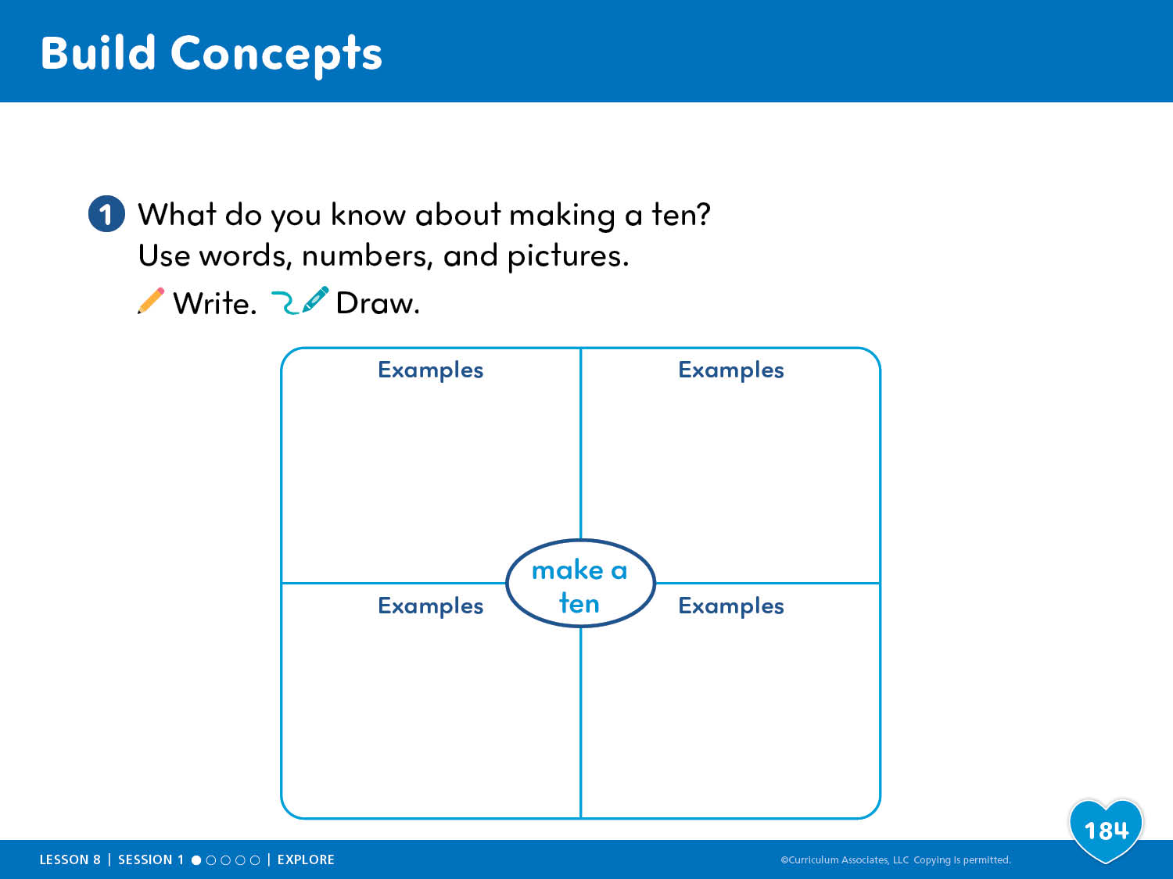
Build Concepts
Notes:
Build Concepts – Teacher’s Guide page 184
What does it mean when you say make a ten?

Slide 11
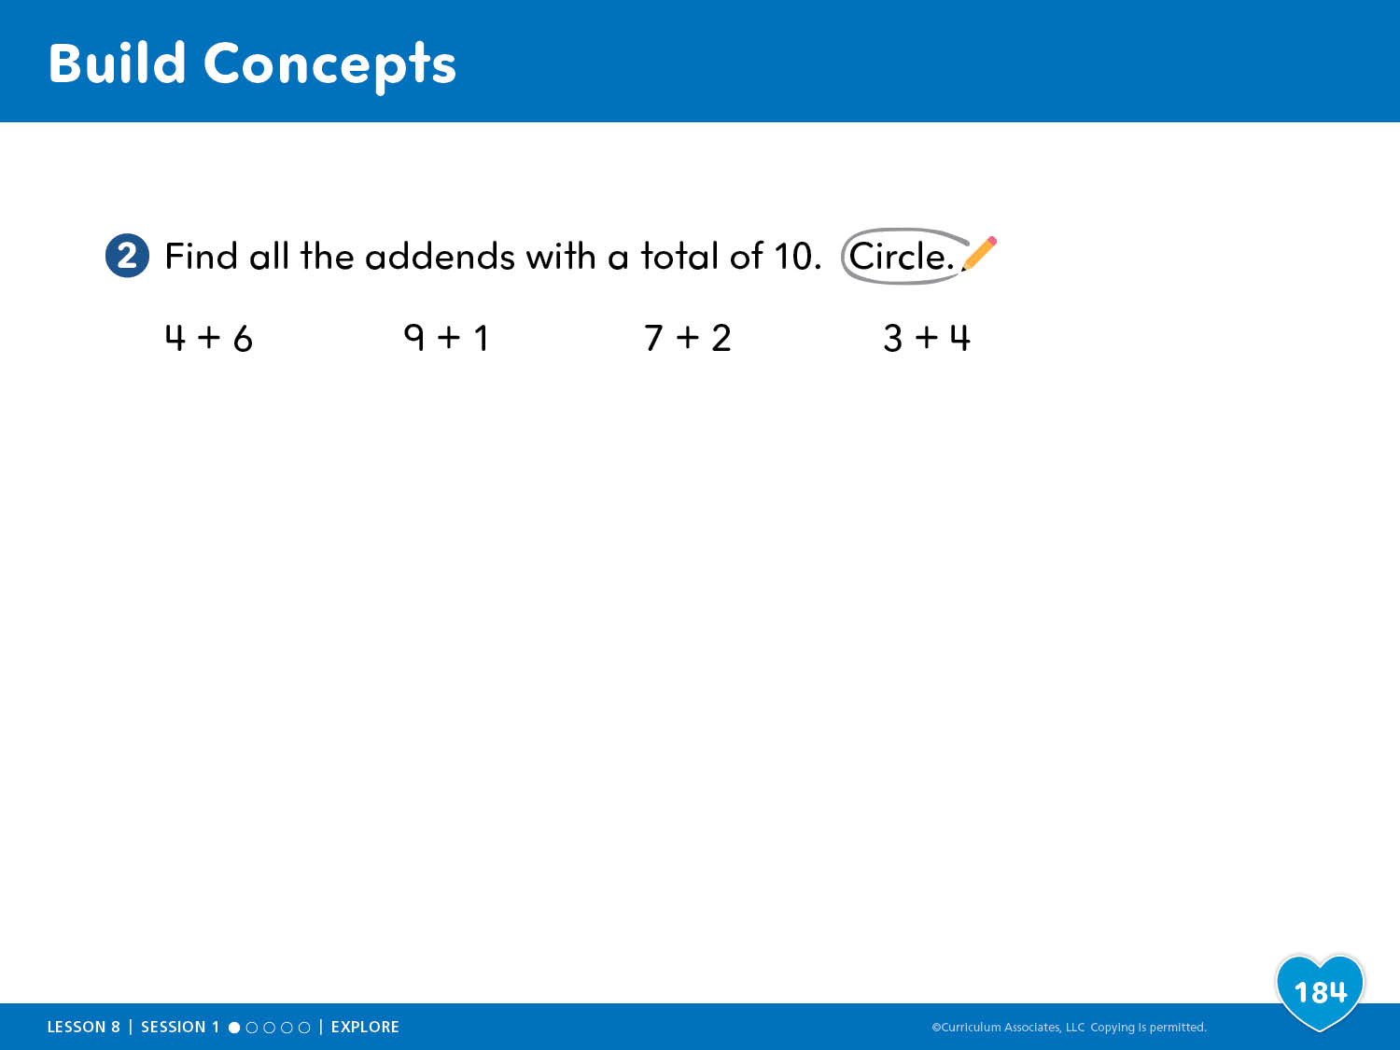
Build Concepts
Notes:
Build Concepts – Teacher’s Guide page 184
What does it mean when you say make a ten?

Slide 12
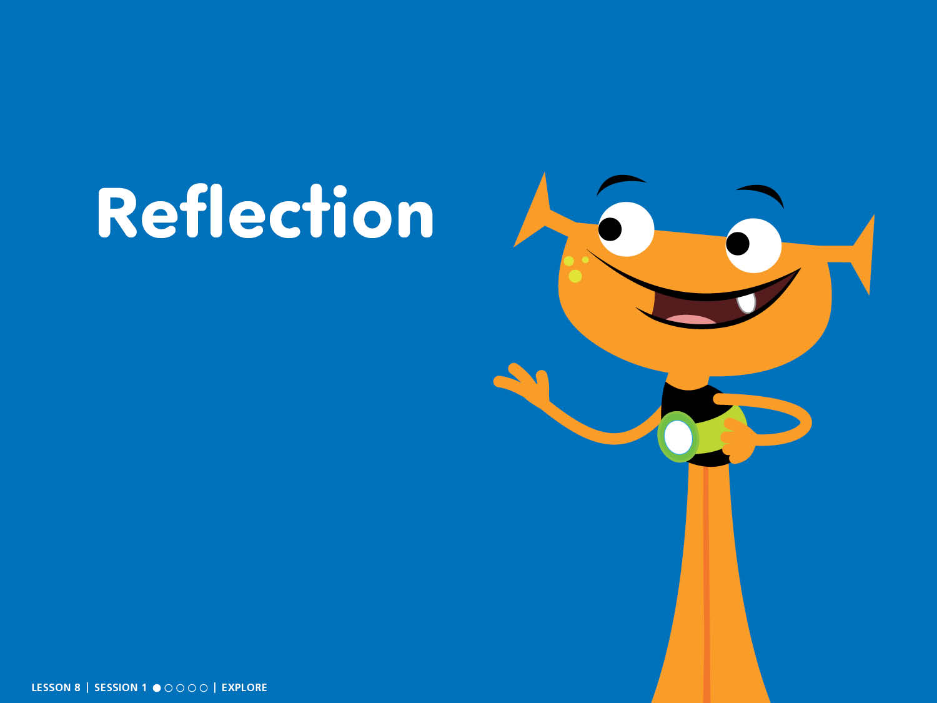
Reflection

Slide 13
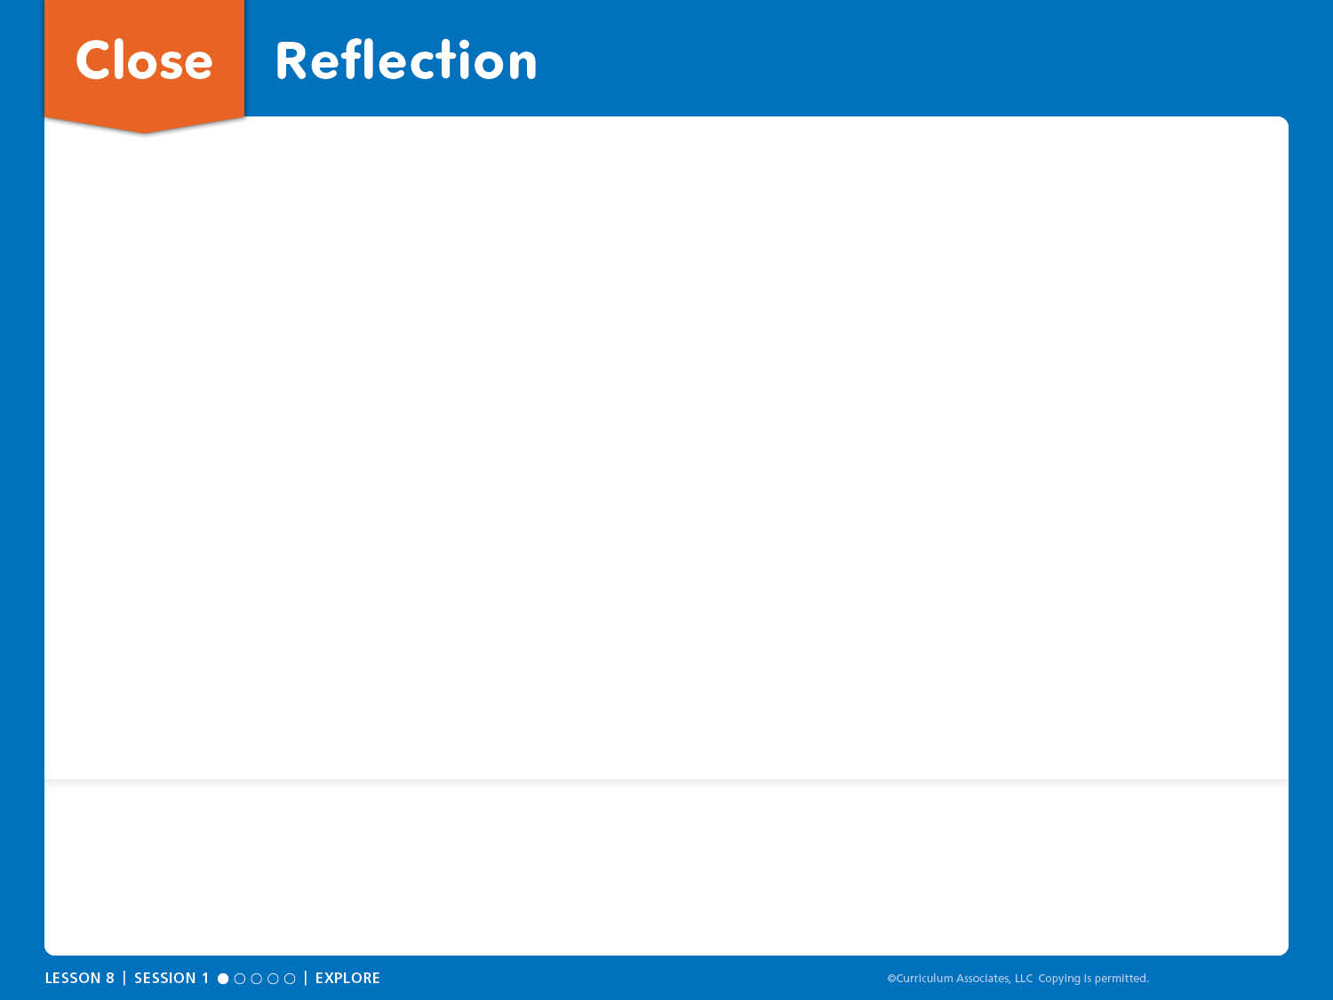
Close: Reflection
I learned . . .
I think . . .
I wonder . . .
MATH REFLECTION How did 10-frames help you show 10 and some more?
SELF REFLECTION Respecting Others: How can you show respect when you compare ways to make a ten with your classmates?

Slide 14
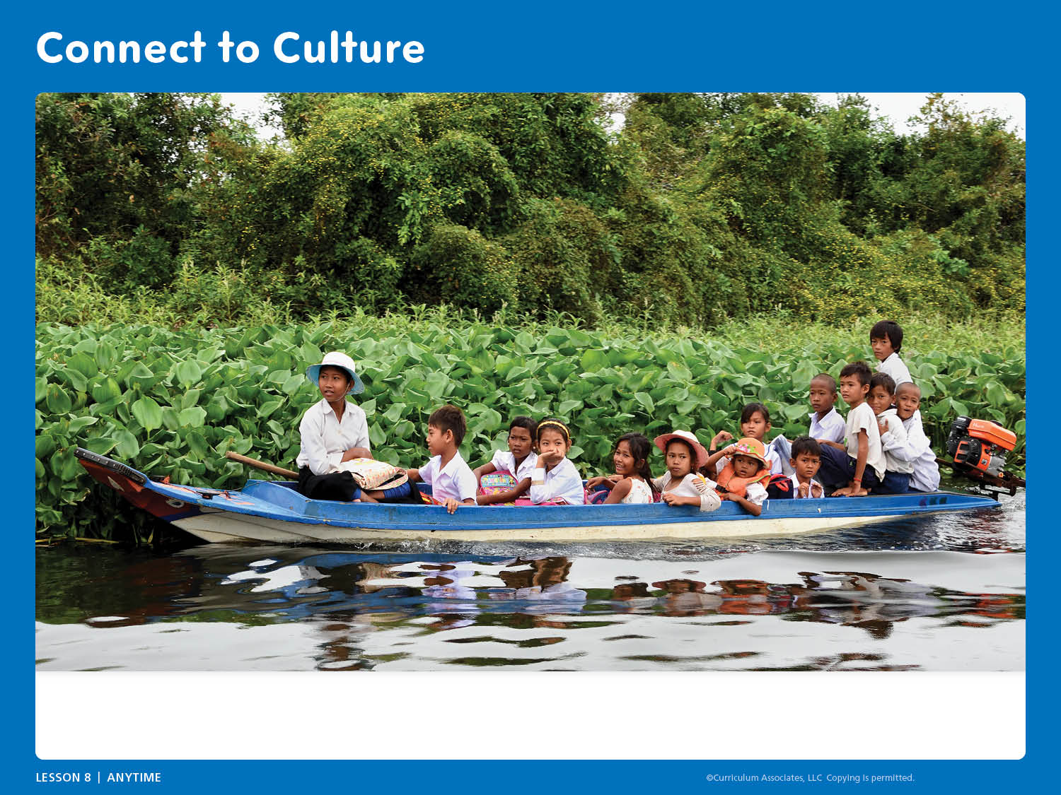
Connect to Culture
Would you like to travel to school by boat? What do you wonder about how children in other places get to school?
Notes:
Connect to Culture – Teacher’s Guide page 182b
ANYTIME DURING THE LESSON
During read-aloud or other whole class times, guide an exploration of ways children around the world get to school based on children’s questions and curiosity.
Show the slide and tell children that in Cambodia (a country in Asia), some children get to school by boat.
ASK: Would you like to get to school by boat? What do you wonder about how children in other places get to school?
Using videos, books, online searches, and information from children and their families, investigate ways children get to school around the world.

