Slide 1
Week 30
Session 5:
Unit 6 Assessment

Slide 2
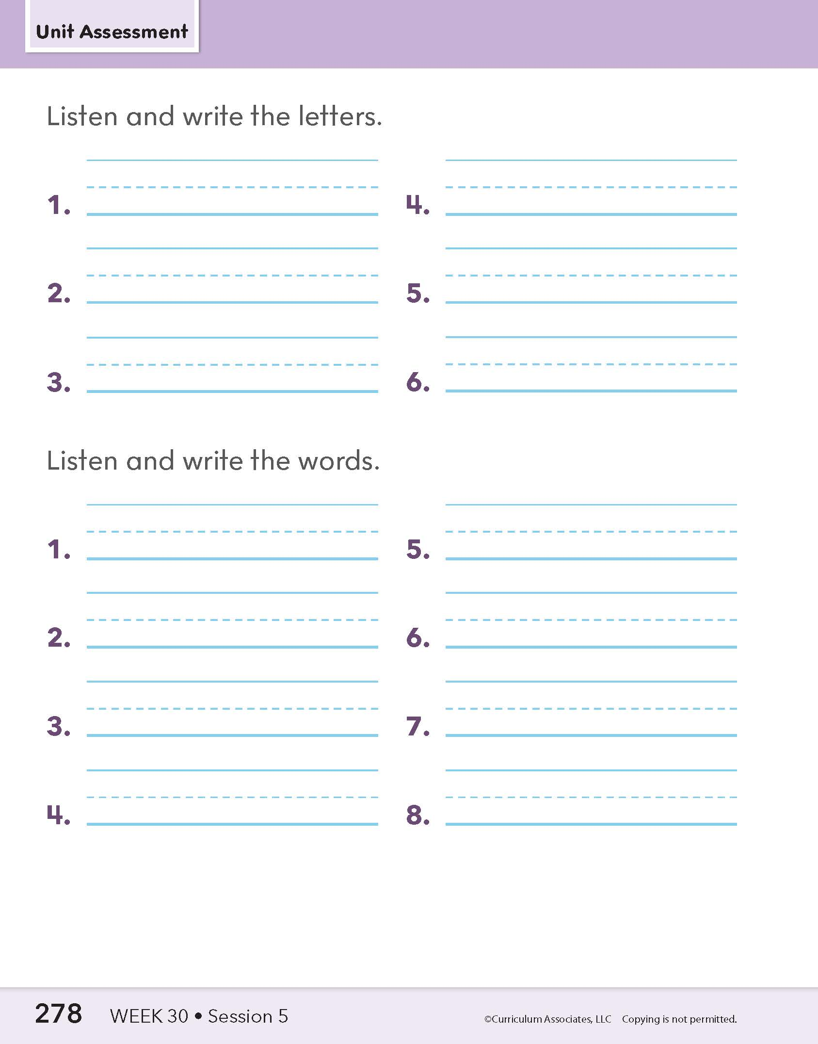
Whole-Class Assessment
5: Assessment
Notes:
Whole-Class Assessment
Tell children they are going to practice some of the sounds and words they learned throughout the unit.
PART 1: Encode Target Sound-Spellings
Say each sound. Have children write the letters that stand for the sound. *Words for teacher reference only.
1. /ou/ (how)*
2. /ôr/ (more)*
3. /o͞o/ (blue)*
4. /ô/ (paw)*
5. /oi/ (boy)*
6. /o͝o/ (look)*
PART 2: Encode Target Words
Read each word. *Provide a context sentence when necessary. Have children write the word.
1. salted
2. recall
3. bedroom
4. point
5. horn
6. drawn
7. house
8. sidewalk
*See the “Context Sentences for Dictation” document under Program Implementation: Assessment Resources in Teacher Toolbox.

Slide 3
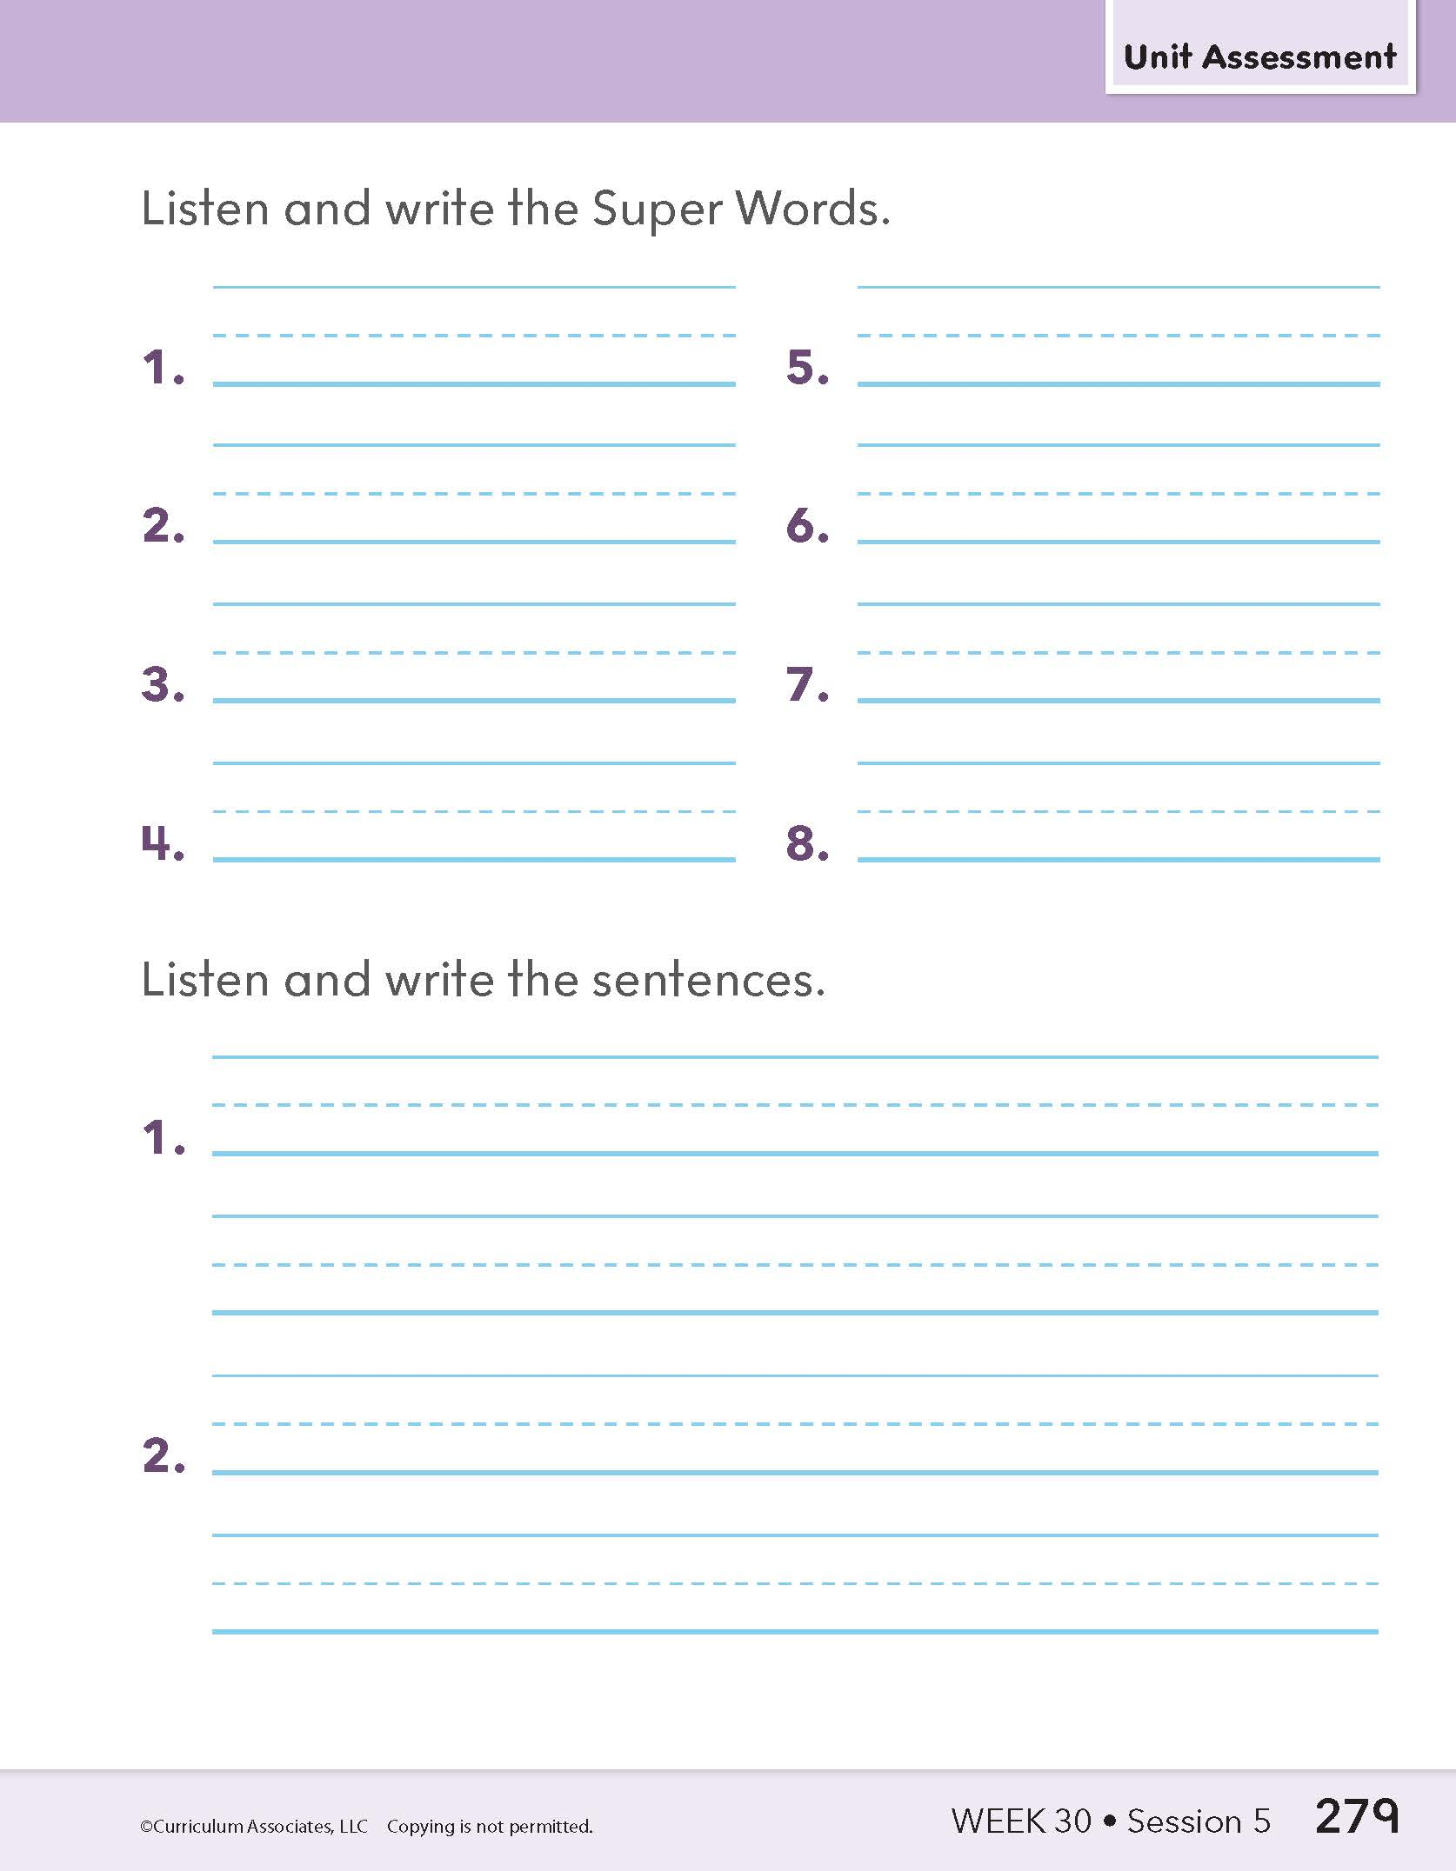
Whole-Class Assessment
5: Assessment
Notes:
PART 3: Spell High-Frequency Words
Read each word. *Provide a context sentence when necessary. Have children write the word.
1. air
2. learn
3. move
4. together
5. full
6. school
7. always
8. pull
*See the “Context Sentences for Dictation” document under Program Implementation: Assessment Resources in Teacher Toolbox.
PART 4: Write Connected Text
Read each sentence. Have children write the sentences. Remind them to use correct spelling and punctuation.
1. The small fawn moves quietly.
2. I walked to school quickly.

Slide 4
Individual Assessment
At dawn Saul looked up in the air. He saw a hawk land smoothly on a wall. The hawk was stalking a small bird.
5: Assessment
Notes:
PART 5: Read Connected Text
Have each child read one passage. Listen carefully for children to read with overall fluency. Choose a different passage for each child if working in pairs.
Passage 1 continues on the next slide.
Passage 1
At dawn Saul looked up in the air. He saw a hawk land smoothly on a wall. The hawk was stalking a small bird. The small bird quickly flew away. Saul looked up in the air again. He saw the little bird in a tall tree. The hawk paused and then flew off.

Slide 5
Individual Assessment
The small bird quickly flew away. Saul looked up in the air again. He saw the little bird in a tall tree. The hawk paused and then flew off.
5: Assessment
Notes:
PART 5: Read Connected Text
Have each child read one passage. Listen carefully for children to read with overall fluency. Choose a different passage for each child if working in pairs.
Passage 1 Continued
At dawn Saul looked up in the air. He saw a hawk land smoothly on a wall. The hawk was stalking a small bird. The small bird quickly flew away. Saul looked up in the air again. He saw the little bird in a tall tree. The hawk paused and then flew off.

Slide 6
Individual Assessment
Paul and Walt play ball together. Paul lightly hits the ball into the air. The ball quickly falls to the sidewalk. It slowly halts near a small grate.
5: Assessment
Notes:
PART 5: Read Connected Text
Have each child read one passage. Listen carefully for children to read with overall fluency. Choose a different passage for each child if working in pairs.
Passage 2 continues on the next slide.
Passage 2
Paul and Walt play ball together. Paul lightly hits the ball into the air. The ball quickly falls to the sidewalk. It slowly halts near a small grate. Then it falls in. Paul and Walt see the ball. But they are not able to pull it out. Finally, the boys just relax on the lawn.

Slide 7
Individual Assessment
Then it falls in. Paul and Walt see the ball. But they are not able to pull it out. Finally, the boys just relax on the lawn.
5: Assessment
Notes:
PART 5: Read Connected Text
Have each child read one passage. Listen carefully for children to read with overall fluency. Choose a different passage for each child if working in pairs.
Passage 2 Continued
Paul and Walt play ball together. Paul lightly hits the ball into the air. The ball quickly falls to the sidewalk. It slowly halts near a small grate. Then it falls in. Paul and Walt see the ball. But they are not able to pull it out. Finally, the boys just relax on the lawn.

