Slide 1
over 10 million students nationally
Notes:
Future note: send agenda

Slide 2
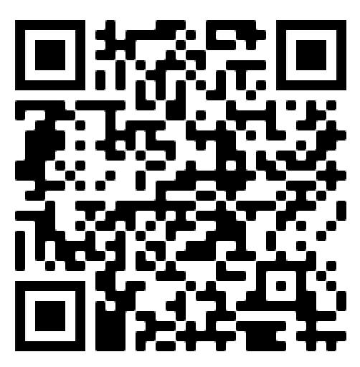
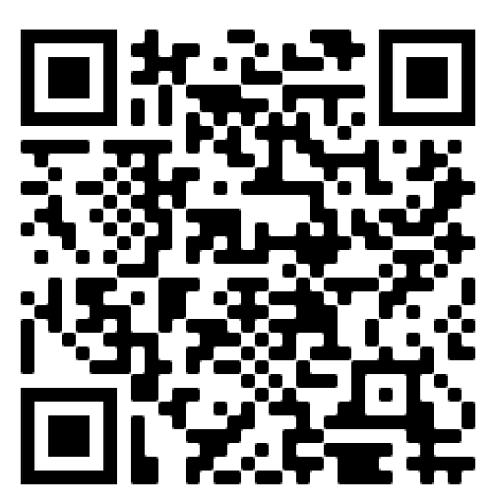
2.3 Provide a full list of language supports for emergent bilingual students and multilingual learners included in the instructional materials and assessments, by grade-level, such as translated, transadapted, and/or authentic texts.
Emergent Bilinguals:
English Learners
Emergent Bilinguals:
Spanish Dual Language

Slide 3
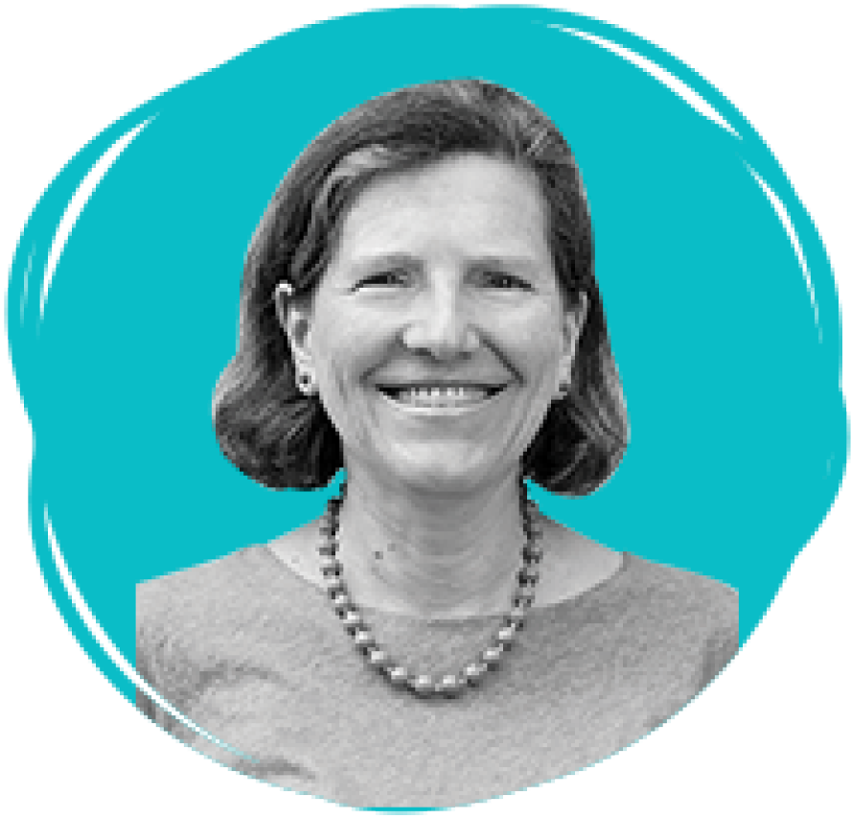
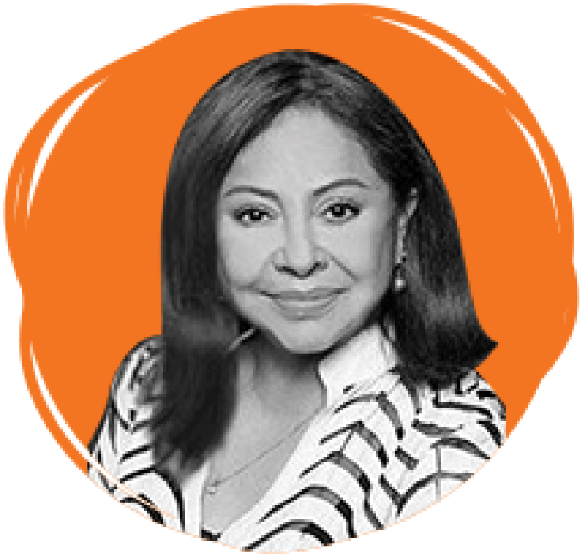
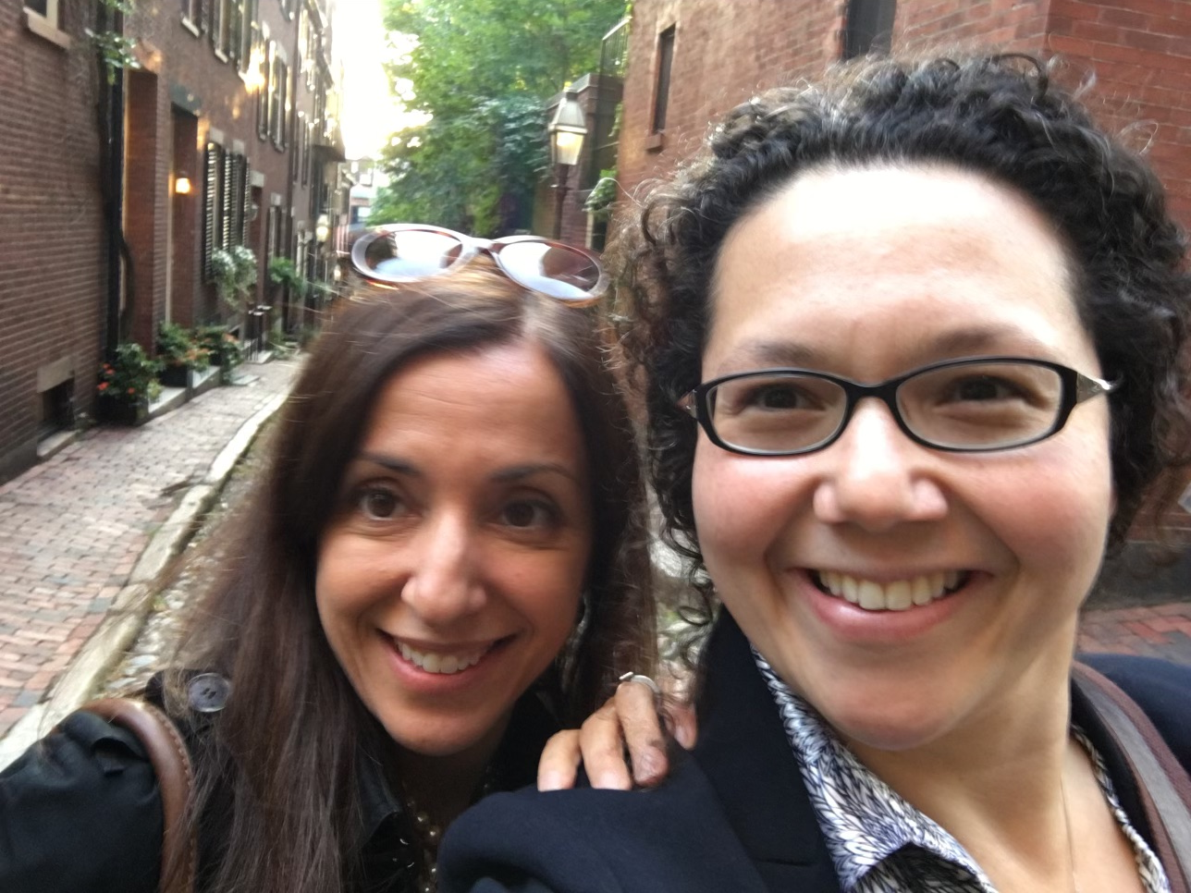
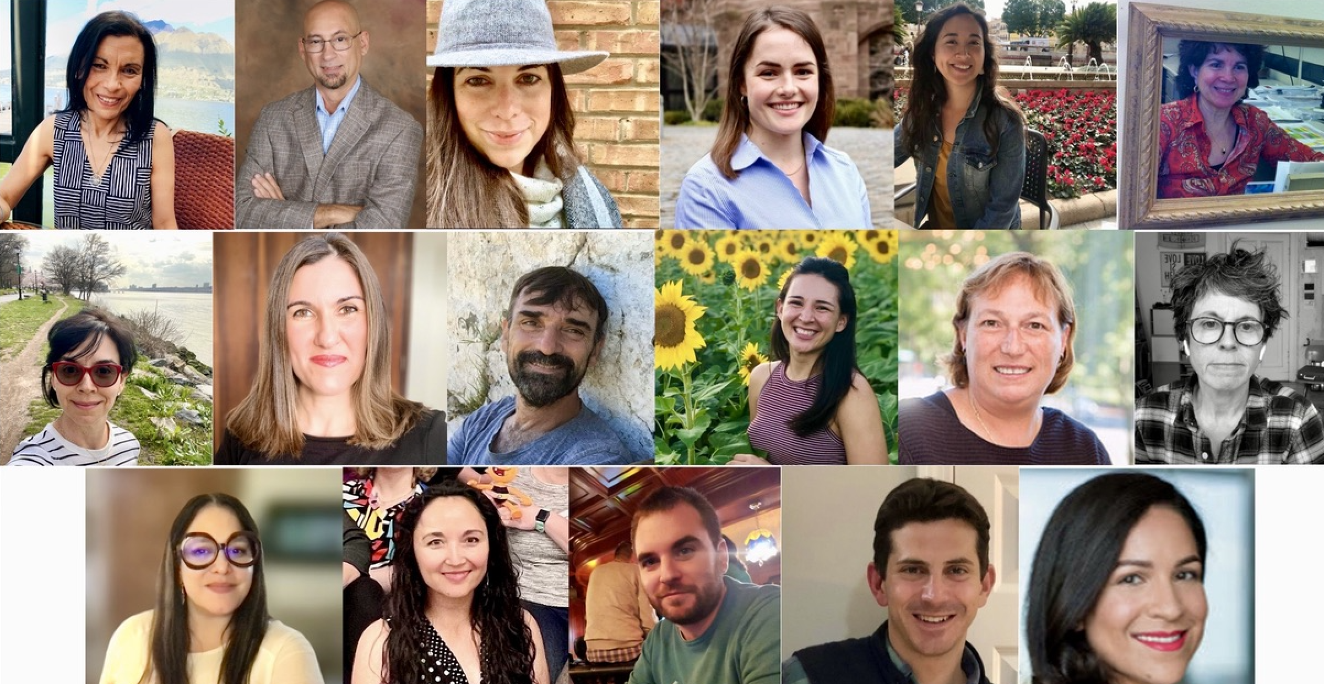
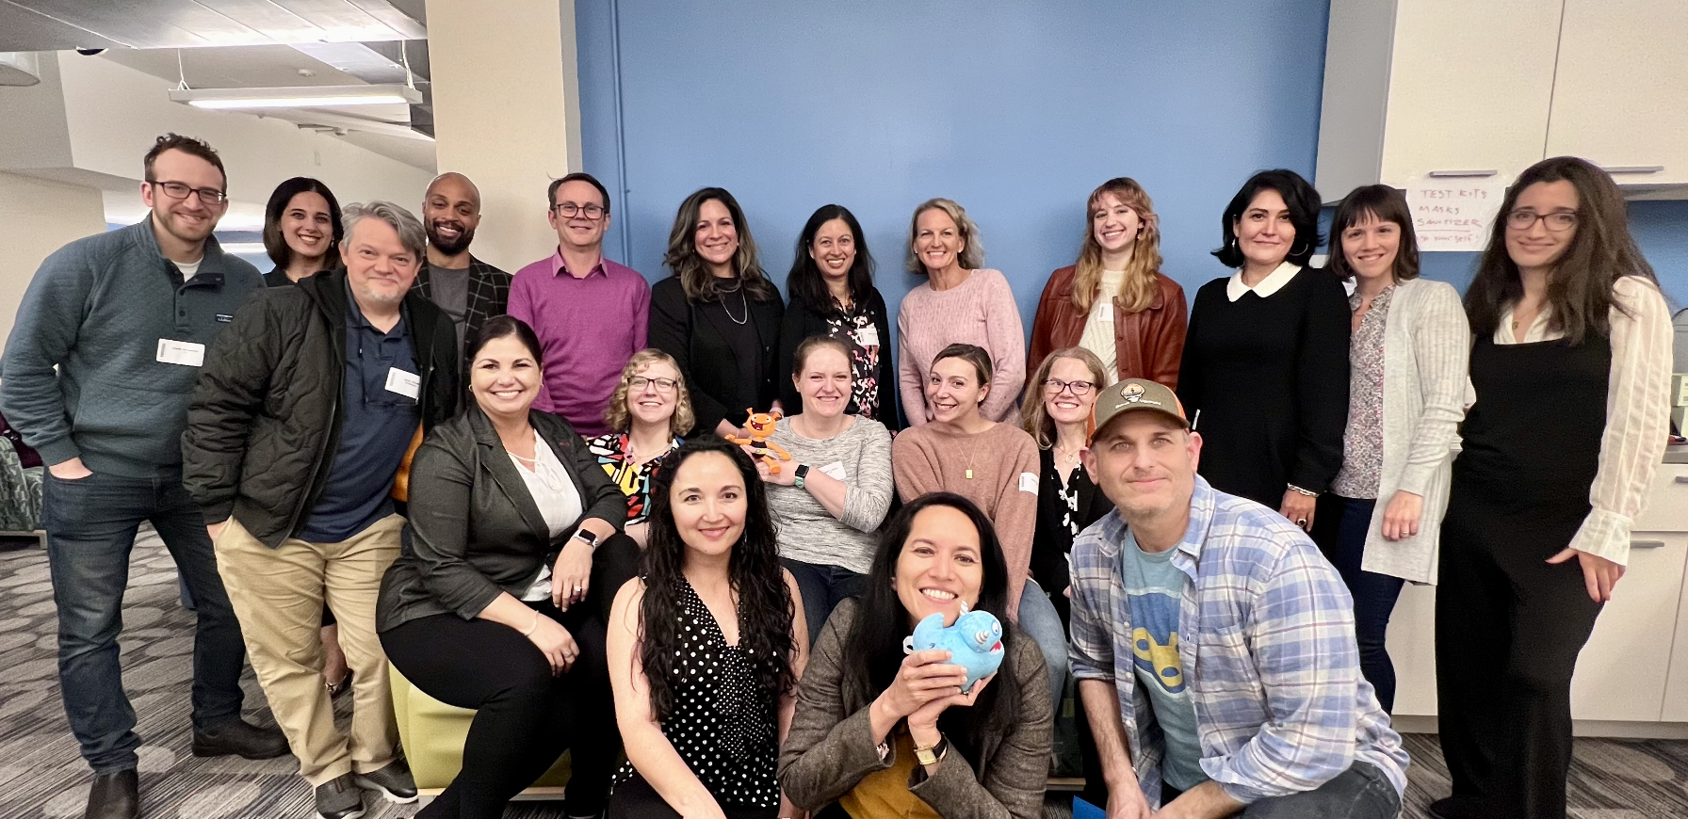
Expertise in Spanish Literacy & Assessment
Developed by Spanish Speakers
The i-Ready Assessment of Spanish Reading was developed from the ground up by native Spanish speakers who specialize in the assessment of key reading concepts in elementary and middle school state standards in Spanish.
Dr. Doris Baker, Associate Professor
Associate professor in the Department of Special Education and the Department of Curriculum and Instruction.
Dr. Elena Izquierdo, Professor
Faculty in Literacy/ Biliteracy/Dual Language/ELL Education at the UTEP and is the principal investigator of Project LEAD.
Notes:
We are very proud of our inhouse editorial team that is comprised of a diverse Spanish speaking pool. Along wth experts like Dr. Bake and Dr qizquierdo we have work to create authentic reading assessments and instructions. CLICK

Slide 4
Expertise in Spanish Literacy & Assessment
Commissioned Text
Voiceover Talent: A sonic way to increase diversity, authenticity, and representation in content, media, and products beyond visuals. ​
Authentic Spanish-speaking talent for all Spanish content that reflects the diversity of the Spanish-speaking world.
Notes:
In addition to out in house team we have taken care an attention to the voice over talent. Making sure that they are native speakers, we jokingly say we want you to sound like univivion, very natural and authentic

Slide 5
Expertise in supporting Emergent Bilinguals
We design all products with Emergent Bilinguals in mind. We leverage research-based best practice guidance and curriculum frameworks – including engagement with organizations such as CGCS and ELSF as well as language and bilingual expert advisors.
As content developers with expertise in language development, our embedded team works alongside ELAR writers and editors from the ground level up.
Our commitment to Emergent Bilinguals in Texas is top of mind.
Notes:
https://www.culturallyresponsive.org/outrageous-love-the-podcast
Just like our commitment to Spanish we are equally committed to supporting multilingual learners. We have work closely with the CGCs duting the LAUSD RFP process and ELSF but what makes us unique is that our experts in ELD sit side by side with the content teams

Slide 6
How do we do this?
Promote engagement and access
Ensure English Learners acquire content knowledge while also acquiring language through culturally responsive grade-level content.
Integrate strategic scaffolds
Provide the right amount of scaffolded support to help English Learners build on their knowledge to achieve independence.
Support academic language development
Offer multiple opportunities for English Learners to acquire and use language that moves toward complexity.
Notes:
See next 2 slides

